Slide 1

FARMER-CENTRED APPROACHES AND INFORMATION FLOW IN AGRARIAN COMMUNITIES
A Social Network Analysis of Approaches Supporting Soil Health Management in Malawi.
By
Frank Tchuwa (April 2023)
Lilongwe University of Agriculture and Natural Resources

Slide 2
Why Social Networks
Social networks as a form of social capital
  Spaces for interactions among farmers, scientists and extension workers
  Collaborate to generate, adapt and scale innovations
  facilitate flow of new knowledge and practices in the agriculture system
FRN PRINCIPLE 3
Networks foster collaboration and opportunities for learning and knowledge sharing

Slide 3
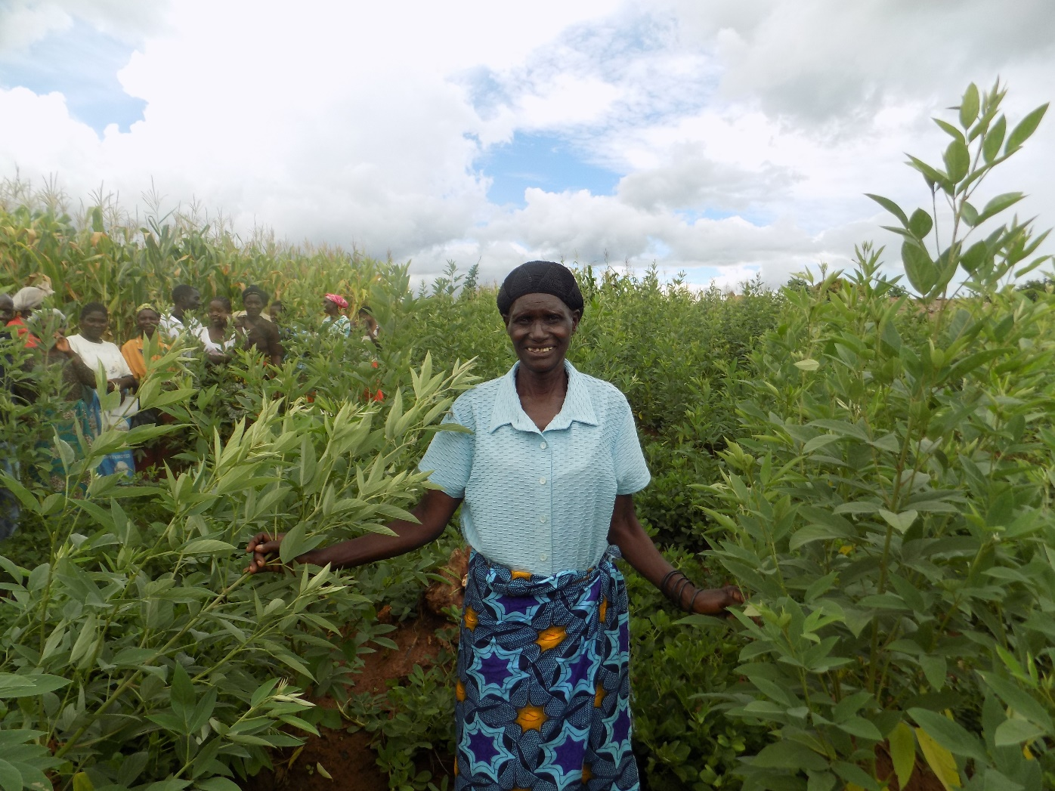
Social Networks in Farmer-Centered Approaches
Evidence suggest that …….
Farmer-centred approaches strengthen social networks
  social ties among members and between groups participating in
    Local Agricultural Research Committees in Latin America
    Farmer Field Schools in West Africa and Kenya
  Lead Farmers contribute to agricultural research
  Farmers recognized as innovation brokers in Honduras
  FFS linked to universities, research, extension in Asia.

Slide 4
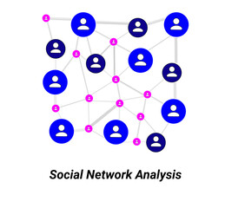
Digging Deep into social networks processes
We know that farmer-centred approaches create social networks, but…..
  Limited understanding of processes occurring in these created networks
Network analysis approach helps
  Investigating phenomena which involve social relations .
Network approach used in adoption studies,
  Common bean technologies in Tanzania (Kansiime et al. 2018),
  Pit planting technology in Malawi (Beaman et al. 2015),
  Improved groundnut varieties in Kenya and Uganda (Thuo et al. 2013)

Slide 5
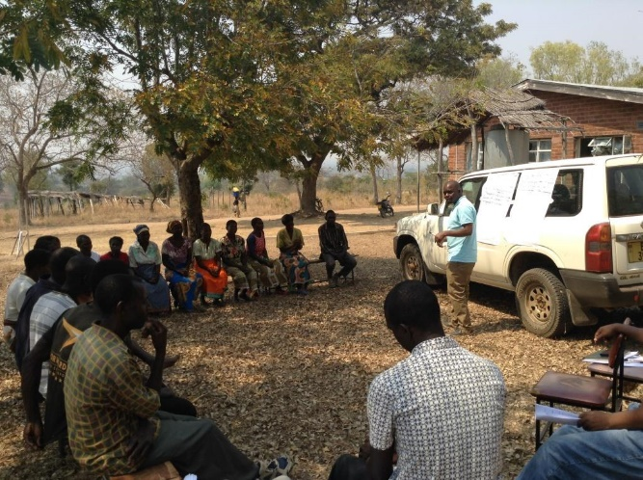
Understanding how farmer-centred approaches facilitate flow of soil health information
A focus on vertical and horizontal social networks.
  Vertical networks (bridging ties)
    involve interactions among actors operating at different levels with unequal power
  Horizontal networks (bonding ties)
    involve interactions among actors operating at same level with equal power
Hypothesis:
  Flow of soil health information from farmer-centred approaches to the broader farming community is affected by processes in social networks

Slide 6
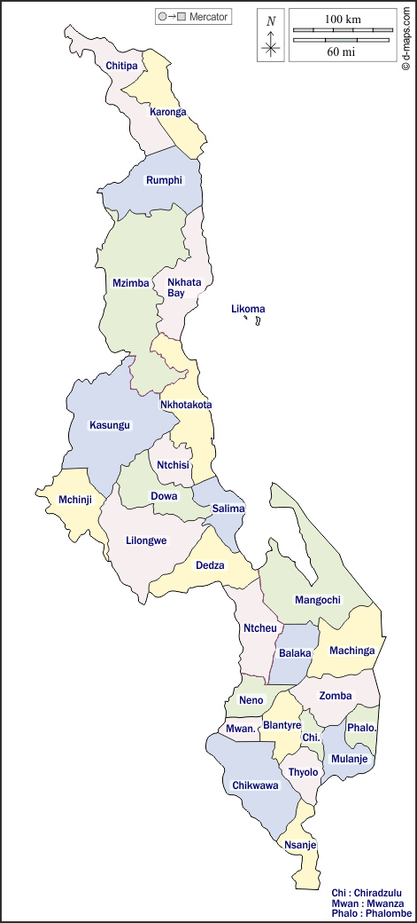
Farmer-centred approaches investigated in the study
Those supporting soil health management in Malawi
  Lead Farmer (LF),
  Farmer Field School,
  Farmer Research Team (FRT), and
  Farmer Research Network (FRN).
Zombwe
Mkanakhoti
Kandeu

Slide 7
Gathering the social network data
1. key informant interviews
  Extension workers, researchers and line managers from public extension, SFHC and LUANAR.
2. Focus group discussions,
  farmers participating in a specific intervention.
What soil health information did you discuss?
How was it shared?

Slide 8
Gathering the social network data
3. Survey
Design informed by egocentric network analysis.
  Different from complete social network analysis
    where all actors are investigated
  Focuses on actors of interest or egos.
    connections and relationships of egos to alters.
      Farmers participating in interventions=egos,
      Non-participants who interacted with the egos =alters.

Slide 9
Gathering the social network data
Sample size of the ego and alter farmers
LF egos (n=54)
FFS egos (n=56)
FRT egos (n=35)
FRN egos (n=52)
Total =197 egos
Alter n=84
Alter n=77
Alter n=54
Alter n=67
Total =282 alter

Slide 10
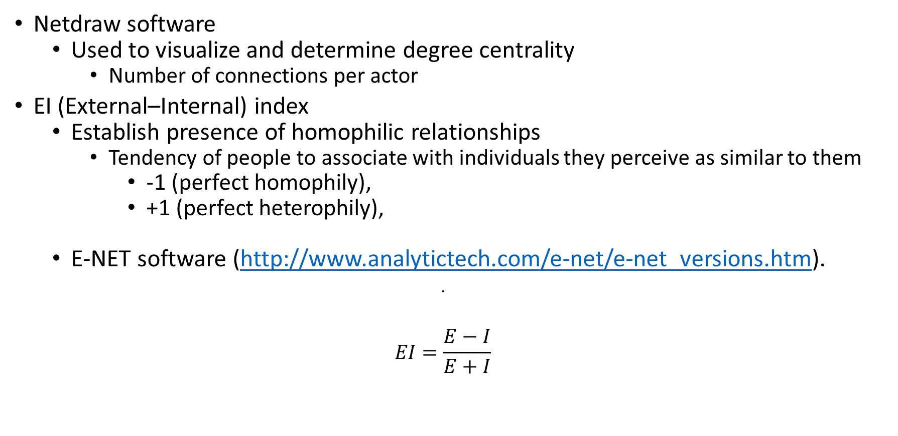
Processing the social network data
Netdraw software
  Used to visualize and determine degree centrality
    Number of connections per actor
EI (External–Internal) index
  Establish presence of homophilic relationships
    Tendency of people to associate with individuals they perceive as similar to them
      -1 (perfect homophily),
      +1 (perfect heterophily),
  E-NET software (http://www.analytictech.com/e-net/e-net_versions.htm).
$EI=\frac{E−I}{E+I}$

Slide 11
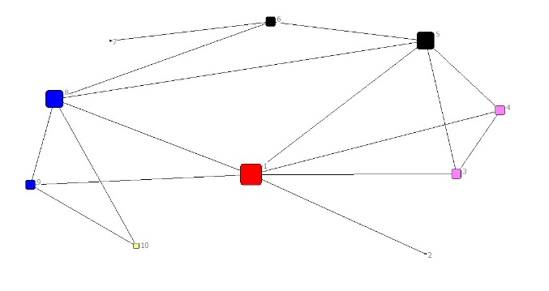
Findings: Vertical networks
Centrality measure in FRN: More interactions among farmers, extension and LUANAR
Actors in the FRN:
1= Farmer Research Group,
2= Group committee, 3=VAC/VDC,
4=Village head,
5= Extension Planning Area, 6=DADO,
7=ADD,
8=LUANAR,
9= University of Greenwich, 10=McKnight CCRP

Slide 12
Findings: Soil health options discussed by actors
Different soil health options discussed in different approaches
Soil health Options | LF | FFS | FRT | FRN
Manure | X | X | X | X
Maize-legume intercropping | X | X | X | X
Maize-single legume rotation | X | X | X | X
Burying crop residues | X | X | X | X
Plant spacing | X | X | X | X
Mineral fertilizer application | X | X | X | X
Improved varieties | X | X | X | X
Ridge realignment | X | X | X | X
Double-up legume | X | - | X | X
Agroforestry | X | X | X | X
Mixing manure and mineral fertilizer | X | - | - | X
Mulching | X | X | - | -
Minimum tillage | X | X | - | -
Pit planting | X | X | - | -
Marker and box ridges | X | X | - | -
Vetiver grass | X | X | - | -

Slide 13
Findings: Soil health options shared in horizontal networks
Egos shared diverse options to alters

Slide 14
Findings: Where egos shared information with alter farmers (%)
Interactions mainly occurred at home, fields and meetings

Slide 15
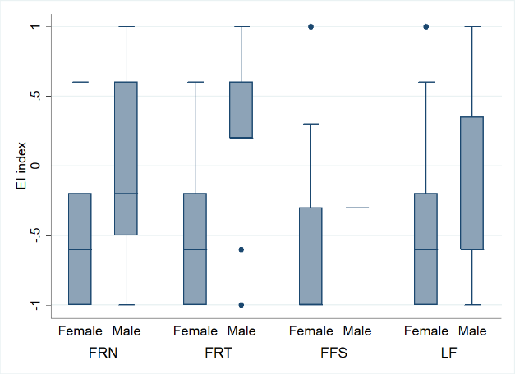
Findings: Which gender did egos share information to?
Homophily tendencies more in females than males
  Cultural issues?
  Patriarchy?

Slide 16
Findings: How far from your village did you share the information?
Homophilic tendencies more in Kandeu
  Marriage system in Southern malawi?
  Uxorilocal system

Slide 17
What do we learn from the social network analysis
Vertical networks enabled ego farmers to access soil health information from external actors.
Horizontal networks mainly occurred in home, fields, and meetings
  facilitated flow of soil health information from ego farmers to broader community.
  However, homophily tendency restricted the flow of information
    Within gender categories (females)
    Within villages

Slide 18
What do findings from social network analysis imply?
Information sharing among diverse actors increased through spaces created in farmer-centred approaches e.g., learning plots
Re-examine assumption that horizontal networks will naturally facilitate diffusion of soil health information in the broader agrarian community
Pay attention to network processes that influence the flow of information to the broader farming community e.g., homophilic tendencies shaped by gender, culture and proximity.

Slide 19
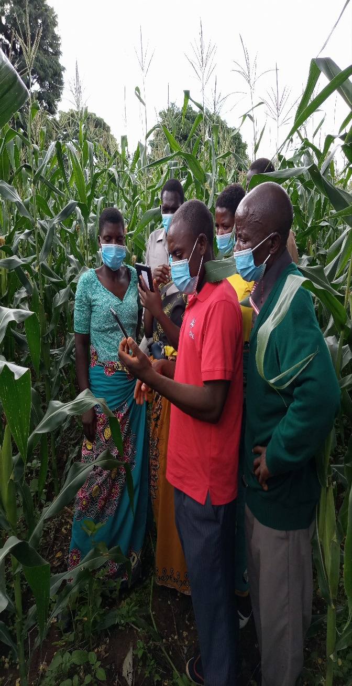
Any remedies for homophilic tendencies?
Facilitating community level workshops
  Networking different villages
Embracing Information and Communication Technologies (ICT)
  (e.g., farmers sharing videos and photos via WhatsApp)
Gender mainstreaming in farmer-centred approaches

Slide 20
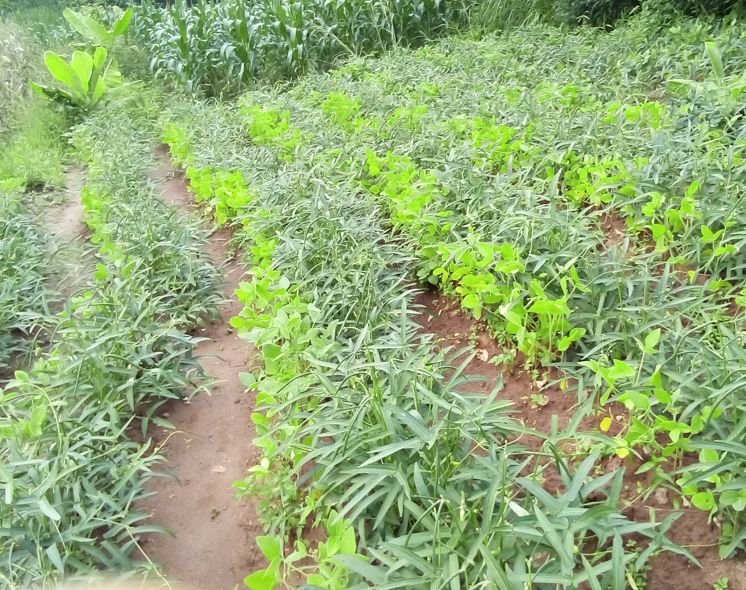

ZIKOMO KWAMBIRI
Thank you

