Slide 1
Thinking in Reverse Order
Baking a Cake
Notes:
This video aims to simplify the concept of “thinking in reverse order” by equating some of the steps in the research process with steps involved in baking a cake.

Slide 2
Steps in Survey Design and Analysis
Study Objectives
Analysis Plan
Questionnaire Design
Data Analysis
Data Collection
Write Report
Data Checking & Cleaning
Notes:
As an example in this video we’ll use a typical research activity – a survey.
Typically researchers would start by defining the objectives of the survey – what are they trying to find out, etc.
The next step is often designing the questionnaire. Of course when designing the questionnaire you need to base it on the study objectives. Questionnaire design can often drag on for some time and questionnaires can become unnecessarily long with interested parties adding extra questions “just in case” or because “that might be interesting”.
Once the questionnaire is finalised the next step is generally the fieldwork for data collection. Of course this can take some time and needs careful planning but for the purpose of this video we won’t go into detail. During and after the fieldwork, the data will need to be thoroughly checked and cleaned to make sure it is of good quality. Again this is a long process and we are not going into detail in this video.
An analysis plan is generally a set of empty tables and graphs that will be populated with results from the analysis. Putting together an analysis plan is usually done either while the fieldwork is taking place or just after and researchers often base their analysis plan on the questionnaire. As already mentioned questionnaires often include questions that are not needed and do not relate to the study objectives, and consequently the analysis plan also becomes too long as researchers feel they need to include tables for the “just in case” questions and the “might be interesting” questions.
Once the data has been cleaned and the analysis plan is finalised the next step would be to run the analysis to produce the results to populate the tables and graphs in the analysis plan. The report is then produced and often involves writing commentary around the completed tables in the analysis plan.

Slide 3


Resulting output
Where do I start?
Notes:
This approach works to some extent but is often not as efficient as it might be. As we said researchers often collect more data than they actually need. Consequently processing the data takes longer than it should as does making sense of the results.

Slide 4
Steps in Baking a Cake
Study Objectives
to make a cake
Questionnaire Design
shopping list
Data Collection
going shopping
Analysis Plan
recipe
Data Analysis
mixing ingredients
Write Report
baking the cake
Notes:
Let’s now move onto baking a cake and the steps involved in that process. This might seem strange but bear with us as we equate these steps to the survey design steps.
Our “Study Objective” is to make a cake – that’s easy enough.
We could think of the questionnaire as being a list of the data we want to collect, so in our analogy the questionnaire becomes the shopping list.
When we do the fieldwork or data collection we are collecting the items on our list so “Data Collection” equates to actually doing the shopping.
There isn’t really a “Checking and cleaning” step, although this could perhaps be checking that the ingredients we have bought are of good quality.
The Analysis Plan could equate to the recipe – this contains details of how we will put the ingredients together.
We then do the data analysis which in our scenario could be mixing the ingredients and once that is done we do the final baking giving us the cake which equates to the report.
We started with the objective of making a cake and finished with a cake; so where’s the problem?

Slide 5
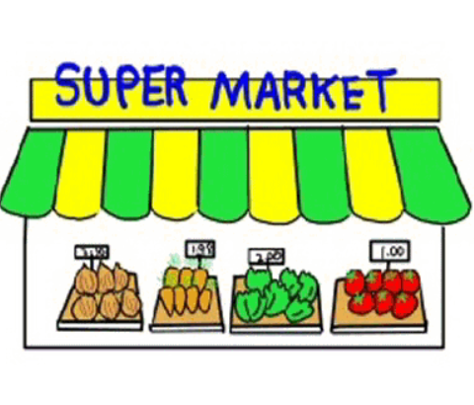


Shopping list
Go shopping
Recipe
Shopping list
Go shopping
Recipe
Notes:
To make this process as efficient as possible we want to make sure we only have one trip to the shops to collect the ingredients we need. But surely that’s why we have a shopping list? But think back to the ordering we had on the previous slide we realise we make the list and go shopping before we get our recipe! This means we might easily forget a vital ingredient – like chocolate!
Some people get round this problem by buying food “just in case” and end up with more than they need which is a waste.
What we propose is to change the order of the steps – and work out the recipe before writing the shopping list. In that way you ensure you buy all the ingredients you need and only the ingredients you need thus reducing waste and saving time and money.

Slide 6
to make a cake
Study Objective
Shopping List
Questionnaire Design
Going shopping
Data Collection
Recipe
Analysis Plan
mixing ingredients
Data Analysis
baking the cake
Write the report
Notes:
Now let’s go from our cake baking steps back to the steps in our survey. We still have making the cake as our Study Objective. Mixing the ingredients and baking the cake equates to analysing the data and writing the report. But to be more efficient we have realised that we need to decide on the recipe before we writing our shopping list. In the same way we should create our analysis plan before we design our questionnaire.

Slide 7
Collect the data you need
Collect ALL the data you need
Collect nothing but the data you need
and don’t forget the chocolate!!
Notes:
This cake baking analogy may seem a bit simplistic but the idea is to get across the message that, before collecting data, you need to know exactly what data you need to collect and you don’t waste time and other resources collecting too much data or even forgetting to collect a vital piece of data (or buy chocolate). If you already have your analysis plan before you go to the field, your shopping list or questionnaire can reflect this.
If you’re ever a witness in a court trial you swear to tell the truth, the whole truth and nothing but the truth. So when running a survey you want to collect the data you need, collect ALL the data you need, and collect nothing but the data you need.
and don’t forget the chocolate.

