Slide 1

Research Methods
Sessions 2023
RMS – April 2023
Global Collaboration for Resilient Food Systems (CRFS)

Slide 2
Statistical Analysis for Agroecology
Sam Dumble (s.dumble@stats4sd.org)
27th April 2023

Slide 3
Overview
We are the “Research Methods Support for Agroecology” project
How and why is this different to “research methods for agriculture”?
We will look at a case study on how to develop an analysis framework for agroecology, and how the principles differ from analysis in traditional agriculture.

Slide 4
Interpreting results
Let’s consider a case study:
The intention was to understand the impact of a program’s activities on a wide and complicated system.
A program helped farmers in 2 different regions convert to organic farming.
Aim was to provide a viable market for organic produce - offsetting any yield reductions through increased prices obtained from organic product sales. They hoped removing chemical fertilisers and pesticides would have positive impacts on both environmental and human health.
Data was collected before, during and after conversion process from some farmers involved in organic conversion program and some farmers not involved in organic conversion program.
Total process took around 5 years.
Notes:
Video as separate part with it’s own mini-intro – blocking this in as a placeholder

Slide 5

Did conversion from conventional to organic farming for cotton have positive outcome on the profits made for farmers involved?
Region 1: p<0.001
Yes! Average profit of farmers enrolled in organic conversion scheme was 10.2% more than that of farmers who did not enroll
Region 2: p<0.001
Yes! Average profit of farmers enrolled in organic conversion scheme was 7.7% more than that of farmers who did not enroll
Project donor
This Photo by Unknown Author is licensed under CC BY-NC

Slide 6

Did conversion from conventional to organic farming for cotton have positive outcome on the profits made for farmers involved?
OK, but why?
Region 1
There was a strong market for the organic crop – the increased sale price was much larger than the reduction in yield.
About half of the farmers still used chemicals anyway… while selling their crop for the organic premium prices!
The other half of farmers saw large increases in the amount of labour needed to farm, but hiring labour was difficult and expensive. Total expenditure on labour decreased, whilst household members were working much longer hours in fields.
  There was lower school attendance for children aged 14-16, as a result of these children being required to do more work on the farms.
Region 2
There was no premium price obtained for organic produce at point of sale.
Many organic farmers reduced cotton production.
  Some moved to other work (construction)
  Others increased the diversity of crops grown.
There was widespread flooding in the final year; 25% of farmers had total crop loss of cotton. Everyone else suffered from lower than average yields.
  The farmers who had diversified crops were less impacted financially.
  Those who were working in construction were also largely economically unaffected by flooding.
This Photo by Unknown Author is licensed under CC BY-NC-ND
Notes:
Multiple methods of data collection through different surveys; monitoring data; focus groups of farmers; key informant interviews with farmers, program officers and other stakeholders in the supply chain

Slide 7
Headlines are not the real story
The story is much more interesting than the headlines!
Some of the story was considered in the original design and analysis:
Surveys captured multiple income sources; it was expected that farmers may take different strategies to counter lower yields
Region 2 was intentionally chosen as part of the study because of its susceptibility to flooding
Other aspects were unexpected, and led to changes to the research design to better study and understand them:
The unexpected impacts of covid on the labour market led to additional market-level research being undertaken to better understand this
The reports that farmers using chemicals could still sell their product for ‘organic’ prices led to further research with the organisations who buy the crops, and specific interviews with farmers about this topic
Adapting from the original protocol and breaking everything down into components for analysis meant we could better understand the results.
Notes:
Stop here

Slide 8
A classic example of ‘statistics for agriculture’
I want to know about fertilizer effectiveness in relation to sugarbeet yields.
I am not sure what combinations of N, P and K are going to maximise my yields.
So, I go to my research station and make a trial according to some principles I know are important:
  Replicated across blocks (n=3)
  Randomised treatments to each plot
  A ‘control’ treatment with no N, P or K
  Controlling potential sources of variability or confounding by applying uniform management across all plots
Block 1 |  | Block 2 |  | Block 3
None |  | NPK |  | NK
P |  | K |  | PK
NP |  | NK |  | P
K |  | P |  | K
NPK |  | None |  | NK
PK |  | PK |  | NK
NK |  | NP |  | None
Data: George Snedecor (1946). Statistical Methods, 4th ed. Table 12.13, p. 332
Notes:
Record from here to slide 5
Let’s start at the beginning - with the sort of example of classic statistics that you might have come across in undergraduate ‘statistics for agriculture classics’

Slide 9
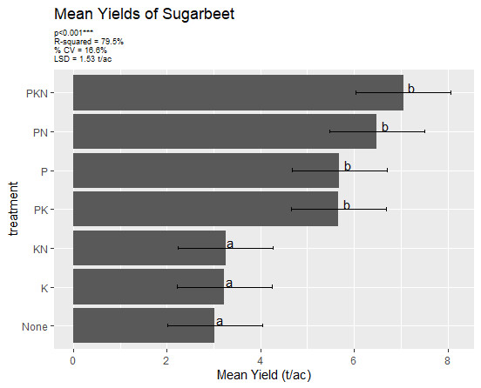
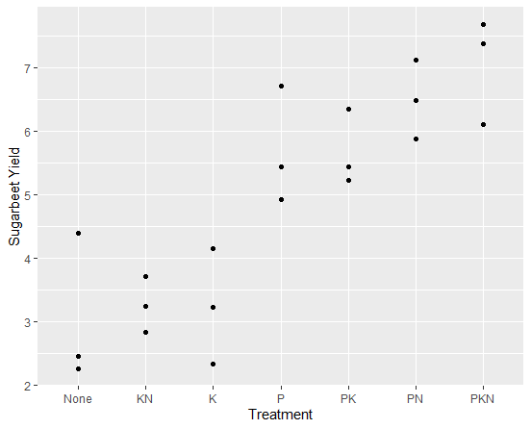
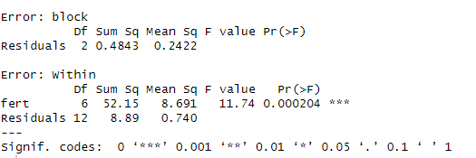
Statistics for Agriculture
Data: George Snedecor (1946). Statistical Methods, 4th ed. Table 12.13, p. 332
Notes:
After measuring the yield I make a plot of my results – and it looks pretty convincing!
What I need is P – the N and K don’t seem to add much
I can do an analysis of variance which accounts for any possible block effect and I see a p<0.001 so I can happily conclude there are differences in the mean performance of my treatments
I might start doing mean separation analysis and calculating LSDs and this will indeed confirm that what I need is P – treatments with P are significantly better than treatments with no P

Slide 10
Statistics for Agroecology?
Let’s try the same approach again on a different problem:
I want to know about production for farmers when they plant soy and pigeon peas as sole crops or as intercrops with each other. I want to test this in real-world on-farm conditions
I recruit 3 farmers to take part in these trials and randomize treatments to 3 plots within their farms
So, I make a trial according to some principles I know are important:
  Replicated across farmers (n=3)
  Randomised treatments to each plot
  Important to test in real world conditions, so I allow farmers to manage plots but provide recommendations on plot management.
Farm 1 |  | Farm 2 |  | Farm 3
Soy |  | Soy + PP |  | PP
Soy + PP |  | PP |  | Soy
PP |  | Soy |  | Soy + PP
Notes:
Record from here to slide 9

Slide 11
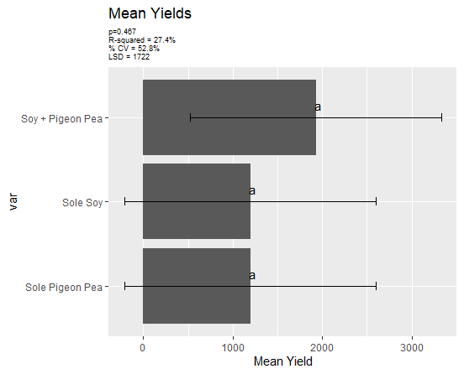
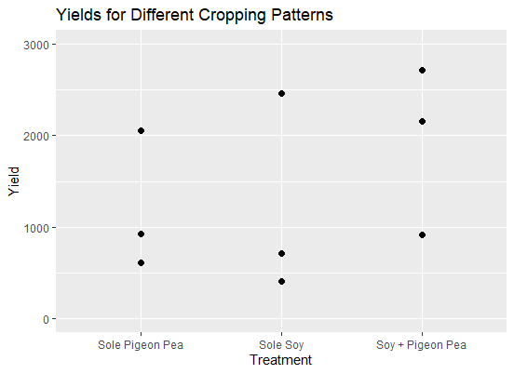
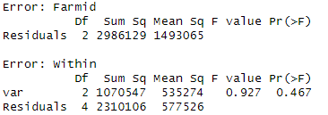
Statistics for Agroecology ?
Notes:
Oh
There seems to be be quite a big range of yields
And no significant differences
And the confidence intervals range from -100 to + 2500 which seems a bit of a range really

Slide 12
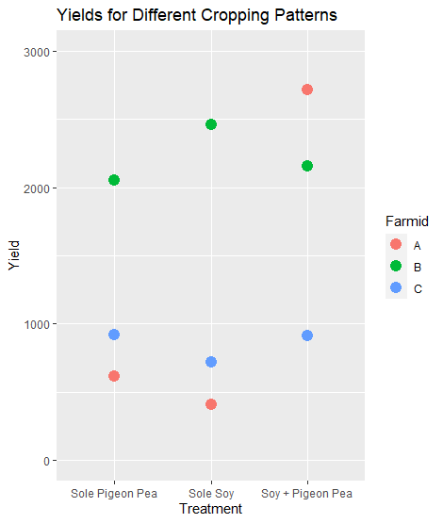
Farmers are not replicates!
Farmer B consistently achieved double the yields of Farmer C!
Some things could have been controlled for – enforcing same management practices rather than recommending them… but then this is not the real world any more!
There will be many other agronomic, environmental, ecological, socio-economic, demographic factors different between the farmers.
We wanted to test in real-world conditions – so we should expect real world variation.
Notes:
There is something jumping out straight away – the farmers are very different from each other

Slide 13
Sample sizes in research for agroecology
Variability is a reality when dealing with research in agroecology.
‘Classic’ agricultural statistical analysis is based on assessing the biological response:
Control for [everything else] to understand if x does y
N=3 might be enough to deal with this
‘Agroecological’ statistical analysis needs to be based on understanding real-world systems and the impact of changes on these systems.
Understand the relationship that x has on y and how
[everything else] relates to this
N=3 is not enough for this!
Generally, in classic agriculture, our only end goal is maximizing yield – a biological outcome. Our goals in agroecology will include the biological (i.e. yield), but will also be social, environmental, ecological…

Slide 14
End of part 1
Any questions so far?

Slide 15
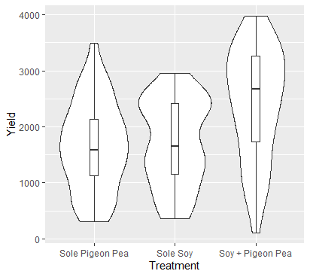
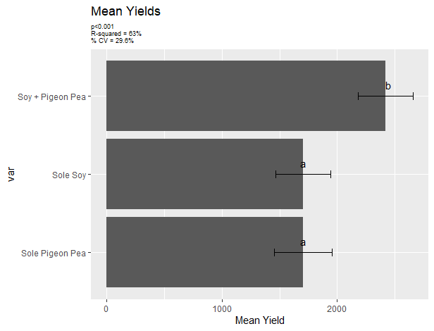
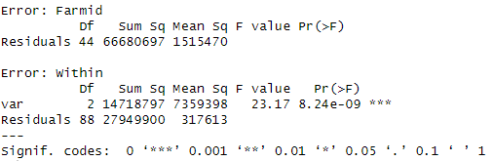
Actually, there were a lot more farmers in the trial…
On average, that intercrop treatment does look pretty good when we bring in all the other farmers!
The analysis of the data could include an identical set of statistical procedures to that fitted with just 3 farmers:
Kareem Longwe and Wezi Mhango, Best Bets project-Malawi,. Mc Knight CCRP
Notes:
Record from here up to slide 13
The methodology behind analysis of variance does not depend on having a perfectly designed trial – it can quite happily deal with unequal sample sizes of treatments or missing values or lack replications on a farm

Slide 16
The averages don’t really tell us the interesting story
Let’s look more closely at just those 3 farmers we saw before:
Farmer B has consistent high yields
Farmer C has consistent low yields
Farmer A has a very high yield for the intercrop treatment and low yield for the sole treatments.
Kareem Longwe and Wezi Mhango, Best Bets project-Malawi,. Mc Knight CCRP
Notes:
We can say from the wider analysis that the intercrop treatment is better ‘on average’. But we can see from our three farmers that the intercropping was only really effecitve for one of them. That analysis of variance is still treating farmers as replicates – considering them as an annoying source of noise rather than as something interesting to be investigated further.
What would be more interesting would be to understand what factors are associated with farmers like Farmer B (higher yields), farmers like Farmer C (lower yields). Although this may be something we know fairly well already.
But what we might be extremely useful is to understand better farmers like Farmer A where the potential impact of adopting intercrop could be very large. If there are manyfarmers with results like this, and we can find commanalities between them then we could provide some extremely well targeted recommendations, with strong evidence behind them

Slide 17
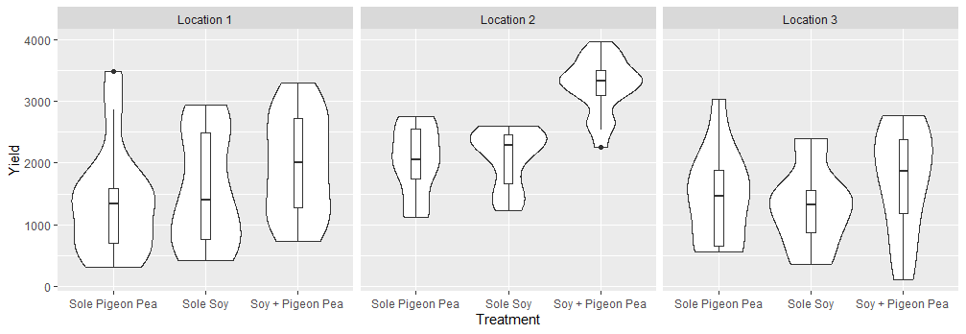
So let’s look at it a bit more…
What factors might be associated with why some farmers have a better performance from an intercropping treatment?
Maybe let’s consider where they came from first and look at results by location:
Location 2 really stands out! A big “GxE” interaction.
We do see a little evidence of improved performance for intercrop in all locations.
Kareem Longwe and Wezi Mhango, Best Bets project-Malawi,. Mc Knight CCRP
Notes:
But is that generalizable to just say location 2 is good for intercropping and locations 1 and 3 are not? What is it about location 2 that makes the intercropping a better option:
Soil quality?
Environmental conditions?
Land management practices – timing of planting/frequency of weeding?
Social factors?
If we collect data on these things we can start to investigate and explore to see which factors vary by location. The factors we consider need to be led by our own knowledge – it’s likely you as the researchers have a much better context of which factors are likely to vary and be worth collecting data on. This also feeds into location choice for research – to make sure we cover different locations which have different conditions.

Slide 18
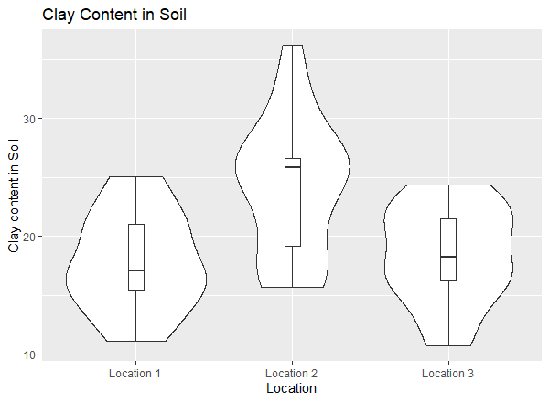
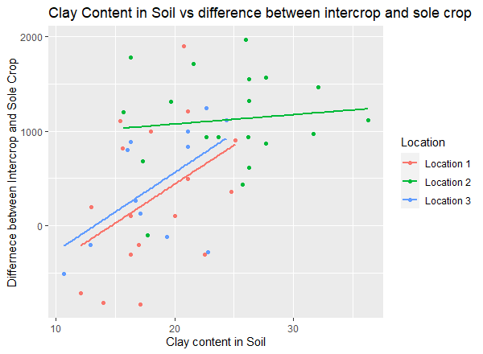
So let’s look at it a bit more…
Location 2 has much higher clay content than locations 1 and 3:
In locations 1 and 3 we can see that increase in clay -> increase in effectiveness of the intercropping… but not in location 2.
Kareem Longwe and Wezi Mhango, Best Bets project-Malawi,. Mc Knight CCRP
Notes:
In this instance one of the key factors related to the soil. And from exploring the data one soil component really stands out.
But what else may be different and how does this all link together? And how can we start to think about this more sustematically

Slide 19
We can make a theoretical framework
Household composition & demographics
Soil characteristics
Wealthier households may have access to better quality land
Female farmers may have
less time available for labour
Intercropping may be better suited to certain soil properties
Better management practices may improve soil health
Land management
Higher yields from Intercropping
Regular weeding and timely planting may provide better conditions
Notes:
Record this to 19 in 1 go.

Slide 20
Agroecology will have multiple inter-related outcomes
Household composition & demographics
Soil characteristics
Soil characteristics
Food Security
Wealthier households may have access to better quality land
Intercropping may
improve soil health
Female headed households may have less time available for labour
Increased food available for consumption
Better management practices may improve soil health
Intercropping may be better suited to certain soil properties
Increased food stores
Land management
Higher yields from Intercropping
Nutrition
Regular weeding and timely planting may provide better conditions
More nutritionally diverse crops used in cooking

Slide 21
Variables that can be measured and tested
Socio economic Status
Organic Matter
# of food gap months
Clay content
Gender of farmer
Soil quality assessment
Adoption of intercrop
Dietary diversity index
Fertiliser application
Intercrop Yield
Time of Planting
Notes:
Stop here

Slide 22
Analysis?
There are sophisticated techniques for how to build a single model with the multiple pathways (e.g. SEM – structural equation modelling)
Multiple more straightforward models are likely to be easier to construct and interpret than one big model
Trying to fit a single model creates challenges
  Pathways between variables operate at multiple levels.
  Things may change over time, and over different timeframes.
  Data may have been collected from different research activities that cannot be easily combined. Or we may only have been able to conduct resource intensive activities with a subset of farmers.
  Some key relationships may be better assessed through more qualitative methods
Notes:
We could look at more sophisticated techniques for how to build a single model with the multiple pathways (e.g. SEM – structural equation modelling)
But multiple models, that are coherently formed and well understood, are likely to be easier to construct and interpret than one big model
There are some big limitations with the bigger model (although none necessarily fatal)
Pathways between variables operate at multiple levels.
seasonal rainfall -> variable from village to village
management practices -> variable from farm to farm
soil composition -> variable from plot to plot
Data may have been collected from different research activities that cannot be easily combined. Or we may only have been able to conduct resource intensive activities with a subset of farmers
They assume all important knowledge can be quantified. Some key relationships may be better assessed through more qualitative methods

Slide 23
We could use our influence diagram as an analysis plan
Socio economic Status
Soil carbon
# of food gap months
Clay content
Gender of farmer
Soil quality assessment
Adoption of intercrop
Dietary diversity index
Fertiliser application
Intercrop Yield
Time of Planting
Notes:
Stop here

Slide 24
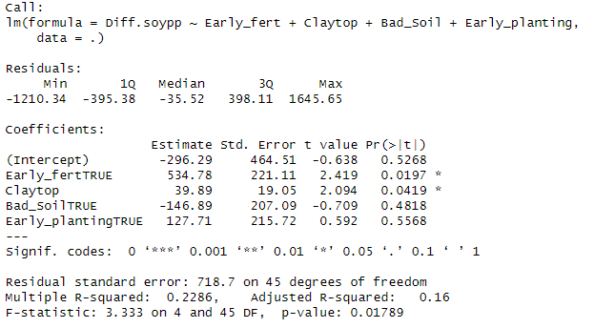
Factors affecting change in yield for intercrop treatment vs sole crop
In this dataset, clay soils and early application of fertilizer looked to be linked to the performance of the intercrop treatment vs the sole crop.
There were no significant relationships with the soil quality assessment, or the planting time.
Kareem Longwe and Wezi Mhango, Best Bets project-Malawi,. Mc Knight CCRP
Notes:
We might fit regression models with our outcome of interest. It maybe that some factors are ‘statistically significant’ and others are not. We can look at inference using relatively standard regression methods providing data is all from the same level and is all in some way quantifiable – but we would make a very conscious choice over which variables we do and do not include as they relate to particular outcome variables
The influence diagram is a ‘living’ diagram – it may be that during fieldwork we noticed something we had overlooked, so we can always go back and add that in.
Or change the diagram if we see that our hypothesis of a relationship was not met.

Slide 25
And then looking at a different component
Socio economic Status
Soil Carbon
# of food gap months
Clay content
Gender of farmer
Soil quality assessment
Adoption of intercrop
Dietary diversity index
Fertiliser application
Intercrop Yield
Time of Planting
Notes:
Stop here

Slide 26
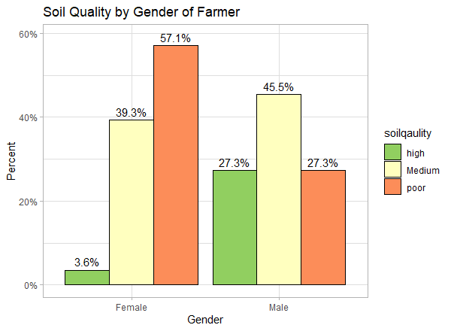
Factors affecting soil quality assessment
Analysis showed education, weeding and planting did not have a clear relationship on soil quality. But gender did.
It is very unlikely the sole reason why soil quality is bad is because the farmer is a woman! There will be other factors related to this that we need to understand.
A more qualitative approach would be helpful to understand what these factors are.
Kareem Longwe and Wezi Mhango, Best Bets project-Malawi,. Mc Knight CCRP
Notes:
4% of female farmers had “high” quality soil vs 27% of male farmers.
57% of female farmers had ‘poor’ quality soil vs 27% of male farmers

Slide 27
Summary
Within the classic agriculture analysis we can only really see the headlines
Taking an agroecological approach we should focus on the story, by trying to understand the whole system and how the different components link together
The ‘statistical methods’ may only end up being very slightly different – but we need to think about how we apply them.
We need careful thought and planning at every stage. Insightful analysis and interpretations can only really come from iterative and collaborative process.
Notes:
Read this on its own

Slide 28

Stats4SD
From the series:
CCRP Research Methods Sessions 2023
Created and presented by Sam Dumble (s.dumble@stats4sd.org)
Global Collaboration for Resilient Food Systems (CRFS)
April 2023
Find more guides and materials at stats4sd.org/resources
© 2023 Statistics for Sustainable Development Creative Commons Attribution-ShareAlike 4.0 International

