Slide 1
Support material and examples

Slide 2
Identify your resources:
You have a lot of experience and know the panorama of agroecology and the 10 elements of the FAO!
What synergies do you see among projects and their expertise with agroecological principles?
What are your local resources? ecological, social (youth, women, families, your core values ...), economic, governance...
What kind of co-learning is needed? Think of local trainings, RMS courses, Steve Vanek's soil courses, Bob's video information sharing, FRNs etc.
Action Plan
Once you have established the synergies between your experience, your needs, your values, the principles and you have chosen a feasible goal, you have the strength to act! What are the steps?
Focus: Is it doable?
You have to be sure that the work is doable! You can't go all over the places. It's worth prioritizing, focusing the work and choosing concrete and feasible steps. What do we want, how do we accomplish it?

Slide 3
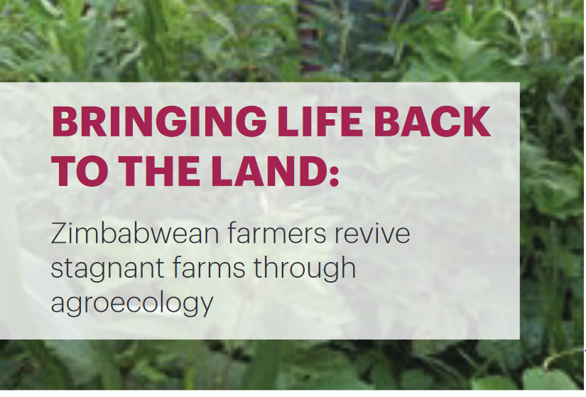
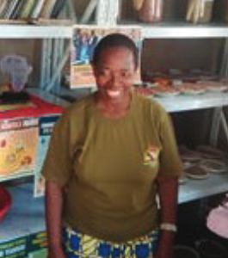
The Shashe farms in the Runde catchment area of Zimbabwe
“A threat as an opportunity”
Farmers protect and nurture their greatest assets: their soil and their water.
Elizabeth Mpofu
Project Founding Chairperson,
Source: https://afsafrica.org/wp-content/uploads/2020/11/zimsoff-2.pdf
Notes:
E

Slide 4
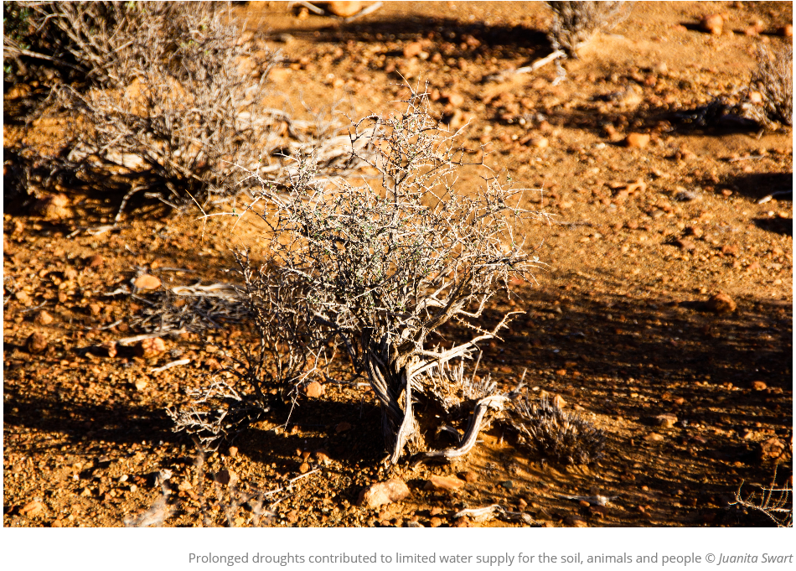
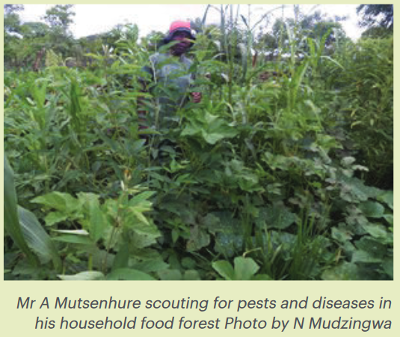
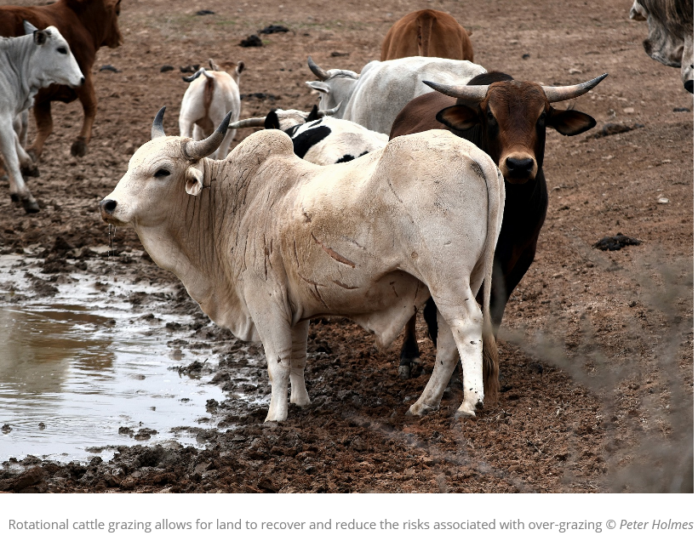
Start
Farmland suffering
Poor livestock management
Soil degradation
Make livestock an asset instead of a burden.
Revive arid cattle-ranching land into rich, abundant food forests.
Climate change
Droughts, little water to feed crops and livestock.
Notes:
E

Slide 5
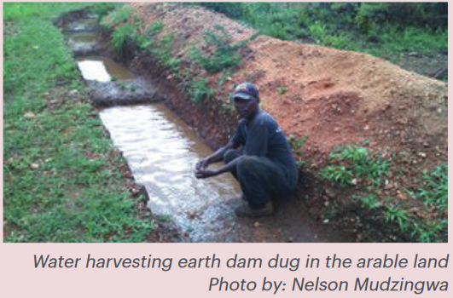
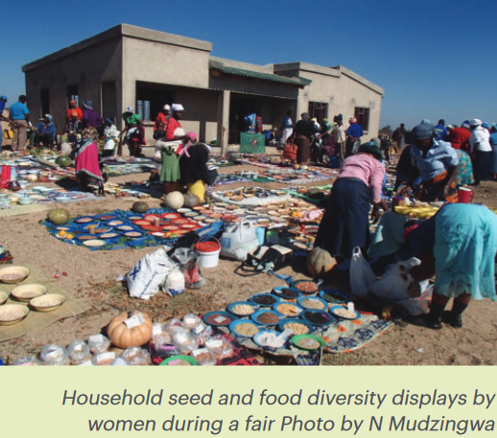
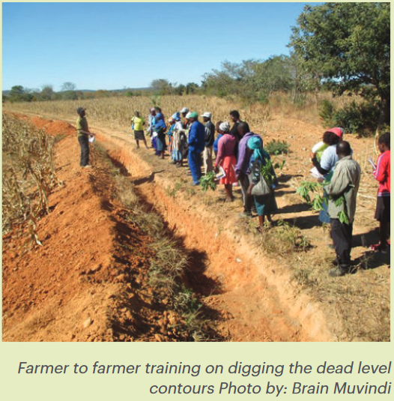

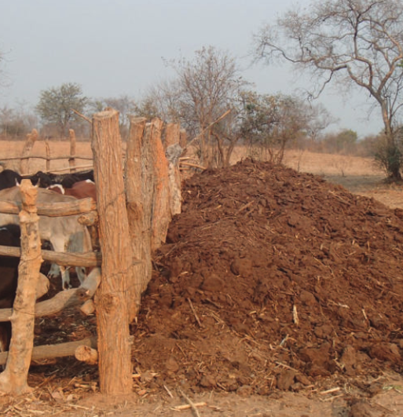

Autonomy and adaptive capacities to manage your agro-ecosystems.
Synergies between different components and activities.
Notes:
E

Slide 6


Managing the soil as a living soul
Recycling and efficiency
Nutrient Cycling
- Manure from livestock cost-effective source of biofertilizer.
- Soil protection and enriching with local organic materials
Notes:
E

Slide 7

Protecting and enriching soil
I am encouraged to practice mulching because it is helping me to achieve better results even during dry periods of the year.” Mr A. Mutsenhure, a local farmer
Notes:
E

Slide 8
What water means to the soil’s life is what blood means to a person’s life.
We don’t allow water to just run through our fields; we keep every drop of water. We harvest rainwater which flows from the road and, as it rains, into the contours that we have built.” Mrs E. Mavedzenge, local farmer
Notes:
E

Slide 9



Agroecology fosters shared decision making
- Women farmers: authority to organize and invest in their family farms.
- Community resilience: improve production for diverse diet and markets
Notes:
E

Slide 10
Conservation is more than just “taking care of nature.”
The relationship between the natural world, the social world, and the spiritual world is of the utmost importance.
Notes:
E

Slide 11




Target principle
Local resources, knowledge, synergies
1
3
2
Planning steps towards target principle
Synergies of principles in action. Transformation
Notes:
E

