Slide 1
Activity
Group work:
Envision an agroecological transition process for your country

Slide 2
Idea
Create a vision of how you can work among projects to create an agroecological transition in your country.
Build your process on synergies among projects and their agroecological knowledge .
You can request the support from the Facilitation Team or the Agroecology Team if you wish.
Notes:
E

Slide 3
Tasks
1
2
    Chose a specific principle that the group would like to strengthen in the country.
    Build a transition process towards the target principles using project synergies.
  Consolidate your work in a 5-minute presentation.
  Examples of formats are provided but the group is free to use their own material.
  Select a presenter. You’ll give your presentation in the second session of the workshop.

Slide 4
Instructions for the group activity
Work groups by country:
3 groups for Burkina, 2 for Mali and 2 for Niger

Slide 5
Task 1. i
Identify one target principle that you would like to strengthen in your country using synergies among projects.
Q: How do you see this principle manifest in your context?
Describe the target principle in your own words based on your experience and context.

Slide 6
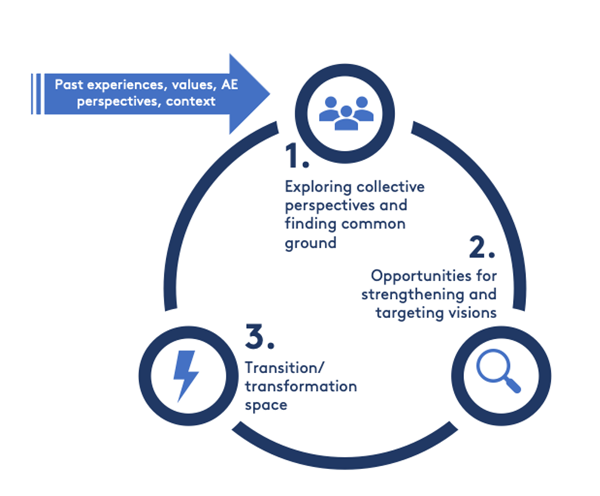
Task 1. ii.
Now, devise a transition process (pathway) that involves the projects of your country to strengthen your target principle and agroecology.
Geographic scale: your country or the areas covered by the projects
Q: Identify what are:
The synergies with other projects
The synergies with other principles that can help the process (you can use the 10 FAO elements)
The concrete steps in the transition process
Core values and resources needed
Concrete ways to monitor and evaluate the process
You can refer to the sample diagrams provided in the support materials or create your own diagram to represent the transition process.
The principles (elements) may appear more than once. Add notes to explain the transition steps.

Slide 7
Task 2.
Create a powerpoint for a 5-minute presentation to be shared in the second session. Use the format provided as a base or another format that works for the group.
Designate a presenter.
Send the presentation to Gabriela (AES team): gbucini@uvm.edu

Slide 8
Support material
More support material in the google drive:
https://drive.google.com/drive/folders/1YveKcU5Ashw7I7eH1zfqhQw-0tq0b31H?usp=sharing
File: « GroupWork_Support_material_and_examples_English.pptx »

Slide 9










The 10 Elements of Agroecology
http://www.fao.org/agroecology/overview/overview10elements/en/
Diversity: diversification is key to agroecological transitions to ensure food security and nutrition while conserving, protecting and enhancing natural resources.
Co-creation and sharing of knowledge: agricultural innovations respond better to local challenges when they are co-created through participatory processes.
Synergies: building synergies enhances key functions across food systems, supporting production and multiple ecosystem services.
Efficiency: innovative agroecological practices produce more using less external resources.
Recycling: more recycling means agricultural production with lower economic and environmental costs.
Resilience: enhanced resilience of people, communities and ecosystems is key to sustainable food and agricultural systems.
Human and social values: protecting and improving rural livelihoods, equity and social well-being is essential for sustainable food and agricultural systems.
Culture and food traditions: by supporting healthy, diversified and culturally appropriate diets, agroecology contributes to food security and nutrition while maintaining the health of ecosystems.
Responsible governance: sustainable food and agriculture requires responsible and effective governance mechanisms at different scales – from local to national to global.
Circular and solidarity economy: circular and solidarity economies that reconnect producers and consumers provide innovative solutions for living within our planetary boundaries while ensuring the social foundation for inclusive and sustainable development.

Slide 10
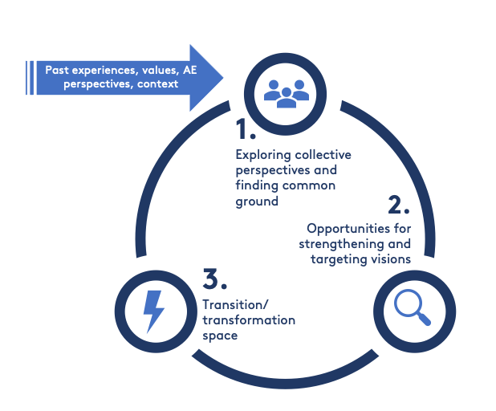
Agroecological transition is a process and journey
Notes:
E

Slide 11
Principles / elements in your words
Principles / elements in your words
Principles / elements in your words
Principles / elements in your words
Principles / elements in your words
Description of transition step
Description of transition step
Description of transition step
Description of transition step
Description of transition step

Slide 12
Identify your resources:
your local resources? ecological, social (youth, women, families, your core values ...), economic, governance...
co-learning needed? Think of local trainings, RMS courses, Steve Vanek's soil courses, Bob's video information sharing, FRNs etc.
synergies that can help you.
Action Plan
Once you have established the synergies between your experience, your needs, your values, the principles and you have chosen a feasible goal, you have the strength to act! What are the steps?
Focus: Is it doable?
You have to be sure that the work is doable! You can't go all over the places. It's worth prioritizing, focusing the work and choosing concrete and feasible steps. What do we want, how do we accomplish it?

