Slide 1


Introduction to ODK
Part 7: Using KoboToolBox – Data monitoring and downloading
Creative Commons Attribution-ShareAlike 4.0 International

Slide 2
Contents
Navigating KoboToolBox Project Page
Monitoring Data
Downloading Data

Slide 3




ODK Process Steps
Paper Survey
ODK Aggregator (ONA, Kobo, etc.)
Download the form to a mobile device for data collection
Upload the form to an ODK aggregator
Download your data to your computer in a .csv, .xlsx etc.
Upload your data to the aggregator
Move from paper to digital by creating an XLSform
Computer
Mobile Device
Notes:
We have already seen in the previous presentation how to move from your paper survey to a digital one by creating an XLSform. In today’s presentation I am going to explore the rest of this ODK system through the steps of uploading your form to an ODK aggregator, downloading the form to a mobile device for data collection, uploading your data to the aggregator, monitoring your data on the aggregator and finally downloading your data to your personal computer in a csv, xls etc.

Slide 4
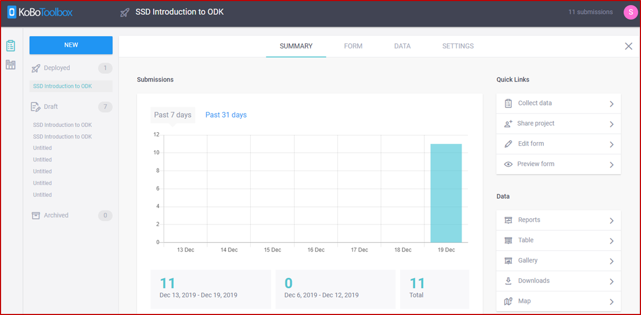
Navigating KoboToolBox
Once you have uploaded some data, you can head back online to the Kobo site and download your data for management, cleaning, analysis etc.
First log back in and find your project. You will see the summary page for your data.
This shows you when data was collected and how many forms have been submitted . There is also a number of options to the right, which, along with the chart, are useful for monitoring data. For instance, you can see if data is submitted before collection should begin.

Slide 5
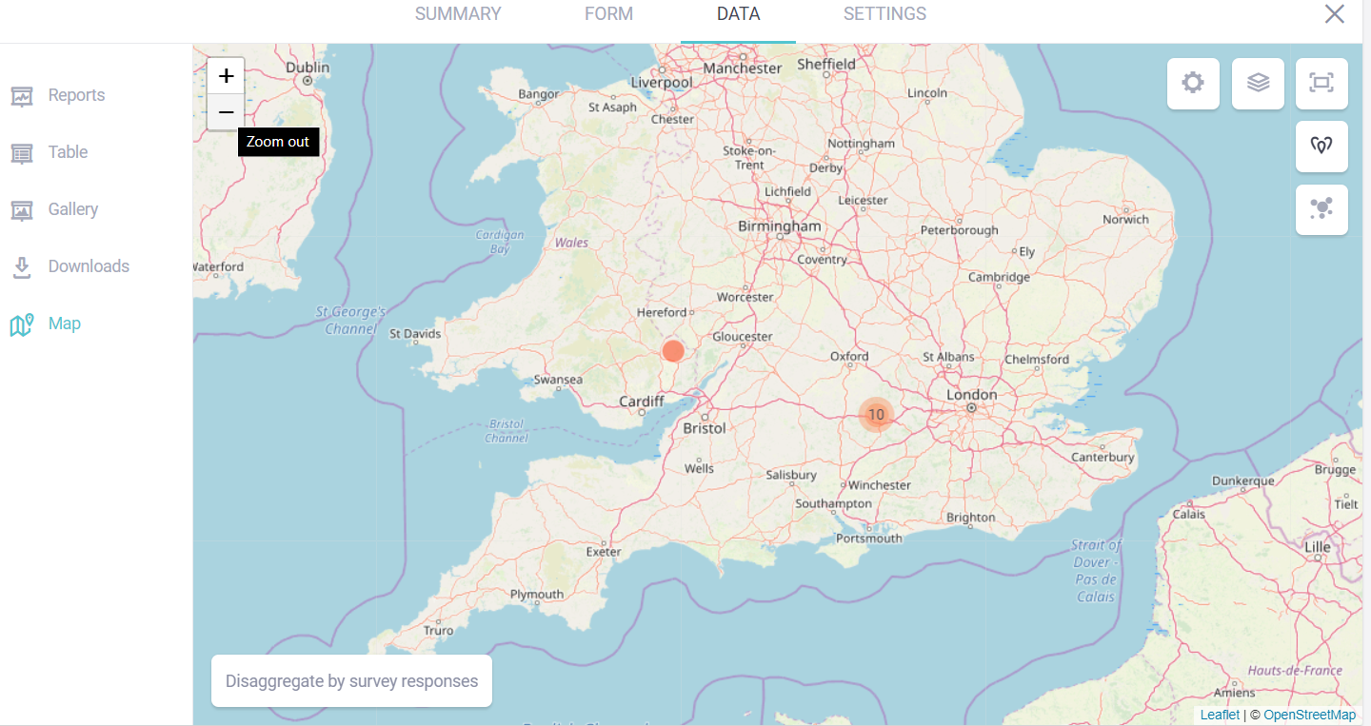
Monitoring Data
On the map page you can see the GPS locations of data submissions/GPS readings for variables.
This is especially useful when data is being collected remotely from your location.
You can check that data is being collected in locations you would expect and not in strange locations far away from data collection sites

Slide 6
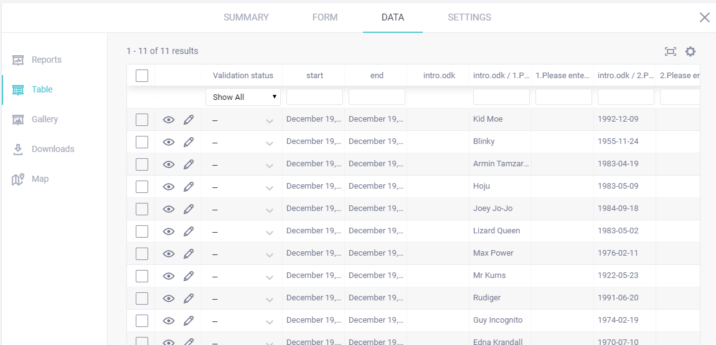
Monitoring Data
From this menu, you can also browse your data in the table tab. You can check through your entries for any unusual looking responses/incomplete entries.

Slide 7
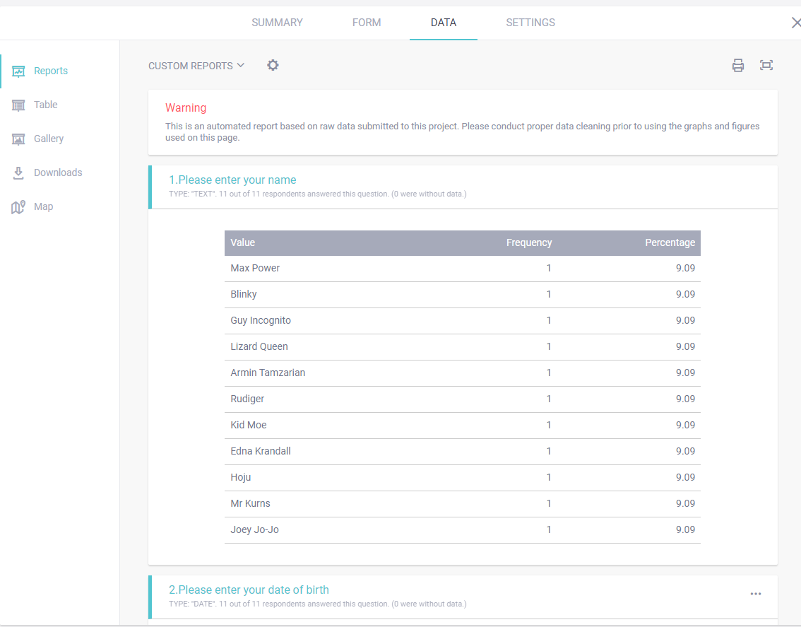
Monitoring Data
You can also browse some graphs and tables from the Reports tab

Slide 8
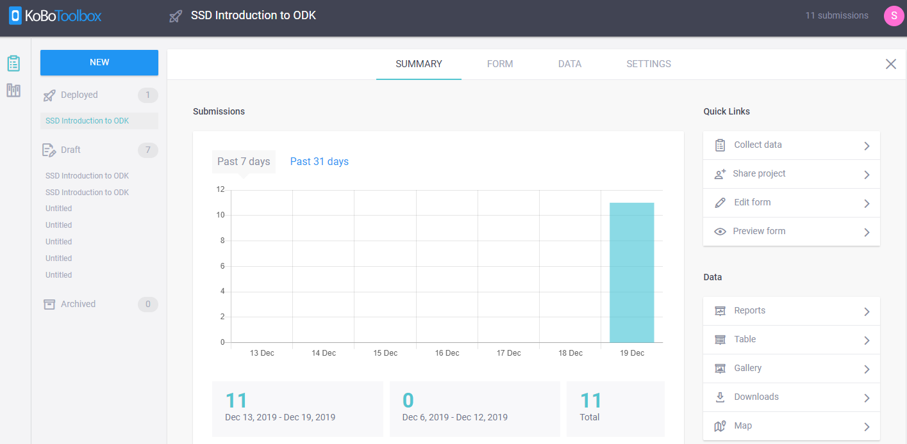
Downloading Collected Data
To download some data, you need to click on either the “DATA” tab or the “Downloads” button.

Slide 9
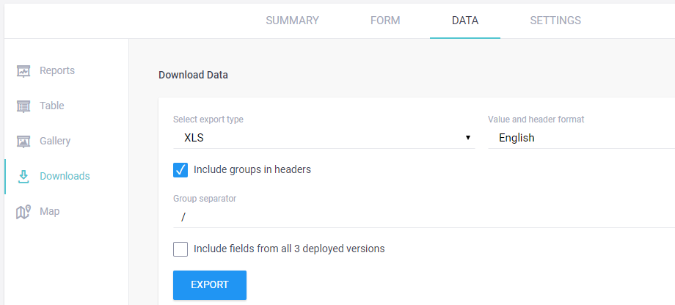

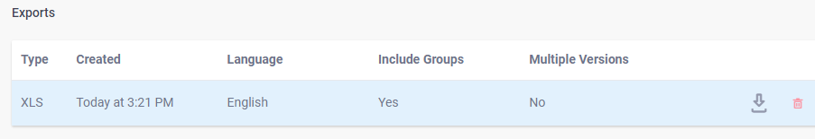
Downloading Collected Data
From here, choose your file format and other options such as inclusion of group names and which versions of the forms you want data from.
Press “Export” and then a file will appear below this box ready to be downloaded by clicking the download icon

Slide 10
Downloading Collected Data:
File Formats
There are a number of file formats you can chose your data to come in:
CSV: All data will be part of one CSV file; when this is opened in Excel, all data from all question groups will be in the same sheet
XLS: This will more conveniently split repeat groups onto separate sheets within an excel workbook
ZIP: Similar to XLS in that it splits repeat groups into separate CSV files. It also has the additional benefit of containing any image, audio or video files which were part of the data collection.
Notes:
It is worth mentioning how these different file formats actually present their data. This is mainly a point of order when your form contains any repeated groups.
In a .csv file, all data will be a part of a single CSV file. When this is opened in excel or other software, all data from all question groupings will appear on the same sheet.
Whereas in a .xls, any repeat groups are arguably more conveniently split onto separate sheets within an excel workbook.
ZIP files are similar to XLS in that repeat groups will be split into separate CSV files. This type also has the additional benefit of containing any image, audio or video files which were a part of the data collection.

Slide 11
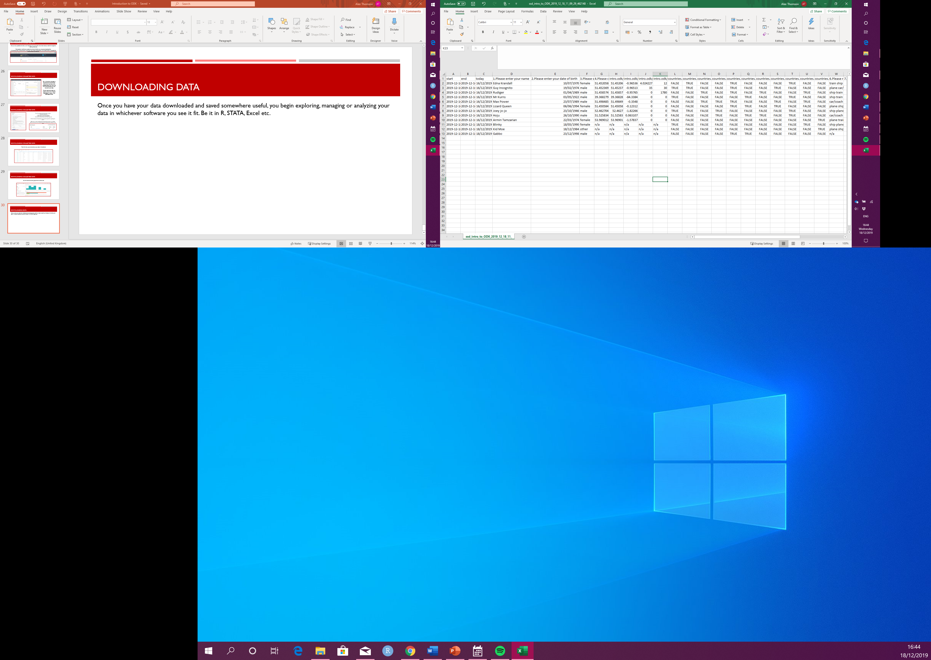


Downloading Collected Data
Once you have your data downloaded and saved somewhere useful, you can begin exploring, managing or analyzing your data in whichever software you see it fit, be it in R, STATA, Excel etc.

Slide 12
Conclusion
Throughout this series of video presentations we have explored:
The entire ODK system from a human readable questionnaire through to downloading your final data.
  Starting at creating your XLSform
  Creating your project on an ODK Aggregator
  Configuring ODK collect on your mobile device and using said device for data collection
  Uploading your collected data back to the server (ODK Aggregator)
  Monitoring your data submissions
  Downloading your project data for cleaning and analysis

Slide 13
From the webinar series:
Introduction to ODK
Created and presented by Alex Thomson
CCRP – Research Methods Support project
May 2020

