Slide 1


Introduction to ODK
Part 6: Using ODK Collect
Creative Commons Attribution-ShareAlike 4.0 International
Notes:
Welcome to part 6 of this series of introductory video presentations on “An Introduction to Open Data Kit (ODK)”, a learning resource compiled by Statistics for Sustainable Development for researchers, students or anyone else who may be interested in learning the fundamentals of ODK and mobile data collection.
This part shall focus on everything to do with the use of ODK Collect, the ideal mobile app to use for your data collection. We shall cover everything from downloading and configuring the app to uploading your collected data back to the server.

Slide 2
Contents
Downloading ODK Collect
Configuring ODK Collect
Downloading form to ODK Collect
Collecting data
Saving and editing forms
Uploading forms to Kobo from ODK Collect

Slide 3




ODK Process Steps
Paper Survey
ODK Aggregator (ONA, Kobo, etc.)
Download the form to a mobile device for data collection
Upload the form to an ODK aggregator
Download your data to your computer in a .csv, .xlsx etc.
Upload your data to the aggregator
Move from paper to digital by creating an XLSform
Computer
Mobile Device
Notes:
We have already seen in the previous presentation how to move from your paper survey to a digital one by creating an XLSform. In today’s presentation I am going to explore the rest of this ODK system through the steps of uploading your form to an ODK aggregator, downloading the form to a mobile device for data collection, uploading your data to the aggregator, monitoring your data on the aggregator and finally downloading your data to your personal computer in a csv, xls etc.

Slide 4
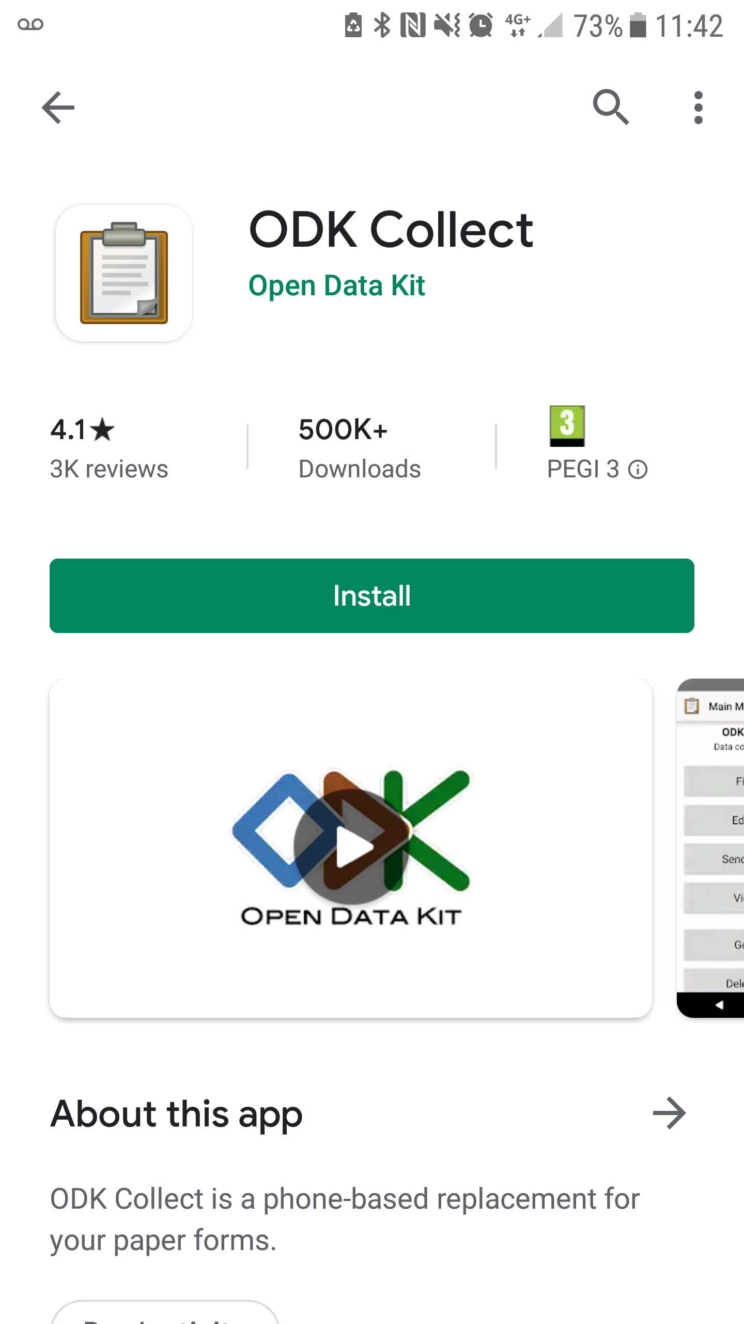
Downloading ODK Collect
ODK Collect is the best app for collecting and uploading data for your project
It has been optimised for Android devices
It can be downloaded for Android phones/tablets through the Google Play store or can be manually installed onto your phone/tablet.
Notes:
Now that we have set up our project and form to KoboToolBox, we can switch over to the mobile device to begin looking at how we can collect data using the form we uploaded.
The best app for collecting and uploading your project data is ODK Collect. It has been optimized for android devices so this would be the most effective way to conduct your data collection.
It can be downloaded for android device phones/tablets through the google play store or can be manually installed onto your phone/tablet if need be.

Slide 5
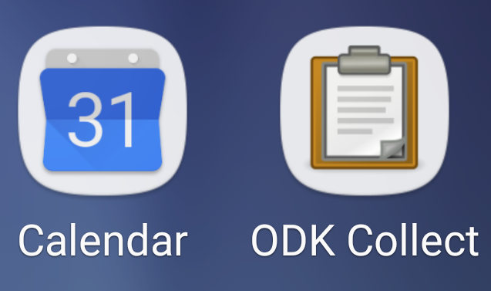
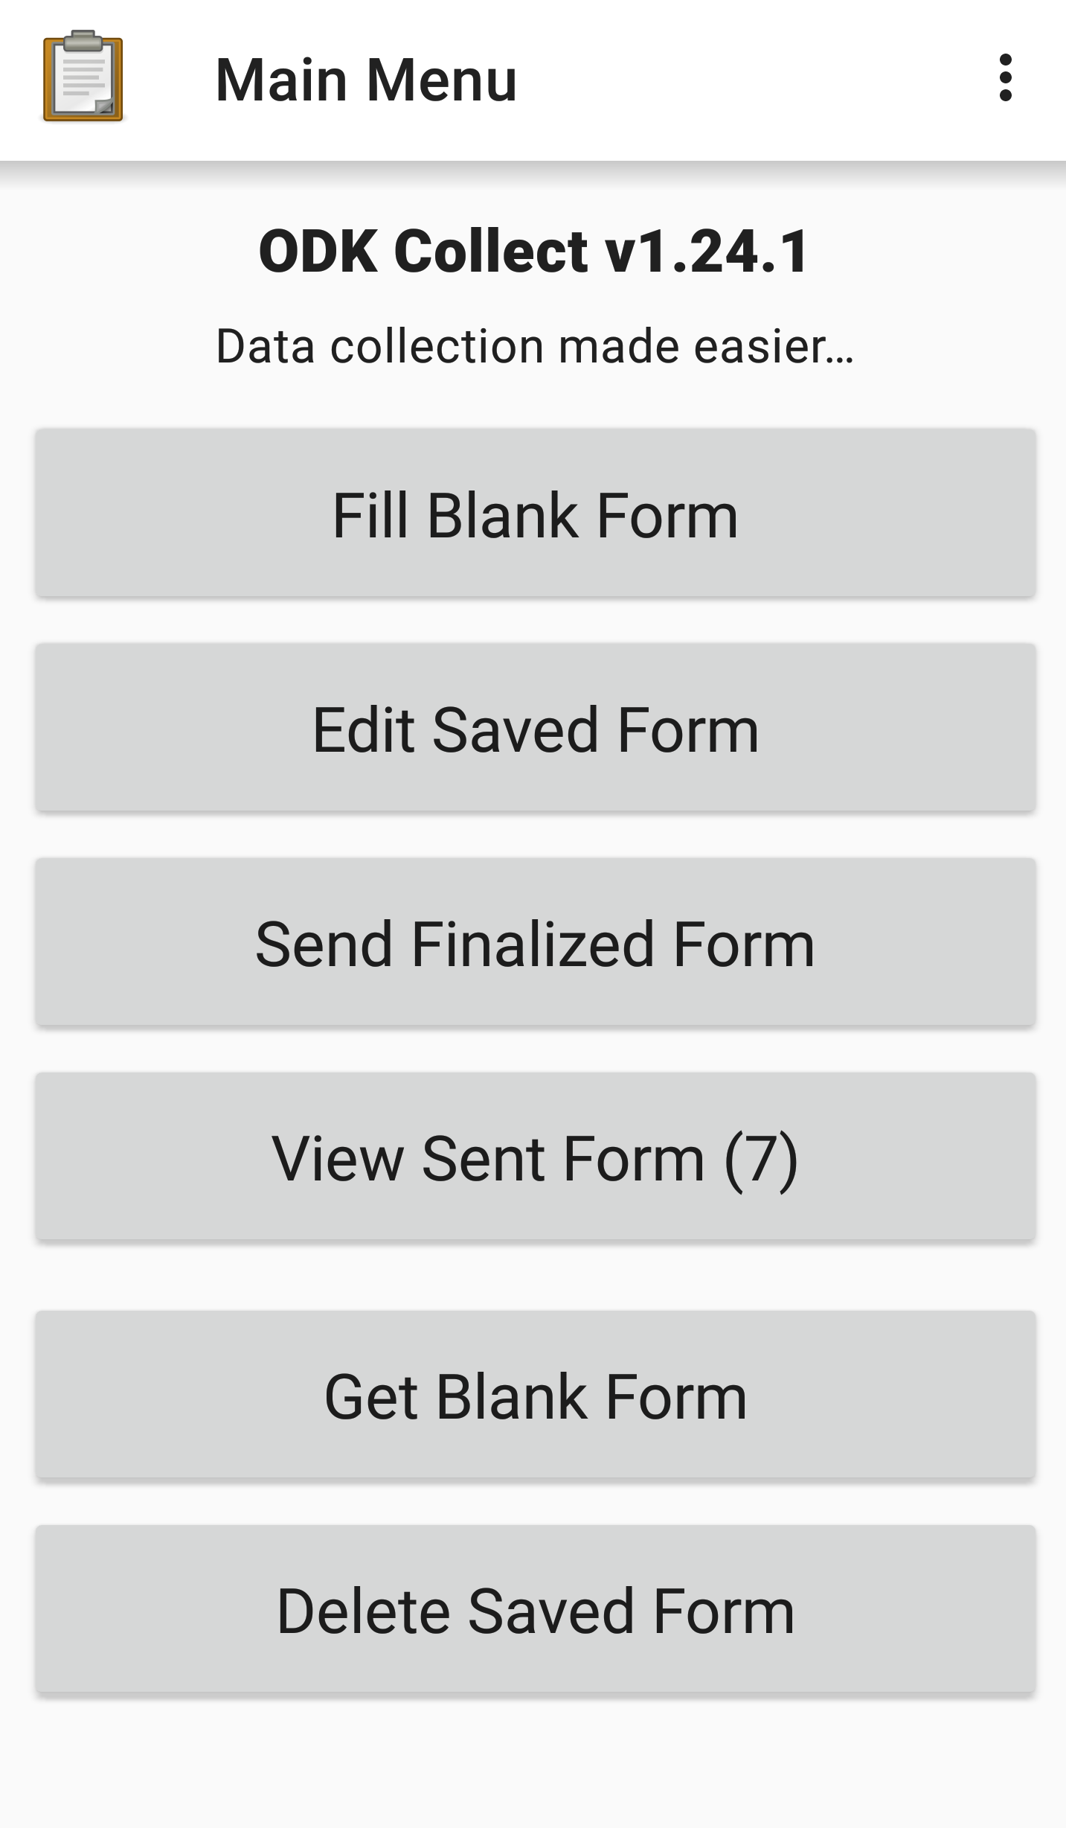
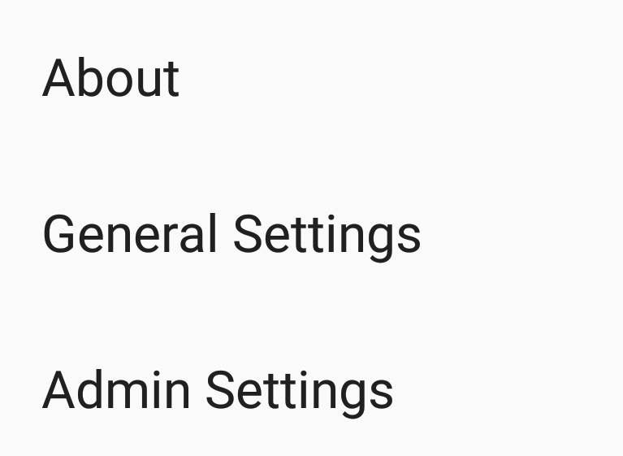
Configuring ODK Collect
When you open the app for the first time, you will be shown a few prompts regarding settings and navigation.
Once you have installed ODK Collect you will see an icon like the one above appear somewhere on your device.
The main menu of the app will appear like the image to the right.
By pressing on the 3 dots in the top right corner of the main menu, you will be shown a drop-down list of settings menus.
Notes:
Once you have installed ODK Collect you will see an icon like this appear somewhere on your device. If you open this up you will be presented with the main menu screen which appear something like this with the version number displayed at the top. Prior to this you will likely be shown a few prompts about settings and navigation which are easy enough to understand.
If you press onto the dotted icon in the top right corner of the main menu, you will be shown a drop-down list of settings menus. The about screen will show some general information linking you to the website, the forum, a link to share the app and a link to leaving a review on the play store.
The general settings will take you into settings regarding form management and the user interface. However it is the Admin settings which are most important in the process of configuring the app to meet our needs.

Slide 6
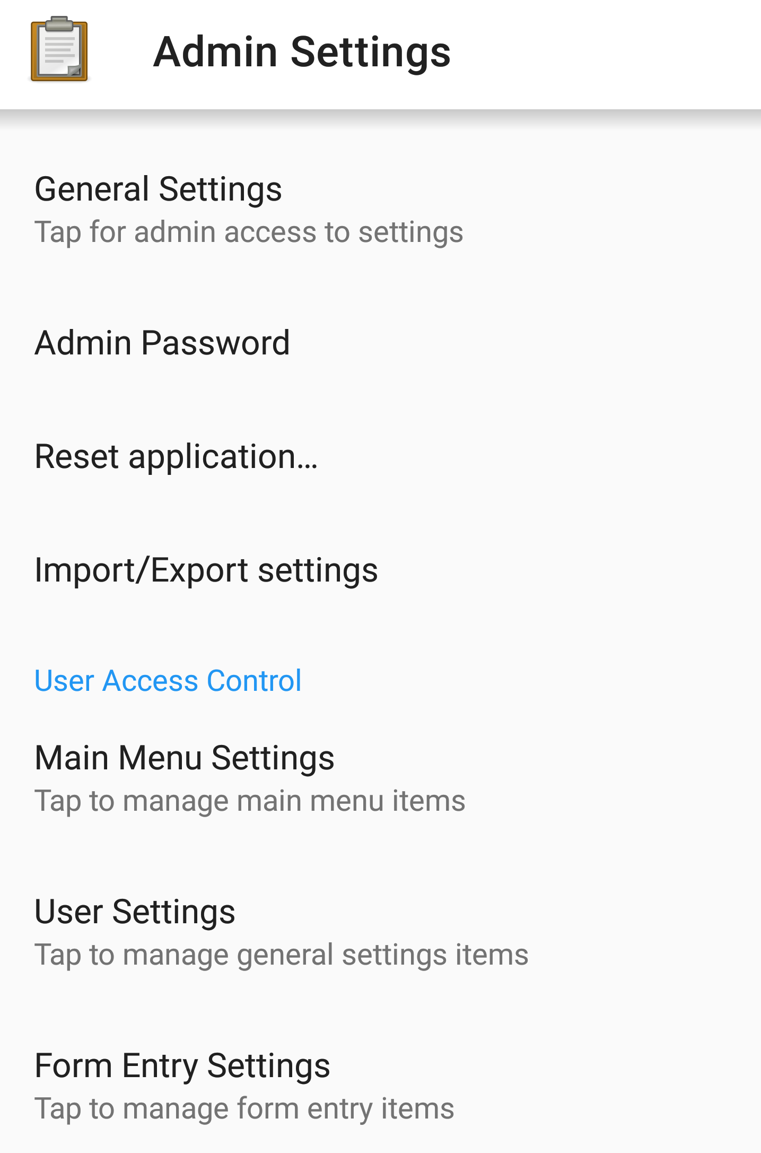
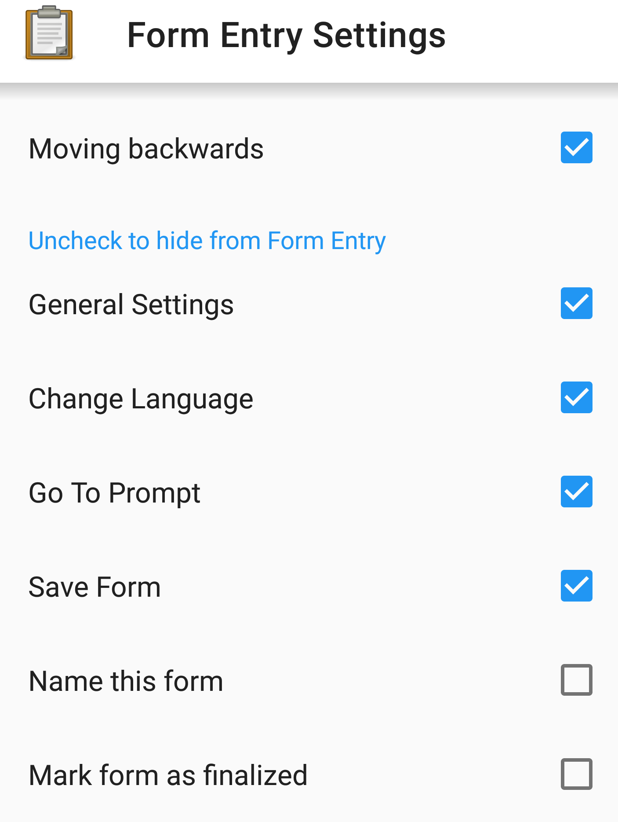
Configuring ODK Collect
If you go into the Admin Settings, you will be presented with a number of additional menus for separate settings.
General settings
Main menu settings
User settings
Form entry settings
The bottom 3 are primarily used for controlling which options/menus can be seen and used.
This can be useful for when setting up accounts for users whose primary role is to collect data, controlling these settings essentially limits the permissions this kind of user would have.
In Form Settings, you can control whether the user can name the form, save it, change the language etc.
Notes:
If you click through onto the admin settings, you will be presented with a number of additional menus for separate settings.
General settings – which is the admin version of the general settings page I mentioned before. Including user and device identity and server settings as well as UI and form management.
Main Menu Settings – which controls what options appear on the main menu
User settings – controls what options are present in the general settings, such as hiding, the server, automatic downloads and deleting forms after sending.
Finally,
From entry settings- this allows you to control what navigation options the user is able to control. Including the ability to change the form language, saving the form and going to prompt (moving freely about the form)
The latter 3 settings (main menu, user and form entry) are primarily used for controlling which options/menus users are able to see and use. This can be useful for when settings up accounts whose primary or sole role is to collect data. By predefining these options you are essentially able to limit

Slide 7
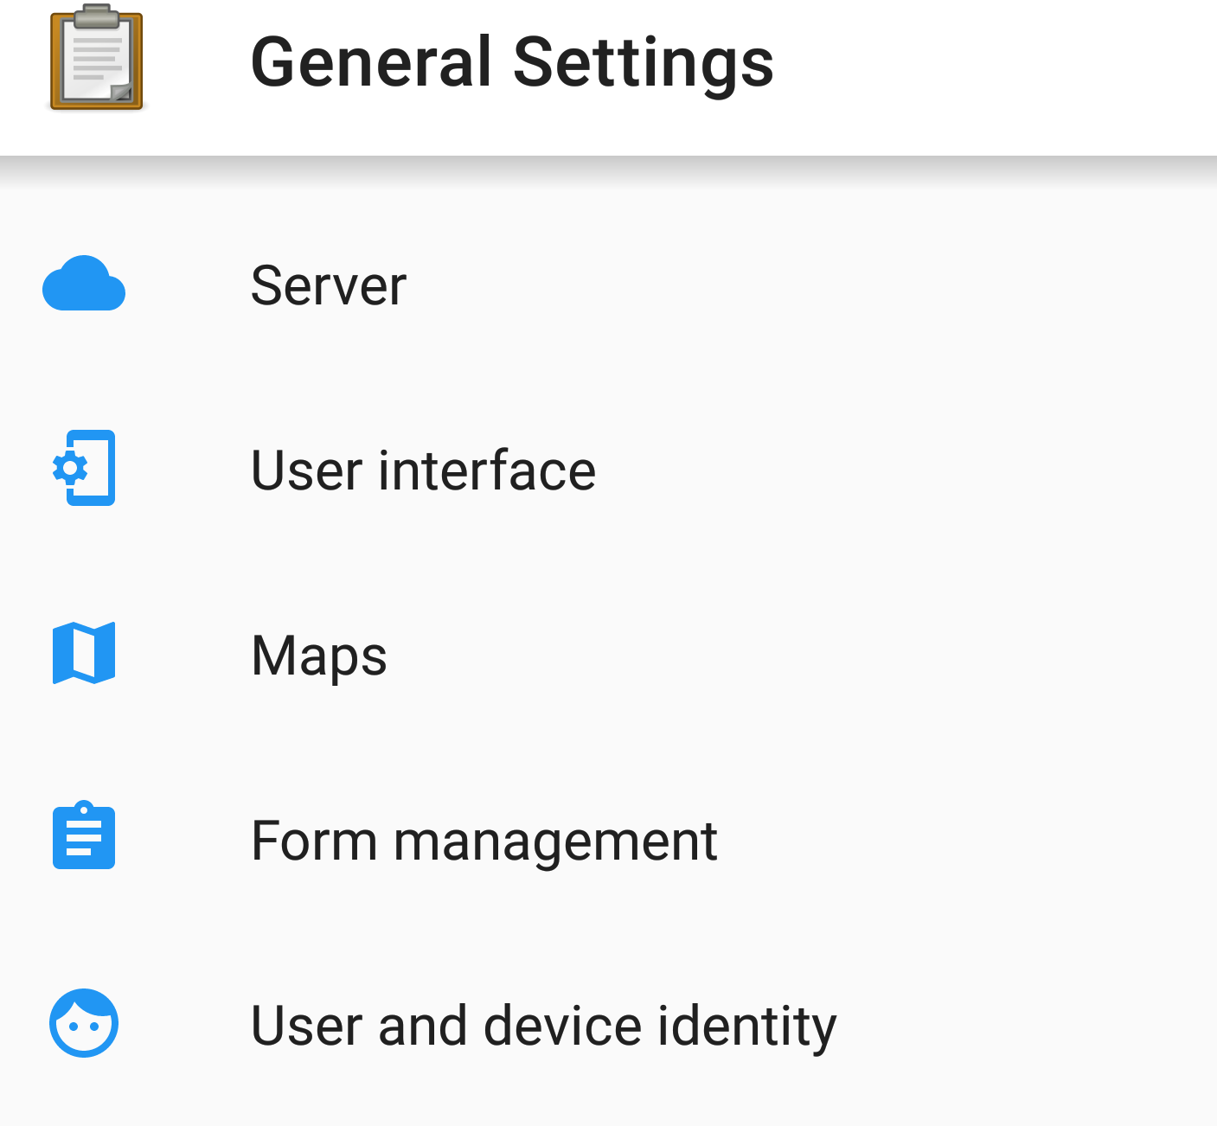
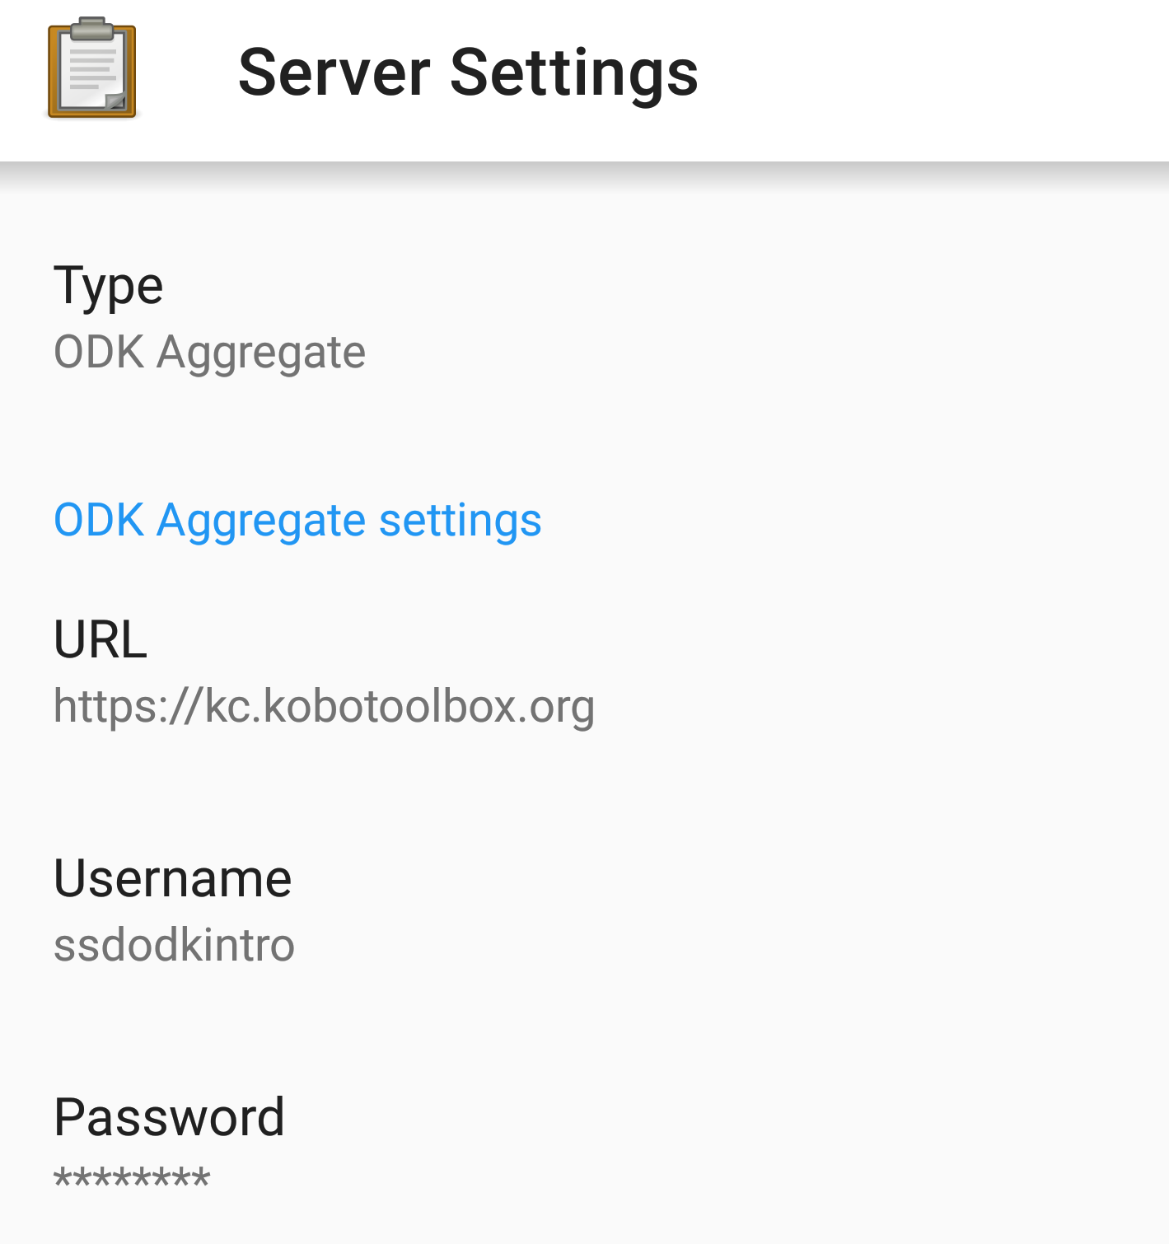
Configuring ODK Collect
Back under the main Admin Settings page, by going into General Settings you will be able to set some key settings required for your data collection.
Firstly, it is important you set up which server you are using to download and upload resources.
This is done within Server Settings by telling ODK the server URL (if you are using Kobo, this would be https://kc.kobotoolbox.org), and then the username and password of the account you set up for your project and uploaded your form.
Doing this will allow you to download your blank forms and upload your completed forms.
Notes:
However, the general settings option here is crucial to configuring the app for your project and data collection needs. You will be able to set some key settings which are completely required before you can beign datra collection. The most important of which is ensuring that your app is set to the correct server, i.e. the server from which you will download your form and to which you will upload your data.
This is done within the server settings by telling ODK the server URL (if you have been using Kobo as this tutorial has been demonstrating, then you will write in https://kc.kobotoolbox.org, and then you would write in the username and password of the account you set up for your project and uploaded your form. Alternatively, if you shared the project with other enumerators as you are not the only one, then so long as they were given permission, they will be able to use their own account rather than yours.
Doing this will allow you to download any forms which are connected to this account and then upload your data once you have completed some instances of the form.

Slide 8



Downloading a Form to ODK Collect
Notes:
Now that we have set up our project and configured ODK Collect, we can now download our form and begin collecting data.

Slide 9

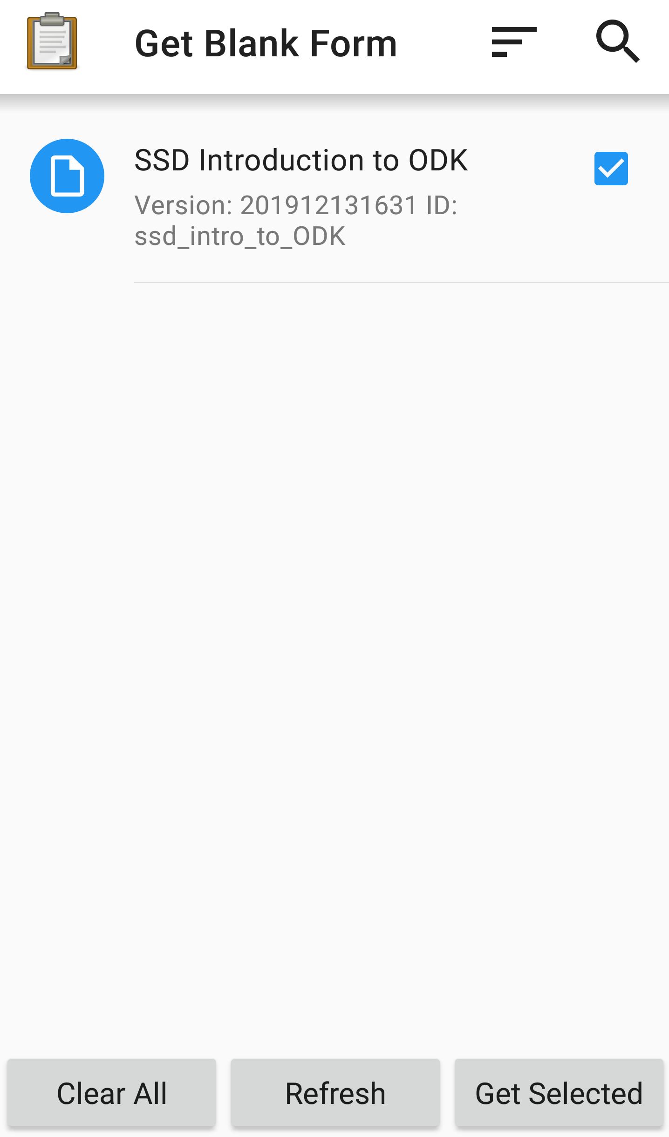

Downloading a Form to ODK Collect
In order to download your blank forms, you will first need to make sure you have an internet connection through your mobile network or wi-fi.
Click on “Get Blank Form” on the main page
Then check the boxes for whichever forms you wish to download and finally press “Get Selected” at the bottom of the screen.
Notes:
In order to download your blank forms in the first place you will need to make sure that you have an internet connection either through your mobile network or through wi-fi.
Firstly, head back to the main menu and then press on “Get Blank Form”. Then you check the boxes for whichever forms you wish to download, in this demonstration there is only one form to download so this one is automatically selected. If you have lots of projects and forms, ODK will default to selecting whichever forms are not currently downloaded onto your device. To download your selected form, simply then press “Get Selected” and your form should install very quickly, it may take slightly longer if there are media files which the form needs to download also.

Slide 10
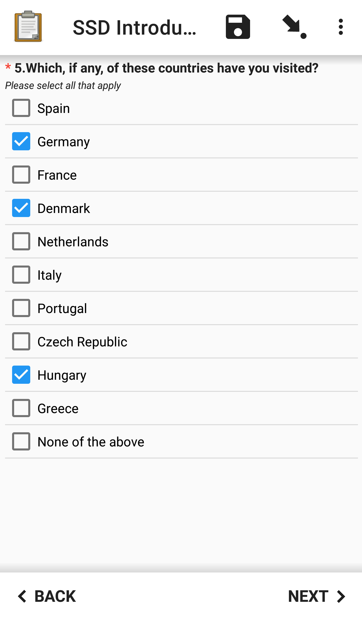
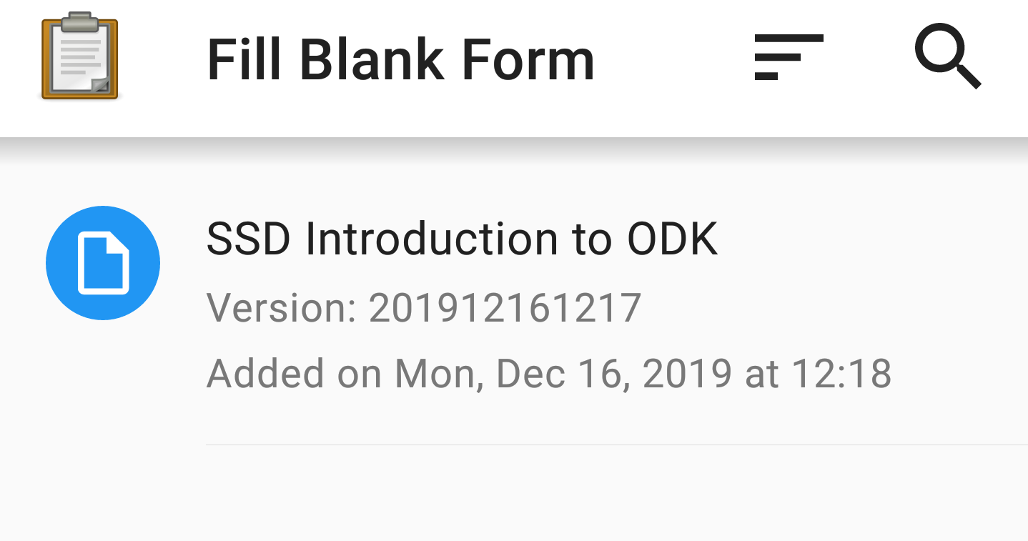
Collecting Data
Once you have your form you can start collecting data by going into “Fill Blank Form” on the main page and then selecting the form for which you would like to collect data.
Depending on your settings, you will move between pages of the form by pressing the next or back buttons at the bottom of the screen.
Notes:
Once you have downloaded your form you can now finally start collecting data. If you return back to the “Fill Blank Form” section on the main page and then select the form for which you would like to collect data. You will then be taken to the first page of the form.
Depending on your settings, you will either move between the pages of the form by pressing the next or back buttons which will appear at the bottom of the screen. Alternatively, the default option is to actually swipe to the side in order to navigate, I personally prefer using the buttons as the swipe navigation can be fiddly. Often you will swipe to move down and this will register as trying to move to the next or previous question

Slide 11
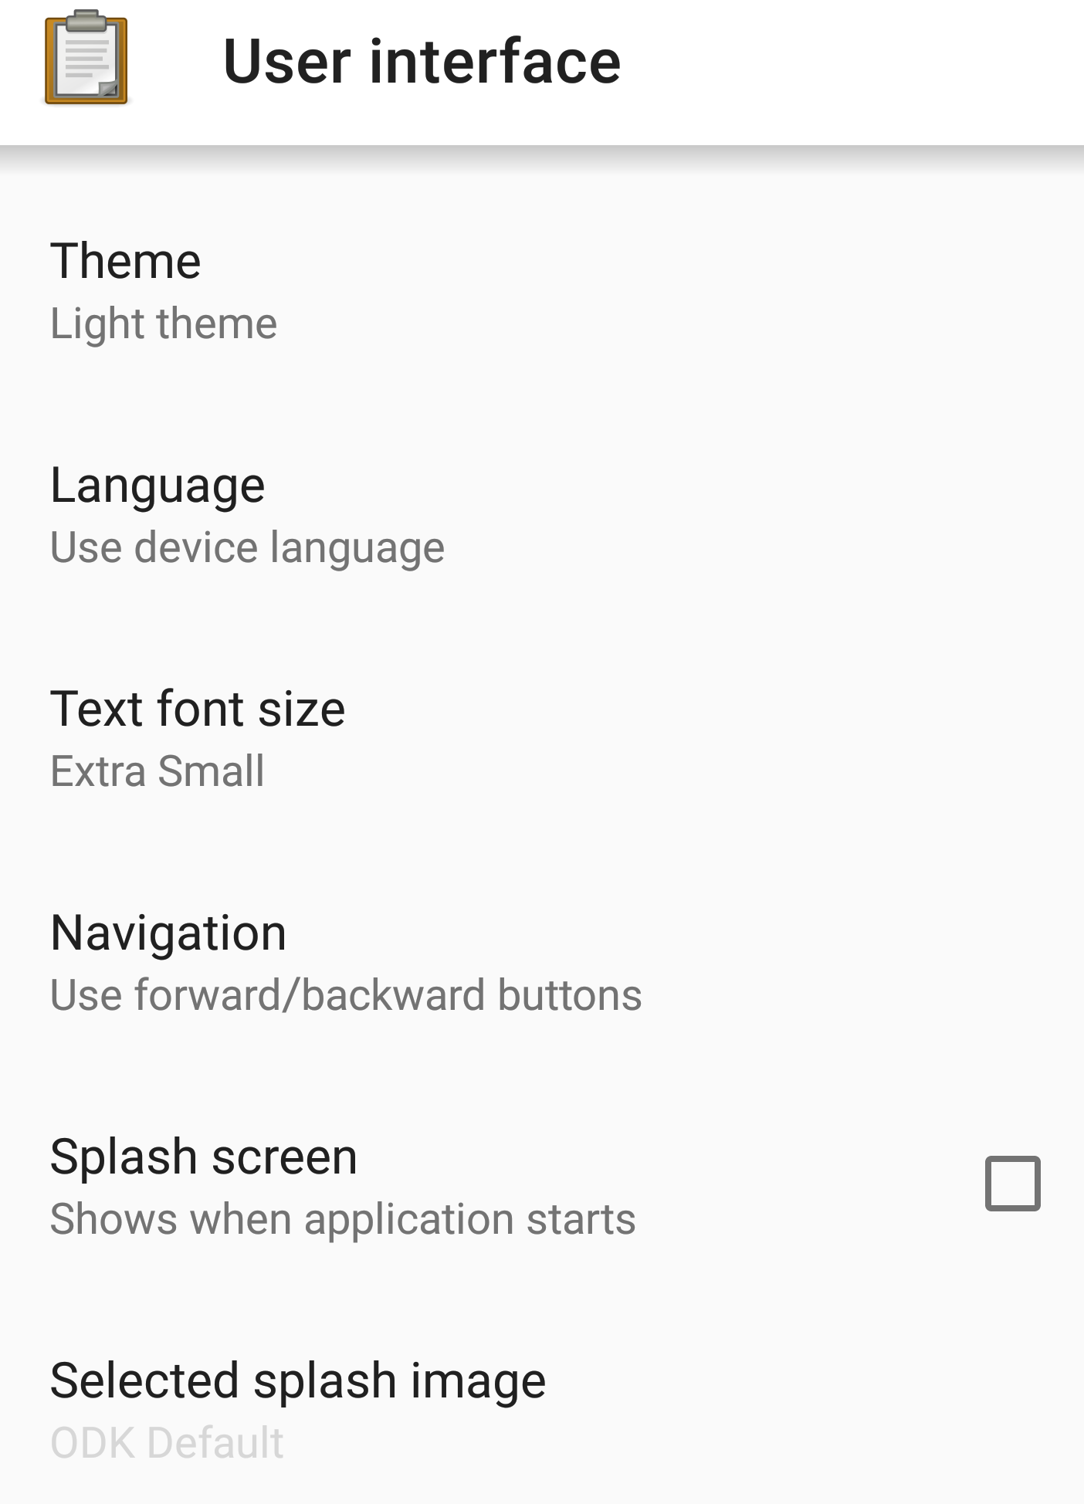
Collecting Data
If you do not have these buttons, you may have the settings selected to navigation by swiping side to side of the screen.
This can be changed by pressing the dotted icon in the top right and then pressing “User interface”, you will be presented with the page on the right (the choice of settings will depend on those set up in the user control settings in the configuration steps.
You can change the navigation options here as well as other choices such as language, font size or even the theme.
Notes:
If you do not have these buttons, you can change the navigation method by pressing the dotted icon on the top right of the screen. And then press on the User Interface settings. You will be presented with this page, the choice of settings will, as previously mentioned, depend on those which had been set on those set up in the user control settings as shown in the configuration steps. You can change the navigation settings to use forward/backward buttons here as well as alter the text font size, the language and change the theme.

Slide 12
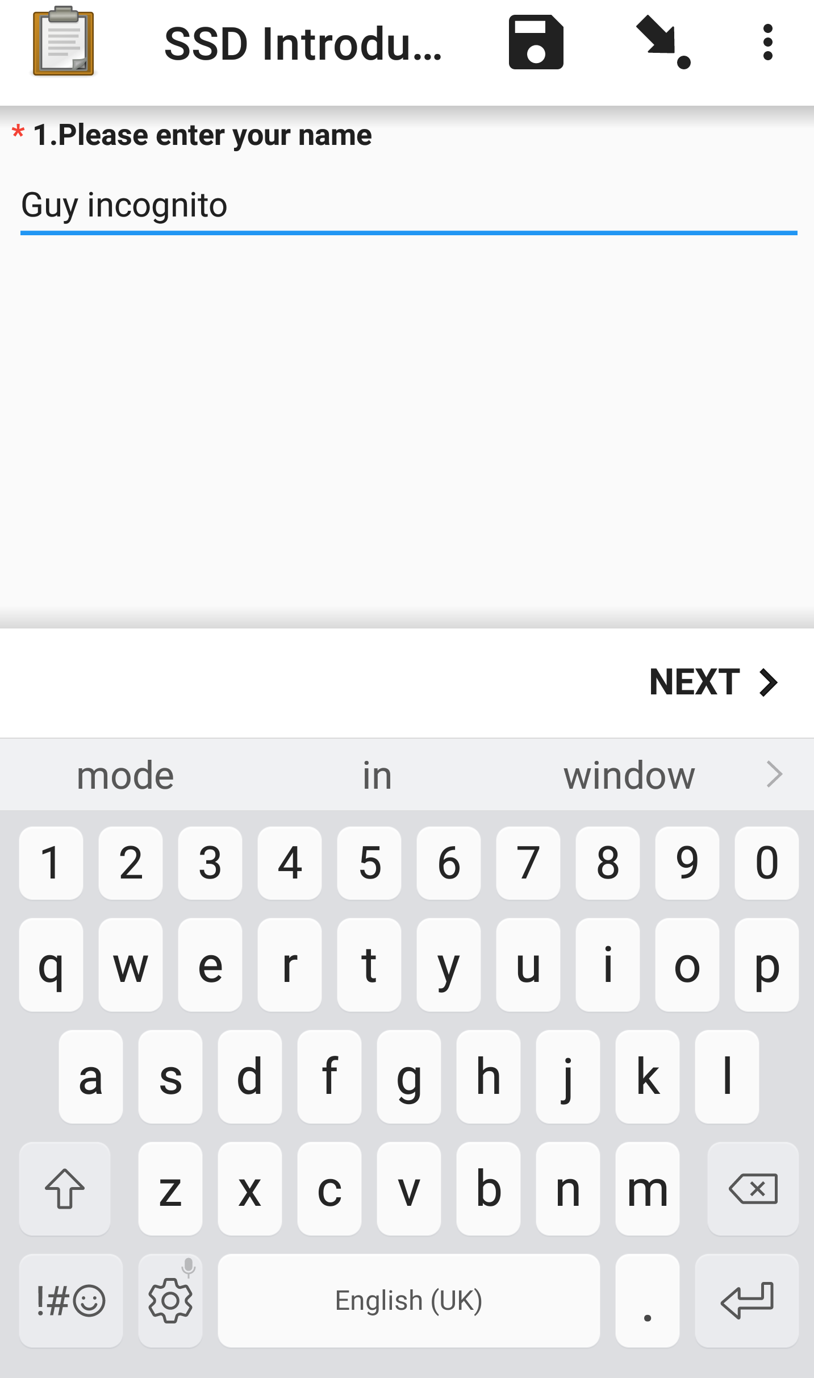
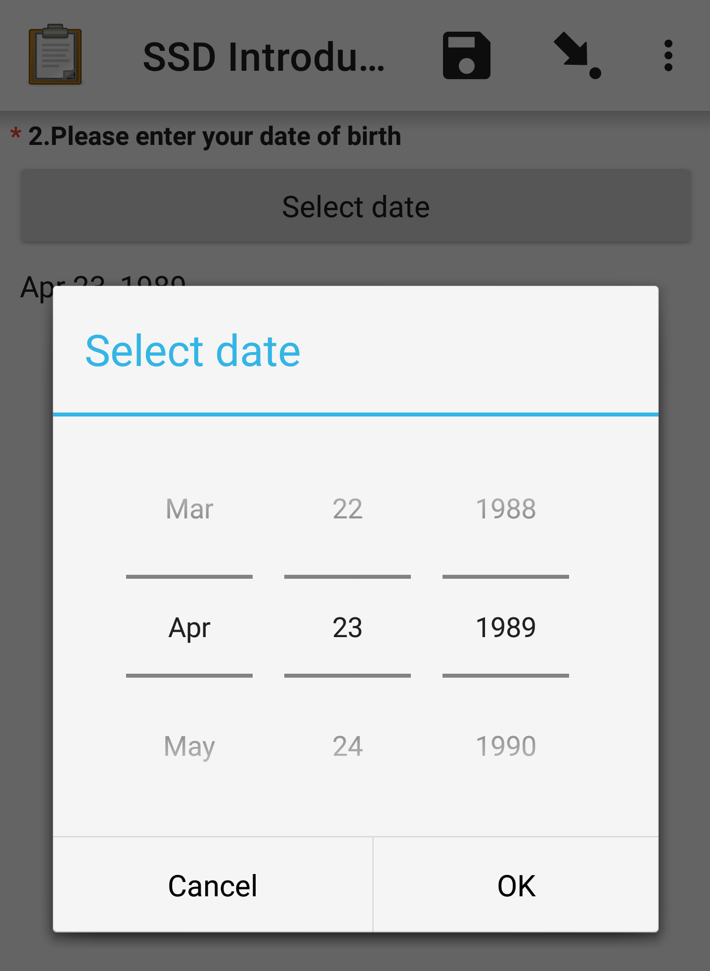
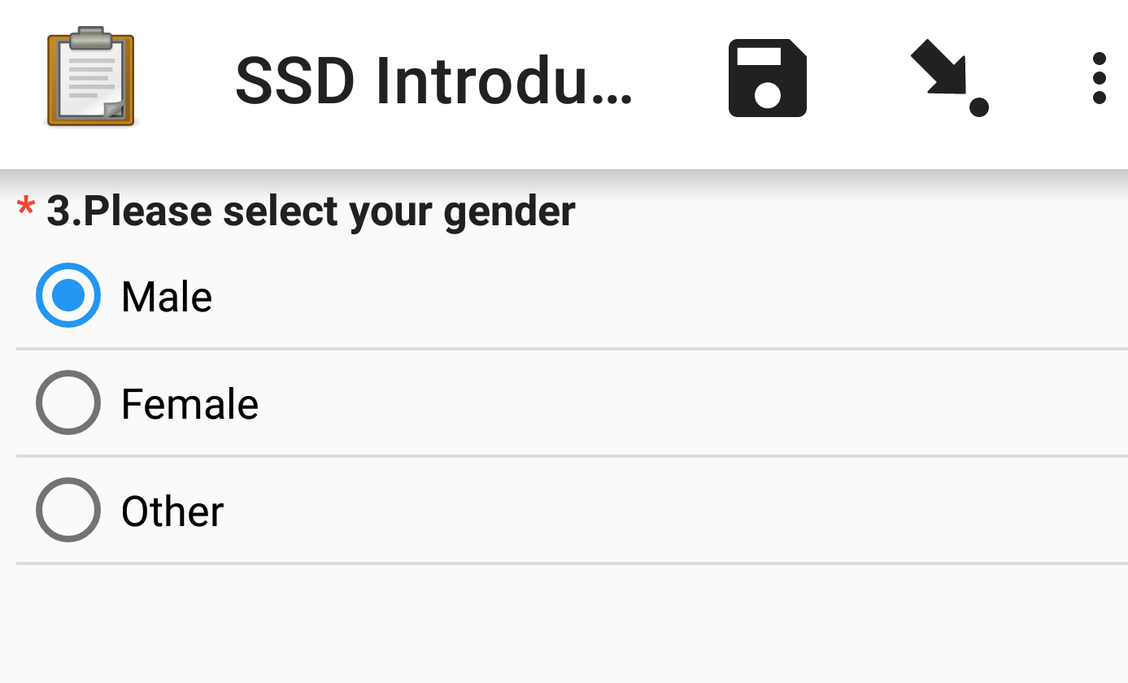
Collecting Data
Text:
Date Widget:
Single Select:
Notes:
In the previous session I described how to create your XLSform, detailing how to create certain question types and how to use hints and labels to display text.
Well in this first image we can see how a text field such as “Please enter your name” would appear on the actual mobile device when an enumerator is collecting data for your project.
2nd is what we would call a date widget, this is not the default appearance for this type of question. If you recall in the previous session when I showed portions of the XLSForm, I had set in the appearance column for this question to be no-calendar – this changes how this date variable is inputted. Rather than displaying a calendar, the user will see this kind of listed option instead.
A single select can appear in many different ways as they have a lot of potential appearance options such as being gridded or appearing in a drop-down list. The appearance shown here is how single select questions

Slide 13
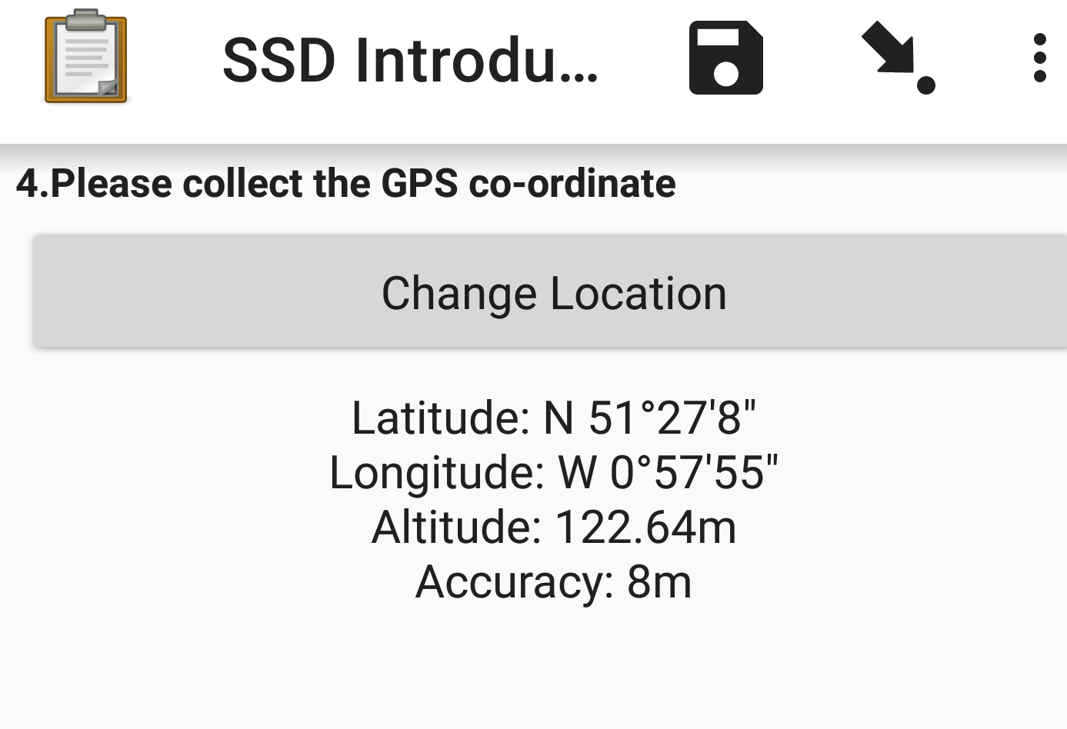
Collecting Data
GPS Location:
Multiple Select:
Notes:
As part of your questionnaire, you may have wished to collect GPS co-ordinates for some purpose. The example here was a collection of a single geo-point at the site of data collection. You will be presented with a button saying “Start GeoPoint”, after pressing this the phone will try to establish a connection to detect GPS co-ordinates and will tell you how accurate the current reading is, increasing in accuracy as more satellites are connected. You can either manually decide when you are happy with the accuracy, or you will have set an accuracy threshold, at which point the form will automatically take the reading once this threshold is matched.
Multiple select questions have many of the same appearance options as single select questions. This is the default appearance, the only difference between this and a single select is the use of square boxes rather than circles as a visual clue. Selected options will be highlighted with blue tick boxes.

Slide 14
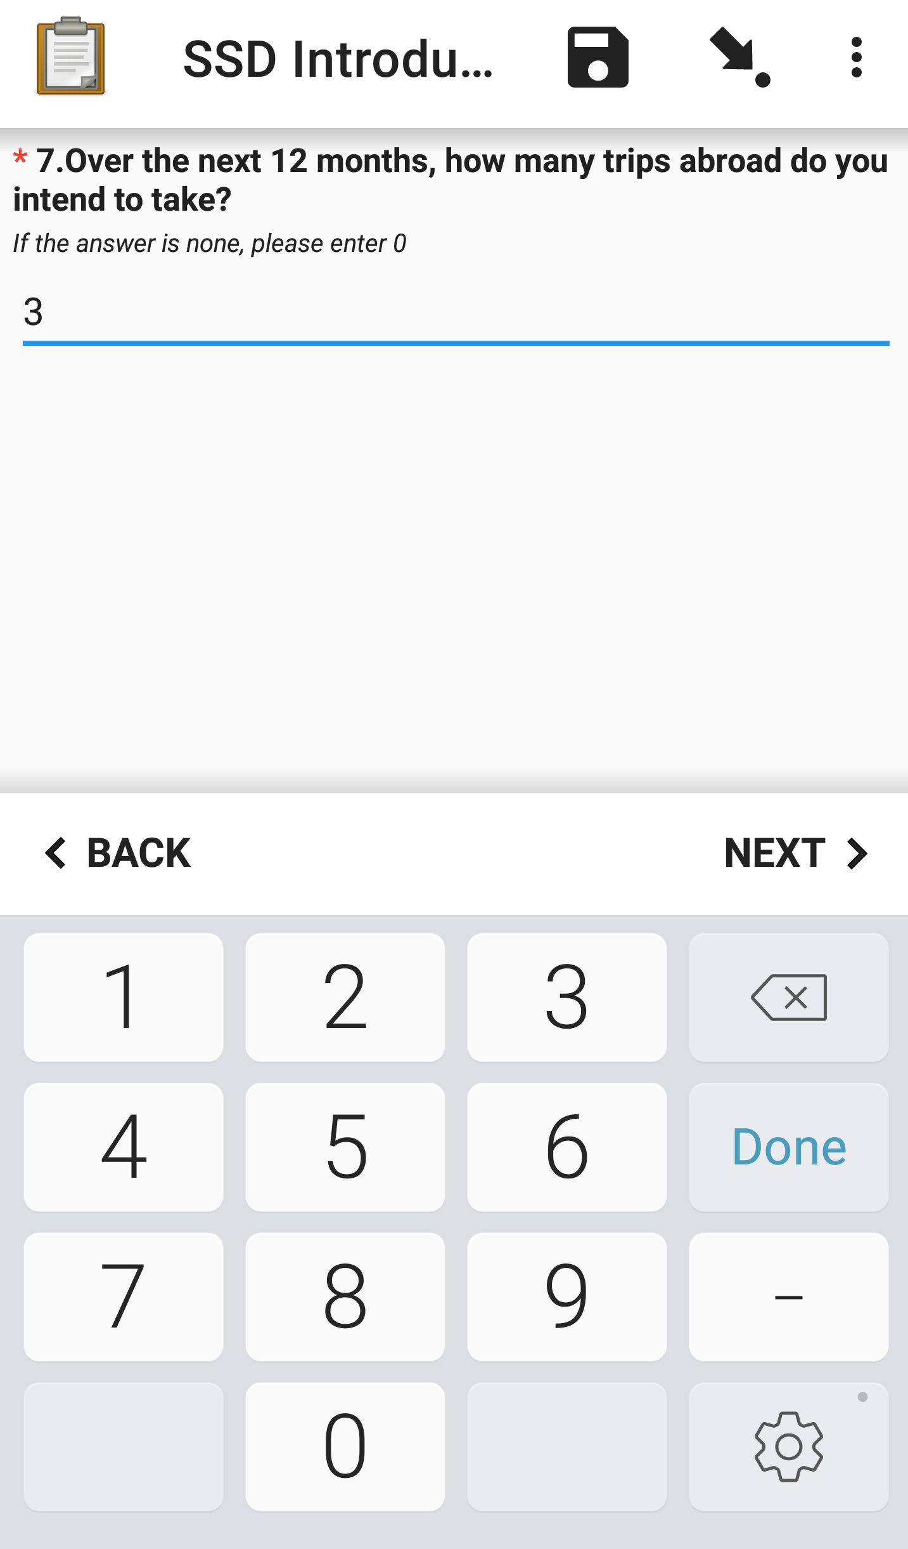
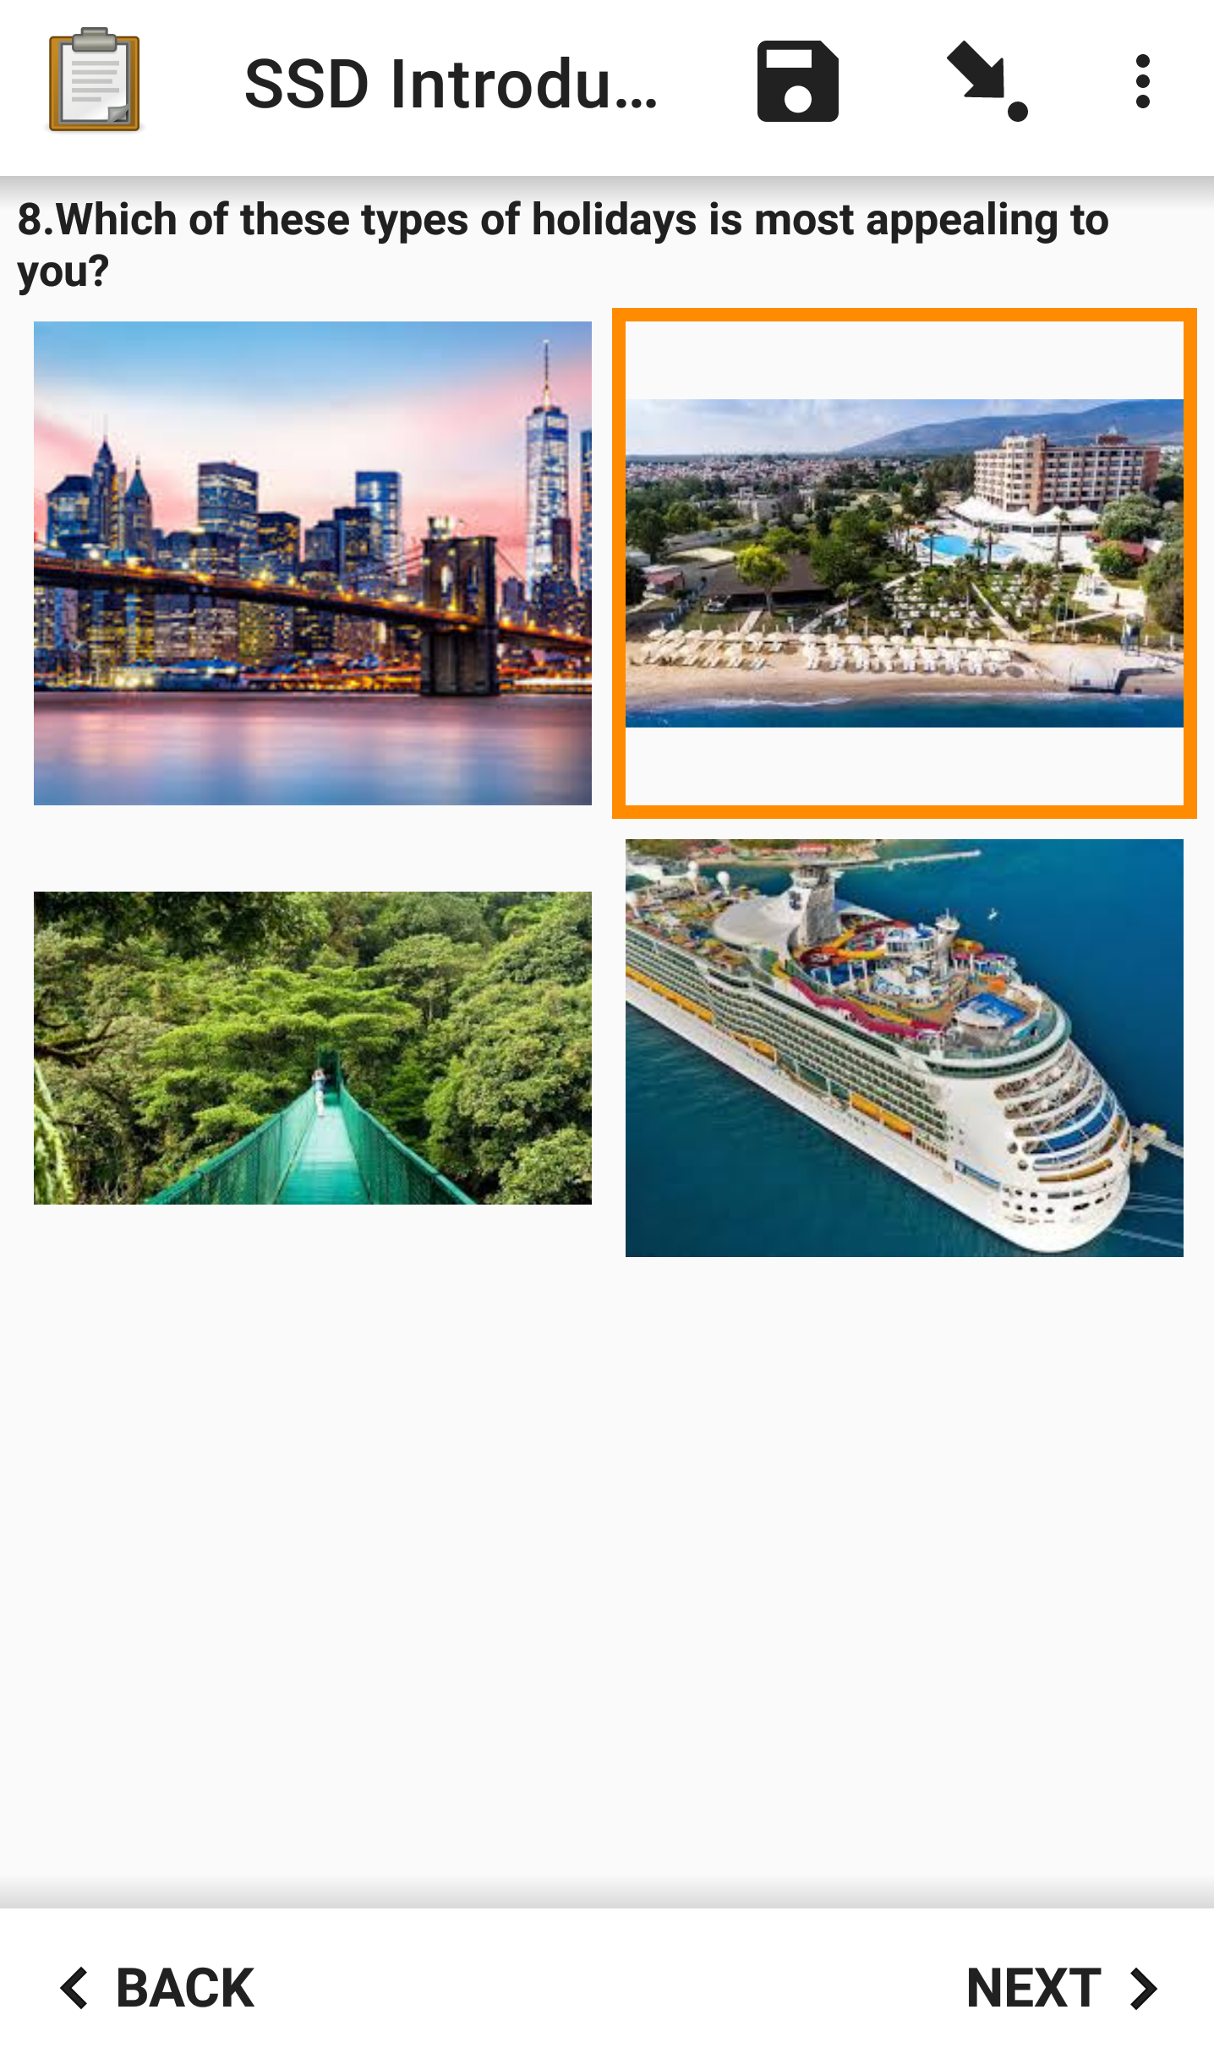
Collecting Data
Single Select with Images:
Integer:
Notes:
Integer questions are fairly simple as when you move onto one, the numpad will automatically open. A decimal input would be slightly different with the addition of buttons for decimal points.
Finally, as mentioned before you can actually use images as answer choices. While I did not fully go over this capability, if you look more into the example XLSForm which has been attached to this project you will be able to see a demonstration and how this is actually a fairly simple process to achieve. As there are no boxes to speak of, the selected option will actually have an orange highlight around the image.

Slide 15
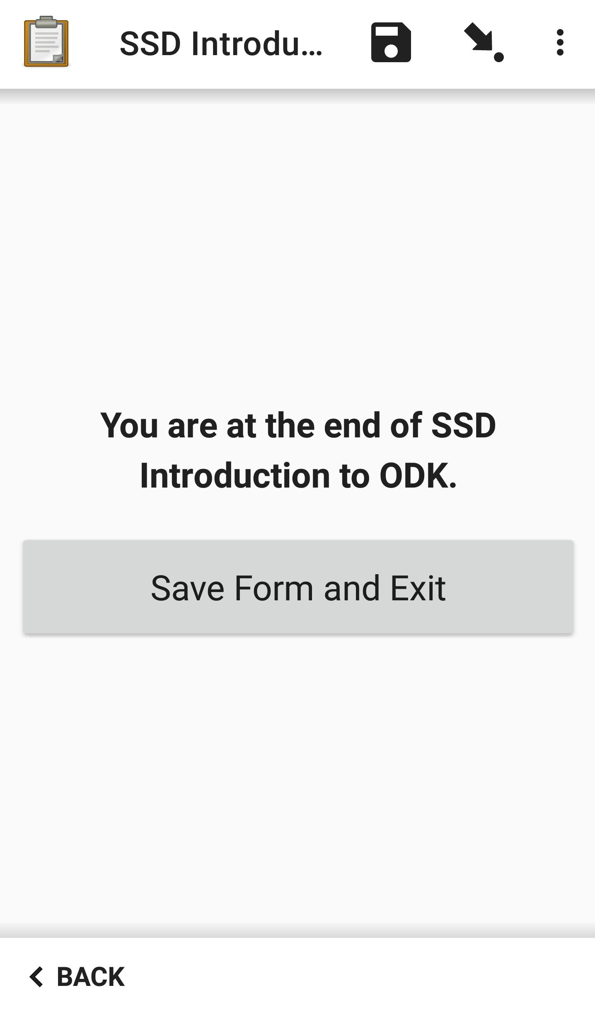

Saving and Editing Forms
When you reach the end of the form you will be presented with the screen on the left.
You can choose to save the form or go back through and edit any question if so needed. You can also save them at any point by clicking the save icon.
If you save the form, you can then edit the form at a later point by pressing “Edit Saved Form” on the main page.
Here you will be shown a list of all the forms you have filled out on this device; they will have a light blue icon next to them if they are unfinalized while finalized forms will have a purple icon.
Notes:
So we have now reached the end of our form. When you do so you should be presented with this screen. You can choose to save the form now, or if need be you can go back and edit any answers before doing so. You can also save them at any point actually by clicking the save icon which will be present at the top of the screen throughout the data collection.
If you save the form you can go back and edit it at any time before it is sent off as a finalized form. If you go back to the main page and press on the “Edit Saved Form” button on the main page, you will be shown a list of all the saved (completed and uncompleted) which are stored on this mobile device which have not been sent back to the ODK server.
They will have a light blue icon next to them if they have not yet been marked as finalized while those which are classed finalized will have a purple icon next to them.

Slide 16
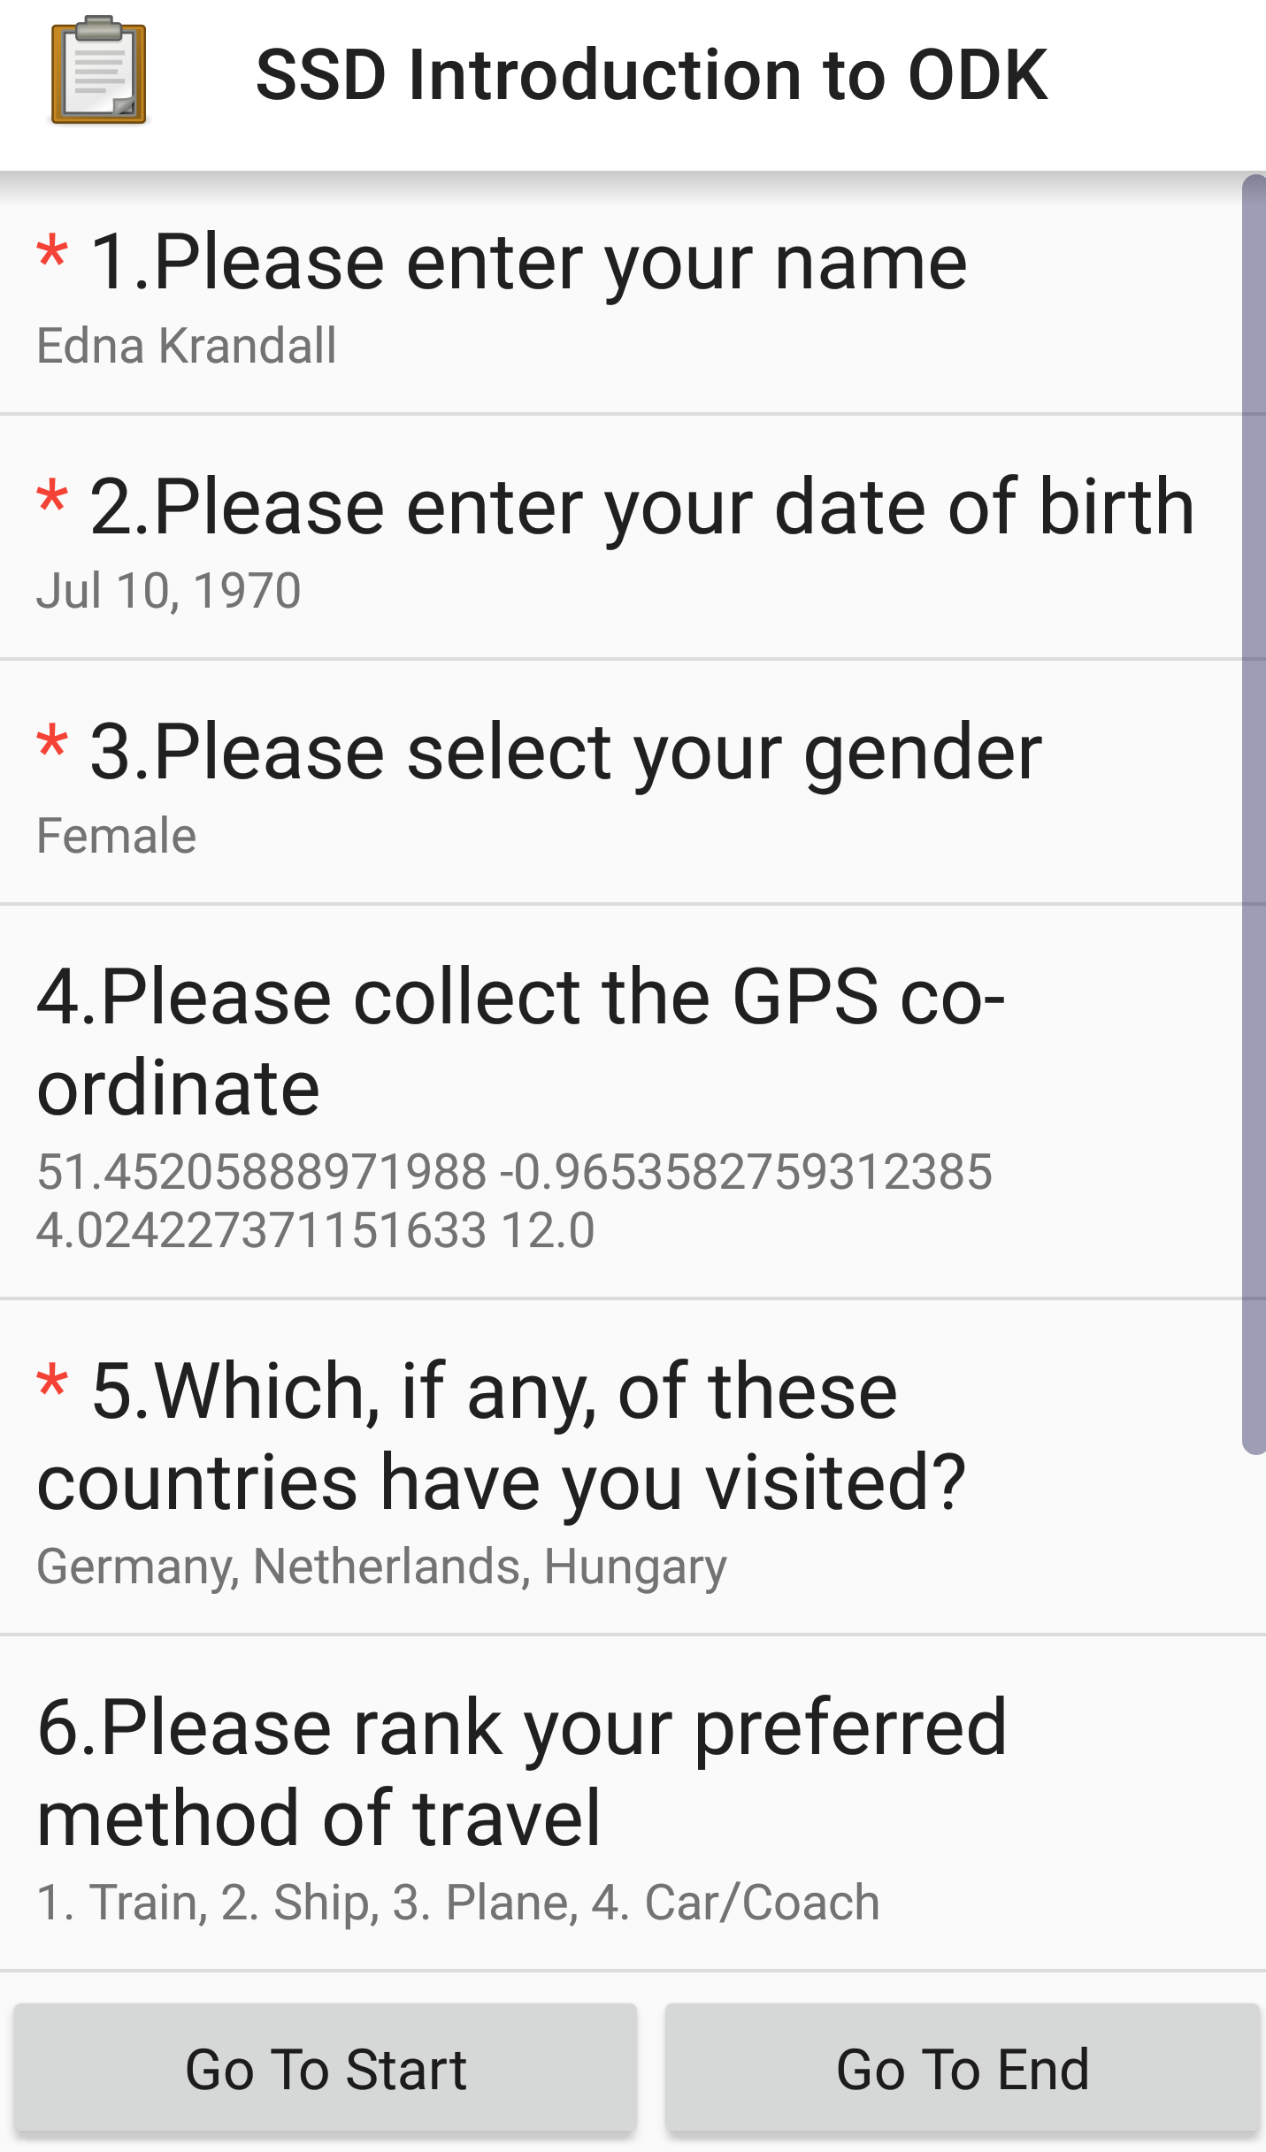
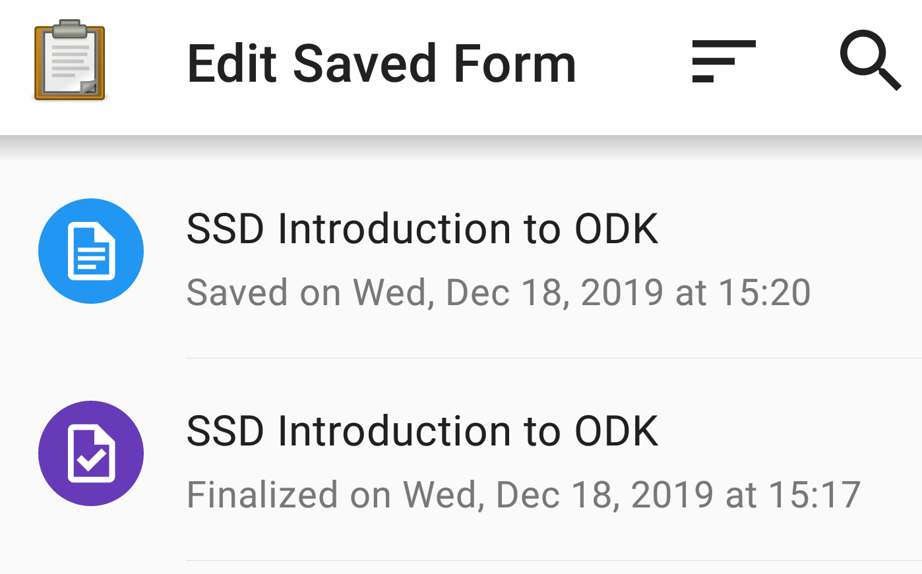
Saving and editing Forms
If you press on the form you would like to edit, you will be shown a condensed version of the form with all of the answers inputted underneath the question.
This makes it easier to navigate to exactly where you need to make an edit.
If you need to make an edit while completing the form, you will be presented with the same screen if you press the icon of an arrow pointing at a dot at the top of the screen. This is the “Go To Prompt” icon.
Notes:
If you click onto the form you wish to edit, you will be down a condensed version of the form with all of the answers inputted underneath the respective question. This makes it easier to navigate to where exactly you need to make an edit.
If you need to make an edit while you are completing the form, you will be presented with the same navigation pane if you press the icon of an arrow pointing at a dot which will appear within the bar located at the top of the screen when filling out a form. This is also known as the “Go to Prompt” icon. This is especially useful for questionnaires with lots of labelled question groups as it will show the groups first, making navigation even easier.

Slide 17
Uploading Saved Forms to the Server
Notes:
Now that we have completed some forms, we can move onto how your mobile device links back to the ODK aggregator by uploading saved forms back onto the server as data.

Slide 18
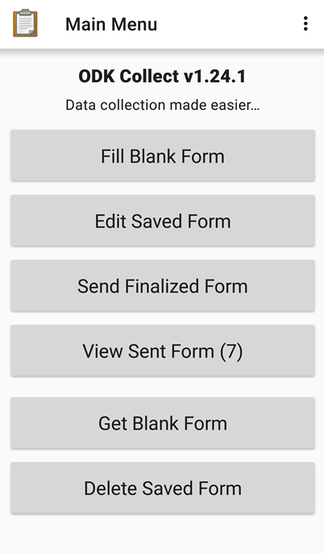
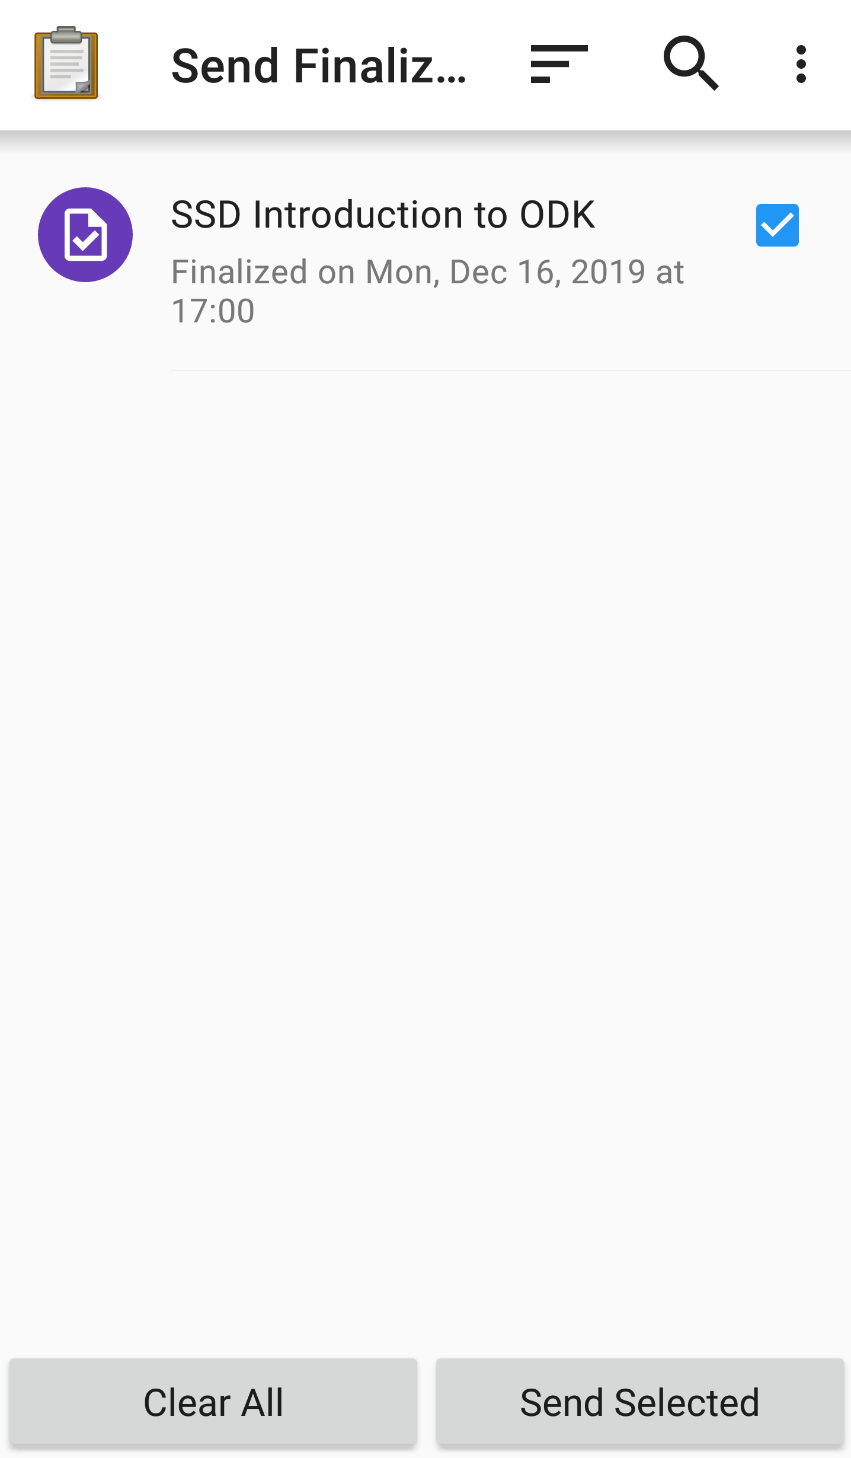
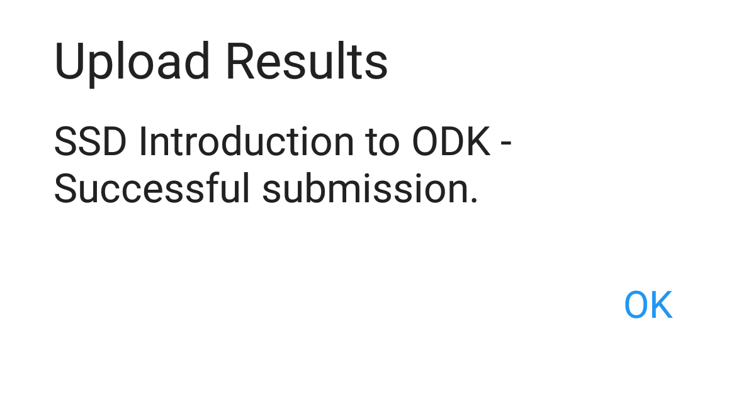
Uploading Saved Forms to the Server
You will once again need a wi-fi or network connection to the internet.
In order to upload your finalized form to the aggregator, you need to press onto “Send Finalized Form”. You will be shown each of the finalized forms on your device.
Check the boxes next to the form you want to upload and press “Send Selected”.
You will be shown the box below when you have successfully uploaded your form.
Notes:
As you did when we downloaded the blank form, you will once again need wither a wi-fi or network connection to the internet in order to do this process.
Once again heading back to the main menu page, you will need to press onto “Send Finalized Form” . Within this pane, you will be shown a list of every form saved onto your device which has been marked as finalized. As you did when downloading the form, you select the checkboxes next to the forms which you wish to upload. Finally simply press “Send Selected”.
Once you have successfully uploaded your form you will be presented with this message.

Slide 19
Summary
Download ODK Collect to an Android device
Configure the server using the URL, your username and your password
Download your form
Collect your data
You can save and edit forms at any point before finalizing
Upload your forms back to your server/aggregator

Slide 20
From the webinar series:
Introduction to ODK
Created and presented by Alex Thomson
CCRP – Research Methods Support project
May 2020

