Slide 1


Introduction to ODK
Part 5: ODK Aggregators
Creative Commons Attribution-ShareAlike 4.0 International
Notes:
Welcome to part 5 of this series of introductory video presentations on “An Introduction to Open Data Kit (ODK)”, a learning resource compiled by Statistics for Sustainable Development for researchers, students or anyone else who may be interested in learning the fundamentals of ODK and mobile data collection.
This part shall focus on using KoboTollbox as your ODK aggregator though many of the steps are similar if not the same in other Aggregators such as ONA. Particularly the steps involving ODK Collect will be the same regardless. This tutorial will be using the example XLSform discussed in the previous presentation. Though alternatively you can use your own account and XLSform along with this presentation. The decision is yours.

Slide 2
Contents
ODK Aggregators
Creating an account with Kobo
Uploading a form to Kobo
Settings

Slide 3




ODK Process Steps
Paper Survey
ODK Aggregator (ONA, Kobo, etc.)
Download the form to a mobile device for data collection
Upload the form to an ODK aggregator
Download your data to your computer in a .csv, .xlsx etc.
Upload your data to the aggregator
Move from paper to digital by creating an XLSform
Computer
Mobile Device
Notes:
We have already seen in the previous presentation how to move from your paper survey to a digital one by creating an XLSform. In today’s presentation I am going to explore the rest of this ODK system through the steps of uploading your form to an ODK aggregator, downloading the form to a mobile device for data collection, uploading your data to the aggregator, monitoring your data on the aggregator and finally downloading your data to your personal computer in a csv, xls etc.

Slide 4
ODK Aggregators
ODK Aggregators are the servers which will store your forms and data.
The usual process is that you upload your form and create a project, then:
  Download forms from this server to mobile devices for data collection;
  Upload your data to the server and monitor submissions;
  Download your data.
As mentioned in Part 1, there are a number of aggregators including Kobo, ONA and Formhub.
This part focuses on Kobo, but many of the principles are transferrable and most servers operate in similar ways.

Slide 5
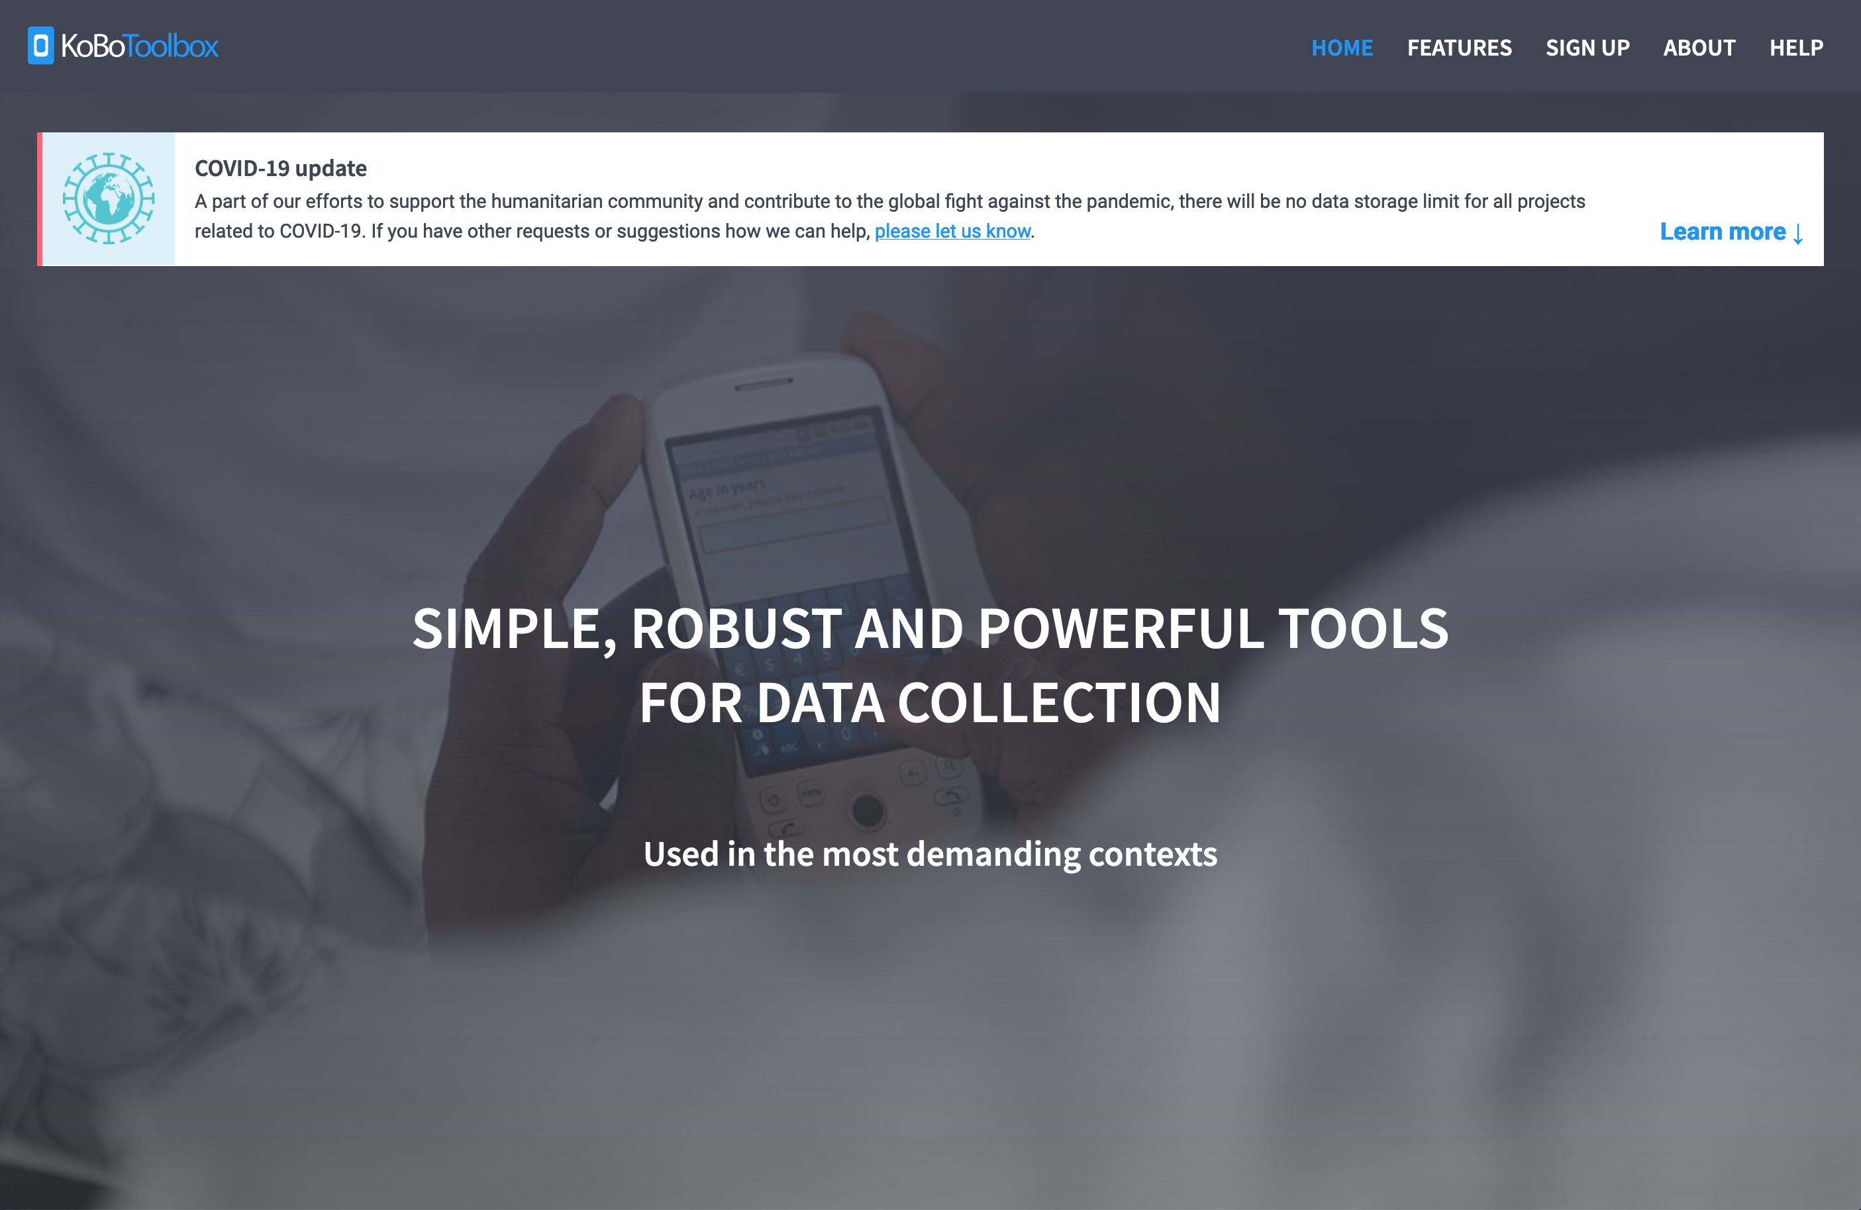
Creating an Account with Kobo
Visit https://kobotoolbox.org
Notes:
As previously mentioned, this set of videos will focus on the use of KoboToolbox as an ODK Aggregator. It can be found at kobotoolbox.org, if you scroll down the homepage until you see this get started section as shown in the picture on the left. It is advised you use the “Researchers, Aid Workers and Everyone Else” option since the other is reserved for members of humanitarian organisations and thus they receive unlimited usage.
You will want to create an account with your own unique username and secure password. Be sure to remember these as you will need these login details to be able to download your forms and upload data onto mobile devices into ODK collect at a later point. For the purpose of this tutorial, an example form and project has been created, you can either use this form and follow the steps to create your own project or you can use the username and password provided to download the form, collect data and download data from the server. This may help you get a better understanding of some of the data monitoring aspects of Kobo which we shall explore.
Username: ssdodkintro
Password: 5EtzQM5aDsxo

Slide 6
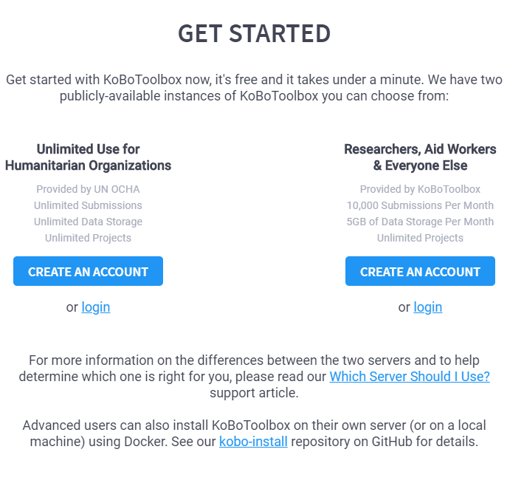
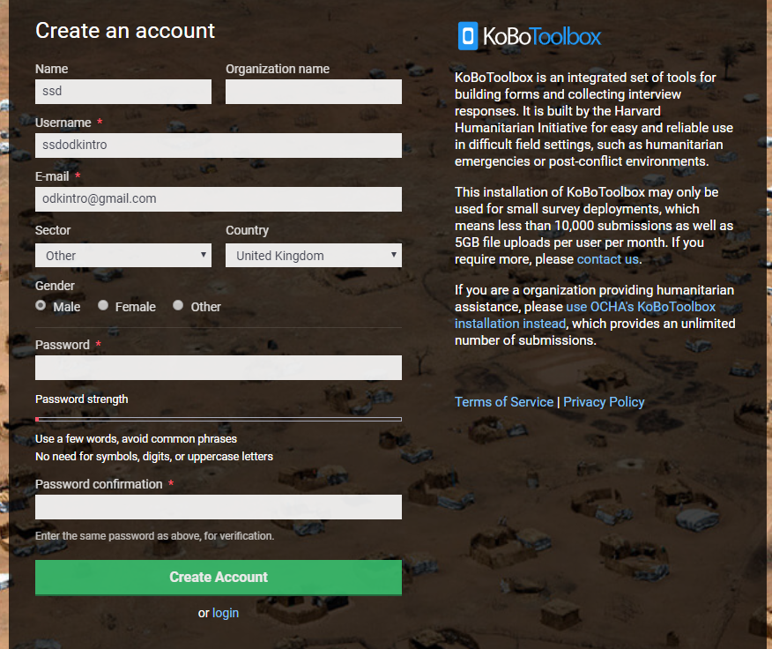
Creating an Account with Kobo
Visit https://kobotoolbox.org
Create Username
Create Password
Be sure to remember these as these are needed to connect to the server and download forms.
You can optionally provide information about your organisation and the sector in which you work.
Notes:
As previously mentioned, this set of videos will focus on the use of KoboToolbox as an ODK Aggregator. It can be found at kobotoolbox.org, if you scroll down the homepage until you see this get started section as shown in the picture on the left. It is advised you use the “Researchers, Aid Workers and Everyone Else” option since the other is reserved for members of humanitarian organisations and thus they receive unlimited usage.
You will want to create an account with your own unique username and secure password. Be sure to remember these as you will need these login details to be able to download your forms and upload data onto mobile devices into ODK collect at a later point. For the purpose of this tutorial, an example form and project has been created, you can either use this form and follow the steps to create your own project or you can use the username and password provided to download the form, collect data and download data from the server. This may help you get a better understanding of some of the data monitoring aspects of Kobo which we shall explore.
Username: ssdodkintro
Password: 5EtzQM5aDsxo

Slide 7
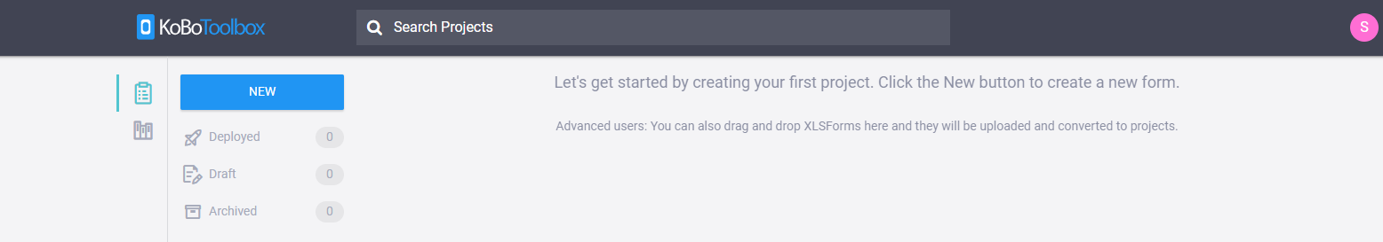
Uploading a Form to Kobo
Once you have activated your account, your first step will be to create a new project so you can upload your form and begin collecting data. The process for creating a project is very similar when using ONA.
First click on the “New” button shown below:
Notes:
Firstly, you will remember at the end of the first part of this series of presentations I showed how to and encouraged you to create your own account on KoboToolBox. You will first want to log back into this account after having replied to the activation email. Your first step within Kobo will be to create a new project to which you will upload your form and begin collecting data. You will need to click on the “NEW” button circled below in this screenshot.

Slide 8
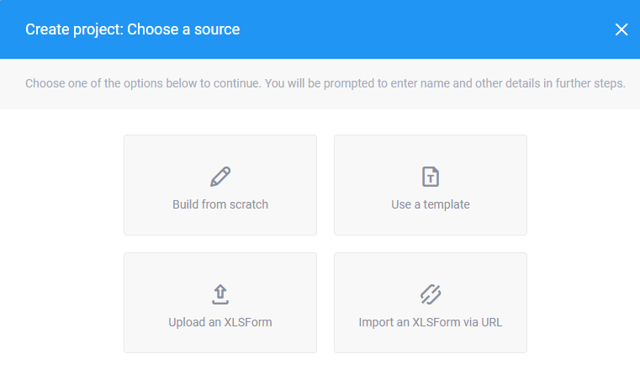
Uploading a Form to Kobo
You can first create your form in Excel and then upload it to Kobo by using the “Upload an XLSForm” link
Or you can use the dedicated “Form builder” tool
Alternatively, you can use a template form or upload your XLSForm via a URL
Make sure your form is saved as either an .xls or .xlsx spreadsheet if you are uploading the form.
The same tools are used in ONA.
Notes:
You will be immediately be presented with this pop-up window asking you how would you like to source the form for your project. If you have done as the previous presentation demonstrated, you can first create your form in excel and then upload it to kobo by pressing on the “Upload and XLSForm” link. Of course make sure your form is saved as either an .xls or .xlsx spreadsheet if you are uploading the form in this manner. You can also use Kobo’s dedicated “Form Builder” tool by pressing on “Build from scratch”. Alternatively you can use a template form provided by Kobo or upload and XLSForm via a URL link.

Slide 9
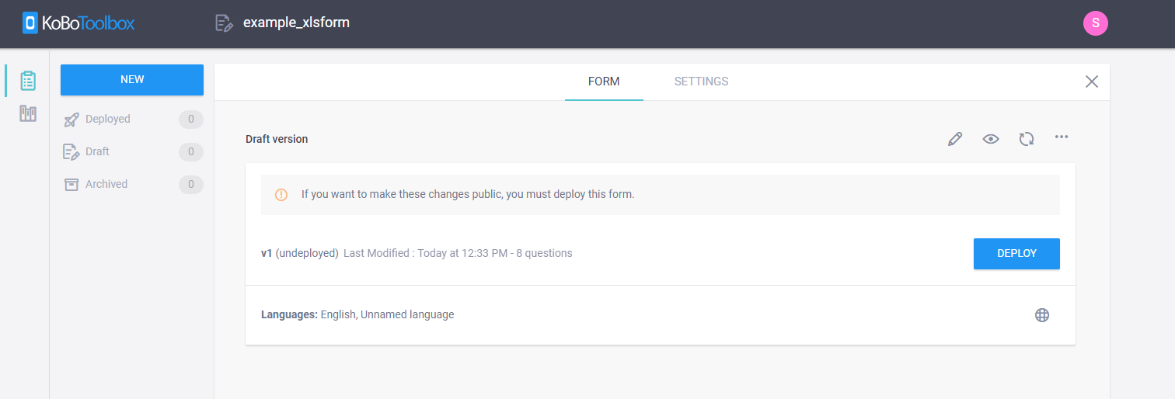
Uploading a Form to Kobo
Once you have uploaded your form, you can post it to the server it by pressing “Deploy”. Once you have done this, you can download your form to a mobile device.
If you are using other aggregators, some will deploy them automatically.
Notes:
Once you have uploaded your form you will need to post it to the server itself by pressing “Deploy” which will be found on the “Form” tab within your project. Once you have done this you can download your form to a mobile device. If you receive errors when trying to upload your form, this may be because there are errors in your form. Sometimes Kobo will be kind and explain exactly what these errors are. You can replace the form attached to the project at any time by clicking on the two circular arrows just to the top right. Once you have corrected your mistakes your form should be able to deploy without any problems.

Slide 10
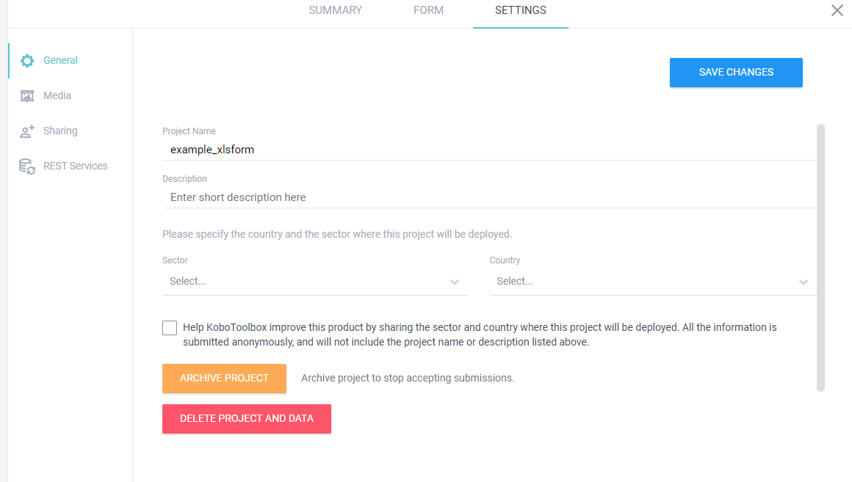
Uploading a form to Kobo
If you go onto the settings tab, you can use this to choose settings about submissions of data, replace the form or even delete your form.
Notes:
If you click onto the settings tab you can use this page to choose various settings in regards to your form and the wider project. For instance, you can choose settings about how users can submit data to your forms, can replace the form on the form tab, or even if need be deleting the form/project and archive it.

Slide 11
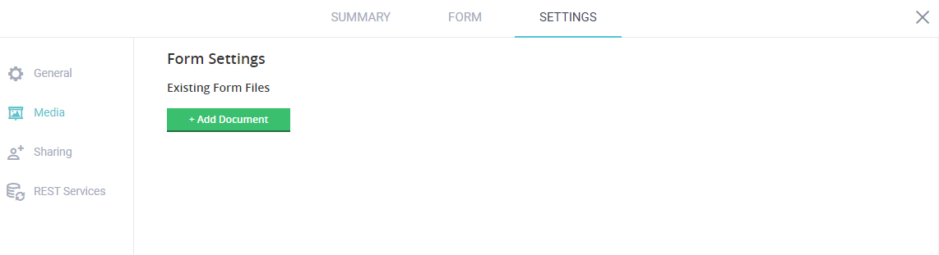
Uploading a form to Kobo
Here, you can also upload media files such as images, audio, videos or other data files which the form uses to pull data from. Other aggregators will allow for media uploads as well.
You may do this because you wish to include questions with media responses, such as selecting a picture or audio file rather than a text option.
Alternatively, you may require some data to be inputted from a separate file, e.g. for data validation or filling long choice lists.
Notes:
From this page you can also upload media files such as images, audio, videos or other data files which the form uses to pull data from. There are a few reasons way you may wish to include media files in your project. While I did not include this in the previous section on XLSforms you can actually use media files such as images, audio or videos as part of questions or notes. For example, you may need to ask the respondent about how big their normal portion sizes of a particular food are, this can be difficult to describe, therefore you instead partner the question with some images to demonstrate various portion sizes. Either this can be as a visual clue to a worded answer, or the picture itself can be used as the answer choice. In the example XLSForm partnered with this series of presentation I included a single select question which uses some images as answer choices.
Alternatively, you may require some data to be inputted from a separate .xls or .csv file. For instance, your form is actually a follow-up study therefore you already have data on everyone you wish to enumerate. You could pull in data from the previous round into your XLSform for data validation, reminders or if you have a initial identification screen which geos down lists of states, districts and villages – you can pull data from the other csv to actually autofill these option lists rather than manually listing every state, district, village and personal ID.

Slide 12
Summary
Choose the ODK Aggregator which suits your needs:
  Other options besides Kobo may be better equipped to your project
  For instance, ONA can host many more projects and more daily submissions (not free)
Upload your XLSform and create a project
  Keep all your forms, media files and data together
You will need your username and password for data collection

Slide 13
From the webinar series:
Introduction to ODK
Created and presented by Alex Thomson
CCRP – Research Methods Support project
May 2020

