Slide 1
Introduction to ODK
Part 4: XLSforms – Form Logic
Notes:
Welcome to part 4 of this series of introductory video presentations on “An Introduction to Open Data Kit (ODK)”, a learning resource compiled for Statistics for Sustainable Development for researchers, students or anyone else who may be interested in learning the fundamentals of ODK and mobile data collection.
This section shall focus entirely on understanding the structure and logic behind making XLSforms in Excel for use in your project. Exploring the coding of constraints and skip patterns as well as how to group and repeat questions. I will also finish off with a few key tips and reminders for you to follow when you start making your own forms. The examples shown in this video will all be part of an example survey form partnered with this presentation which you will be able to download and explore. You may also use said form as part of a practice project to help familiarise yourself with ODK, Kobo and mobile data collection. It is also the form which is attached the example project associated with this resource.

Slide 2
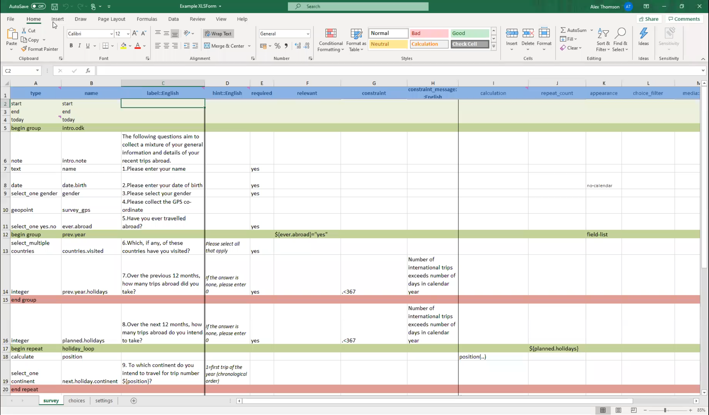
Example XLSForm
The example XLSForm used for demonstrations in this webinar series is available for download at:
https://stats4sd.org/resources/500
You can use it to explore and practice or follow along with these videos.

Slide 3
Contents
Constraints
Relevancies and Skip Patterns
Grouping questions
Repeating questions
Best practices
External Links

Slide 4
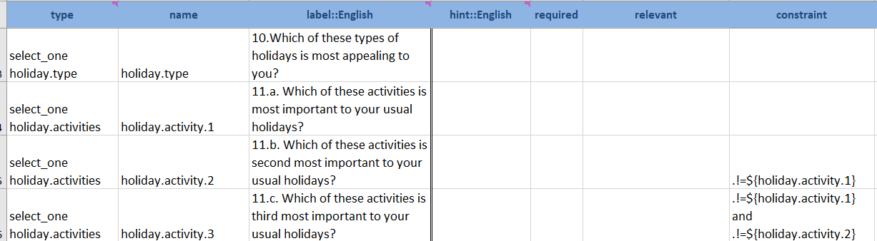
Constraints
Constraints are an easy way to make sure the data you collect is valid. E.g. age should not be above 120.
Constraints are written into the “constraint” column of the survey sheet.
In the example below, respondents are shown a list of 5 activities and asked what their 1st, 2nd and 3rd most important activities are to a holiday. However, we have set constraints to ensure no answer is selected multiple times.
You can also include messages in the “constraint_message:[language]” column explaining why a certain answer is not allowed.
.!=${holiday.activity.1} This means that .(holiday.activity.2) cannot be equal to holiday.activity.1
Notes:
Moving past question types now to some more complicated, but useful, form logic. Firstly let’s start with adding constraints to your form. These are an easy way to make sure that the data you collect is as valid as possible. For instance, you may ask a respondent for their age and therefore set a constraint that the inputted value should not be above 120 as this is a highly unlikely value and may be outside your target audience if you only intend to interview people of certain age groups. Essentially, they limit what constitutes an acceptable answer.
The formulae for a constraint is written into the “constraint” column of your survey sheet. In the example below the respondents are shown a list of 5 activities and then sequentially asked what their first, second and third most important activities are for enjoying their average holiday. However, in order to avid duplication we have made sure that it is not possible for the answer to 11.b to be the same as 11.a and that 11.c cannot be the same as 11.b and 11.a.
Not shown in the picture is that you can also add text to the constraint_message column which will appear when the constraint is broken so that you can explain to the enumerator why a certain answer is not allowed.
Remember that we use ${} around variable names when referring to them in our coding of the form. The ODK aggregator will not understand the constraint if this styling is not used. As in many statistical and coding software, we use != when we mean “not equal to”

Slide 5
Constraints
Operator: not equal to
Refers to the variable being created in the current row (in this case, holiday.activity.2)
.!=${holiday.activity.1}
Name of the variable we are referring to
Notes:
Moving past question types now to some more complicated, but useful, form logic. Firstly let’s start with adding constraints to your form. These are an easy way to make sure that the data you collect is as valid as possible. For instance, you may ask a respondent for their age and therefore set a constraint that the inputted value should not be above 120 as this is a highly unlikely value and may be outside your target audience if you only intend to interview people of certain age groups. Essentially, they limit what constitutes an acceptable answer.
The formulae for a constraint is written into the “constraint” column of your survey sheet. In the example below the respondents are shown a list of 5 activities and then sequentially asked what their first, second and third most important activities are for enjoying their average holiday. However, in order to avid duplication we have made sure that it is not possible for the answer to 11.b to be the same as 11.a and that 11.c cannot be the same as 11.b and 11.a.
Not shown in the picture is that you can also add text to the constraint_message column which will appear when the constraint is broken so that you can explain to the enumerator why a certain answer is not allowed.
Remember that we use ${} around variable names when referring to them in our coding of the form. The ODK aggregator will not understand the constraint if this styling is not used. As in many statistical and coding software, we use != when we mean “not equal to”

Slide 6
Constraints
.!=${holiday.activity.1}
This means that .holiday.activity.2 cannot be equal to holiday.activity.1
Notes:
Moving past question types now to some more complicated, but useful, form logic. Firstly let’s start with adding constraints to your form. These are an easy way to make sure that the data you collect is as valid as possible. For instance, you may ask a respondent for their age and therefore set a constraint that the inputted value should not be above 120 as this is a highly unlikely value and may be outside your target audience if you only intend to interview people of certain age groups. Essentially, they limit what constitutes an acceptable answer.
The formulae for a constraint is written into the “constraint” column of your survey sheet. In the example below the respondents are shown a list of 5 activities and then sequentially asked what their first, second and third most important activities are for enjoying their average holiday. However, in order to avid duplication we have made sure that it is not possible for the answer to 11.b to be the same as 11.a and that 11.c cannot be the same as 11.b and 11.a.
Not shown in the picture is that you can also add text to the constraint_message column which will appear when the constraint is broken so that you can explain to the enumerator why a certain answer is not allowed.
Remember that we use ${} around variable names when referring to them in our coding of the form. The ODK aggregator will not understand the constraint if this styling is not used. As in many statistical and coding software, we use != when we mean “not equal to”

Slide 7
Constraints
.!=${holiday.activity.1}
Used around variable names
This means that .holiday.activity.2 cannot be equal to holiday.activity.1
Notes:
Moving past question types now to some more complicated, but useful, form logic. Firstly let’s start with adding constraints to your form. These are an easy way to make sure that the data you collect is as valid as possible. For instance, you may ask a respondent for their age and therefore set a constraint that the inputted value should not be above 120 as this is a highly unlikely value and may be outside your target audience if you only intend to interview people of certain age groups. Essentially, they limit what constitutes an acceptable answer.
The formulae for a constraint is written into the “constraint” column of your survey sheet. In the example below the respondents are shown a list of 5 activities and then sequentially asked what their first, second and third most important activities are for enjoying their average holiday. However, in order to avid duplication we have made sure that it is not possible for the answer to 11.b to be the same as 11.a and that 11.c cannot be the same as 11.b and 11.a.
Not shown in the picture is that you can also add text to the constraint_message column which will appear when the constraint is broken so that you can explain to the enumerator why a certain answer is not allowed.
Remember that we use ${} around variable names when referring to them in our coding of the form. The ODK aggregator will not understand the constraint if this styling is not used. As in many statistical and coding software, we use != when we mean “not equal to”

Slide 8
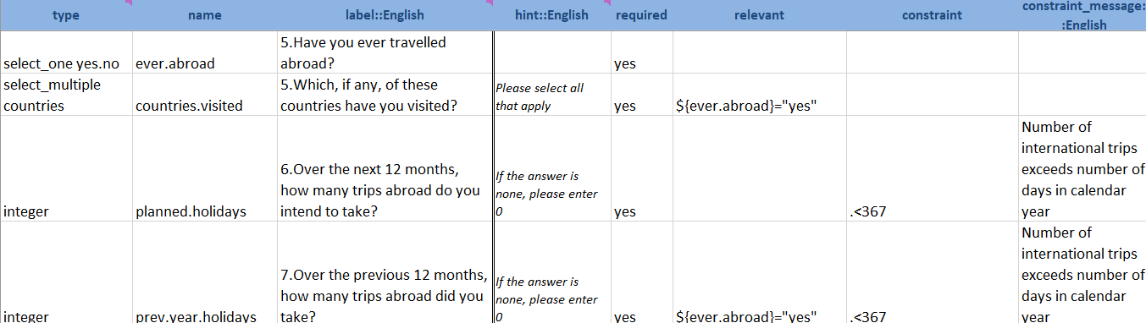
Relevancies and skip patterns
Relevancies are basically a handy way of including traditional skip patterns automatically into your form.
With the “relevant” column you can code in automatic skipping of questions based on answers to other questions.
In the example below, we ask which of a list of 10 countries has the respondent been to. But this question only appears if they answered “yes” to the previous question – “Have you ever travelled abroad?”
Notes:
Relevancies are another important part of form logic you will need to understand. They are basically a handy way of including traditional skip patterns automatically into your form. With a paper form skip patterns would be done manually and therefore easily open to human error. With the “relevant” column you can code in skip patterns which will occur automatically based on answers to other questions.
In the example below, we ask which of a list of 10 countries has the respondent been to. But naturally we would only want this question to appear to respondents who have definitely been abroad, other wise we know the answer is going to be none. Therefore, by writing ${ever.abroad}=“yes” we have coded it so that this question will only appear if they answer yes to the question “Have you ever travelled abroad?”. Therefore we avoid asking the question to someone for whom the question would not be relevant. In this picture you can also see an example of the constraint messages I mentioned on the previous slide, as if someone reports having more than 366 international trips in a year then a message will appear saying “Number of international trips exceeds number of days in calendar year”

Slide 9
Relevancies and skip patterns
Operator: equal to
Refers to the variable ever.abroad
${ever.abroad}=“yes”
The answer must be yes for this question to appear
Notes:
Relevancies are another important part of form logic you will need to understand. They are basically a handy way of including traditional skip patterns automatically into your form. With a paper form skip patterns would be done manually and therefore easily open to human error. With the “relevant” column you can code in skip patterns which will occur automatically based on answers to other questions.
In the example below, we ask which of a list of 10 countries has the respondent been to. But naturally we would only want this question to appear to respondents who have definitely been abroad, other wise we know the answer is going to be none. Therefore, by writing ${ever.abroad}=“yes” we have coded it so that this question will only appear if they answer yes to the question “Have you ever travelled abroad?”. Therefore we avoid asking the question to someone for whom the question would not be relevant. In this picture you can also see an example of the constraint messages I mentioned on the previous slide, as if someone reports having more than 366 international trips in a year then a message will appear saying “Number of international trips exceeds number of days in calendar year”

Slide 10
Grouping questions
You can also group questions together
This could be useful for a number of reasons including: grouping similar questions together (i.e. question modules), overall appearance or skip patterns.
You start a group with “begin group” in the type column (you do not have to include anything in the name or label column though it could be useful to do so).
You close the group by typing “end group” into the same column.
Notes:
A useful piece of logic to remember is the usefulness of being able to group questions together. This can be useful for many reasons, including ; grouping similar questions together as part of questionnaire modules – a pretty standard structuring format for any questionnaire. Also you can use them to benefit the overall appearance of your survey. For instance, you may wish to have a note explaining the purpose of a question which is read aloud to the respondent, a question and a note afterwards which only appears when certain answers are inputted. You can therefore group these all together and use the appearance column to make them all appear on the same page together, as I will show you in this slide. Or you can use them when many questions are skipped at once, or whole modules are only relevant to certain respondents; grouping of this type will ensure the entire group is skipped.
You start a group with a row which will include “begin group” in the type column. You do not have to include anything in the name or label column, but it is advised that you do so you can keep better track of how your form is structured and will aid in navigating your form on mobile devices. You will end the group by including a line saying “end group” after the last question in the grouping. It is possible for you to nest groups within other groups and there is not a limit on doing this, however it is best no to do this too many times so you can avoid a messy and complicated form structure.
In this example we have moved around some of the previously discussed questions shown on the previous slide, grouping two questions together. Specifically the question concerning which countries you have visited and how many trips one took in the previous two months. As both had the same relevancy of only being asked when the respondents has said they have previously been abroad, we have moved this relevancy code to the line with the “begin group”. Therefore, the whole group will now only appear when the condition is met. Additionally in the “begin group” line I have written “field-list”. What this does is tell ODK that every question within this grouping should appear on the same page on mobile devices.

Slide 11
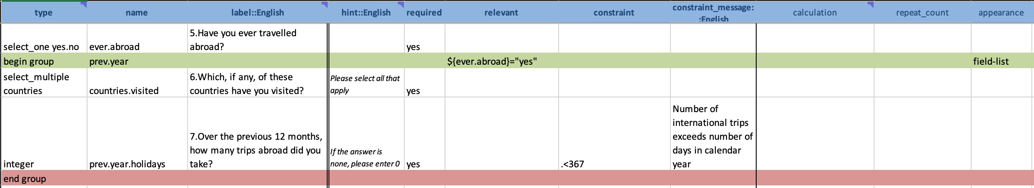
Grouping questions
In the example, we have moved around some of the questions shown on the previous slides, grouping two questions together.
We have also moved the relevancy to the “begin group” line. The whole group will only appear if the condition is met.
The “field-list” text in the “appearance” column means that all questions in the group will appear on the same page.
Notes:
A useful piece of logic to remember is the usefulness of being able to group questions together. This can be useful for many reasons, including ; grouping similar questions together as part of questionnaire modules – a pretty standard structuring format for any questionnaire. Also you can use them to benefit the overall appearance of your survey. For instance, you may wish to have a note explaining the purpose of a question which is read aloud to the respondent, a question and a note afterwards which only appears when certain answers are inputted. You can therefore group these all together and use the appearance column to make them all appear on the same page together, as I will show you in this slide. Or you can use them when many questions are skipped at once, or whole modules are only relevant to certain respondents; grouping of this type will ensure the entire group is skipped.
You start a group with a row which will include “begin group” in the type column. You do not have to include anything in the name or label column, but it is advised that you do so you can keep better track of how your form is structured and will aid in navigating your form on mobile devices. You will end the group by including a line saying “end group” after the last question in the grouping. It is possible for you to nest groups within other groups and there is not a limit on doing this, however it is best no to do this too many times so you can avoid a messy and complicated form structure.
In this example we have moved around some of the previously discussed questions shown on the previous slide, grouping two questions together. Specifically the question concerning which countries you have visited and how many trips one took in the previous two months. As both had the same relevancy of only being asked when the respondents has said they have previously been abroad, we have moved this relevancy code to the line with the “begin group”. Therefore, the whole group will now only appear when the condition is met. Additionally in the “begin group” line I have written “field-list”. What this does is tell ODK that every question within this grouping should appear on the same page on mobile devices.

Slide 12
Repeating Questions
As part of your survey, you may wish to repeat a question/group of questions a certain number of times. You can do this by nesting questions between a “begin repeat” and an “end repeat”
There are multiple ways to set how many times these repeat.
  You could have it fixed, say 3 times by typing 3 into the “repeat_count” column.
  Alternatively, you could set it dynamically to the value of another variable e.g. for every member of a household
    This is done by typing the name of the variable in the column instead (e.g. ${planned.holidays} – number of planned holidays in next 12 months).
Notes:
Similar to grouping questions, you can repeat questions. You may wish to repeat questions a given number of times. You can do this by nesting the questions between lines saying “begin repeat” and “end repeat”, very much like you do with other question grouping.
There are multiple ways you can set how many times you want questions to repeat. You could have it fixed say 3 times, by typing 3 into the “repeat_count” column. This is the most simple way to conduct a repeat but it is rare you will know beforehand how many times you want a section to repeat as more often than not you will want the questions to repeat depending on an answer to an integer question. For instance you may wish to ask a set of questions about every member of a household there fore you can set the “repeat_count” to match whatever the answer was to the question, “Besides yourself, how many people live in your household?”. This is done by typing the name of the variable in the column instead.
In the example below, we are asking which continent is the respondent travelling to for each of their trips over the next 12 months. The first 2 calculates included in this repeat group help us to dynamically input the trip number into the question label. In other words, when answering this group on a mobile device, it will show “trip number 1”, “trip number 2” etc. for however many trips the respondent stated they were going to take over the next 12 months.

Slide 13
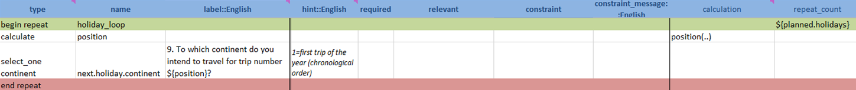
Repeating Questions
In the example below, we are asking which continent the respondent is travelling to for each of their trips over the next 12 months.
The first calculate helps us dynamically input the trip number into the question label; i.e. on the device, it will show “trip number 1”, “trip number 2” etc.
This repeat group will repeat based on how many times the respondent has said they plan to travel over the next 12 months, using the planned.holidays variable.
Notes:
Similar to grouping questions, you can repeat questions. You may wish to repeat questions a given number of times. You can do this by nesting the questions between lines saying “begin repeat” and “end repeat”, very much like you do with other question grouping.
There are multiple ways you can set how many times you want questions to repeat. You could have it fixed say 3 times, by typing 3 into the “repeat_count” column. This is the most simple way to conduct a repeat but it is rare you will know beforehand how many times you want a section to repeat as more often than not you will want the questions to repeat depending on an answer to an integer question. For instance you may wish to ask a set of questions about every member of a household there fore you can set the “repeat_count” to match whatever the answer was to the question, “Besides yourself, how many people live in your household?”. This is done by typing the name of the variable in the column instead.
In the example below, we are asking which continent is the respondent travelling to for each of their trips over the next 12 months. The first 2 calculates included in this repeat group help us to dynamically input the trip number into the question label. In other words, when answering this group on a mobile device, it will show “trip number 1”, “trip number 2” etc. for however many trips the respondent stated they were going to take over the next 12 months.

Slide 14
Best Practices and Key Reminders
Make good use of the constraint column; this will aid greatly in ensuring data quality and validity.
In the “required” column, you can type in “yes”, this means the question must be answered in order to proceed. This protects against missing data and you can add alternative codes/options for a non-response.
Limit the use of text fields; select questions are much better for data consistency and analysis.
Make sure your hints and labels are clear and easy to understand .
You can also use the appearance column to alter how questions appear. E.g. field-list will group a bunch of questions onto a single page rather than separating them.
Notes:
I am going to leave the basics of XLSforms there, though there are plenty more question types and more complicated things you can achieve with a more detailed understanding of form logic. For instance, I did not go over how you can even include some basic html formatting into labels and hints so that you can make things bold, italic, change colour, text size etc. And only briefly touched upon the many things you can do with the appearance column. This resource was meant as a general introduction and there are more resources linked at the end of the presentation for you to explore and learn from at your own leisure.
I am going to end this video presentation with a suggestions for best practices and some key reminders to remember when you begin creating your own XLSform for mobile data collection.
Firstly, be sure to make good use of the constraint column as this will be a great aid in helping you to ensure data quality and validity as you design your project. Therefore reducing the number of issues you will have when it comes to cleaning and analysing your data.
In the “required” column you can type in “yes” to make sure that a question must be answered in order to proceed, while it is best not become reliant on this as there may be genuine answers for which you were not prepared for and therefore the respondent literally cannot answer the question. However, you can use this to help protect against missing data, especially if as part of your answer choices you include possible missing codes for why a question does not have a certain answer. Therefore you could also incorporate missing data codes directly into your survey.
Limiting the use of text fields is always a good tip for improving the quality of your survey whether digital or not. Select questions are much better for data consistency and analysis, if you really want to include the option for writing in your own response you can include “ or_other” after the list name which means that an other- please specify option will be included in your question. Though this will create another or_other column in your final data which could also be cumbersome to analyse.
Make sure your hints and labels are easy and clear to understand, remember that we are still aiming to streamline the process of mobile data collection as much as possible.
Remember you can always use the appearance column to alter in certain ways hwo questions will appear such as making answer choices appear in a grid or a drop-down list. Or making all questions within a group appear on the same page

Slide 15
Best Practices and Key Reminders
REMEMBER: when referring to a variable in a constraint, calculation or relevancy, use the format ${name}.
Ensure the name you are using is the one in the name column; if your survey is being translated do NOT translate the variable name in instances such as these.
Use a . instead of ${name} when referring to a variable in its own constraint column (e.g. .>100).
REMEMBER: you cannot include any spaces in your “name” column
Colour your begin group and end group rows to easily keep track of your structure
Notes:
A big reminder is that when you want to refer to the value of a variable in a constraint, calculation, relevancy or even a label or hint, always use the format ${name}. Also when you are using them in labels or hints remember that while you would translate text in these columns when using multiple languages, the variable name within the brackets will remain in the language that it was originally written. In other words, regardless of language you will always write the text which is contained within the name column of the survey sheet.
Additionally, when you are referring to a variable in the same line as when you are creating it, use a period to represent this value. This would be used in the constraint column, rather than using the ${name} format you would use a full stop, for instance .>100 will say the answer must be more than 100. This is the only case where you do not use the standard variable name referencing I have discussed.
Remember that you cannot include any spaces in your “name” column.
And finally a general tip to help you more easily keep track of the flow and structure of your form as you are writing it, is to colour code your begin and end group/repeats so you can easily see where each begins and ends. Especially as your form will only work if every group which has been opened has been subsequently closed.

Slide 16
Other Resources
Improve your ODK forms in 6 easy steps: Blog by Dave Mills, Stats4SD
  https://stats4sd.org/blog/44
Example XLSforms
  https://stats4sd.org/resources/296
XLSform template
  https://stats4sd.org/resources/297
Extra guidance
  http://xlsform.org/en/
Notes:
I have attached a few extra resources with some extra guidelines, tips and example XLSforms in these links here including a blog by my colleague Dave Mills who wrote up 6 easy steps for improving your ODK form. Thank you for listening, in the final part of these presentations I will explore how to upload your form to the sever, how to configure ODK collect on your device, how to collect data and how to monitor and download data from the server.

Slide 17
From the webinar series:
Introduction to ODK
Created and presented by Alex Thomson
CCRP – Research Methods Support project
May 2020

