Slide 1


Introduction to ODK
Part 3: XLSforms – Question types
Creative Commons Attribution-ShareAlike 4.0 International
Notes:
Welcome to part 3 of this series of introductory video presentations on “An Introduction to Open Data Kit (ODK)”, a learning resource compiled for Statistics for Sustainable Development for researchers, students or anyone else who may be interested in learning the fundamentals of ODK and mobile data collection.
Exploring many of the different question types and how to code them. The examples shown in this video will all be part of an example survey form partnered with this presentation which you will be able to download and explore. You may also use said form as part of a practice project to help familiarise yourself with ODK, Kobo and mobile data collection. It is also the form which is attached the example project associated with this resource.

Slide 2
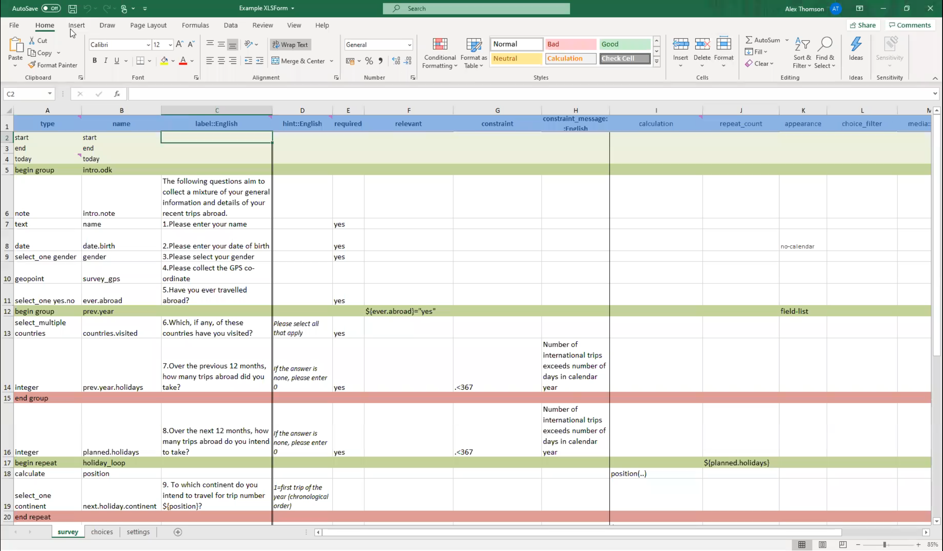
Example XLSForm
The example XLSForm used for demonstrations in this webinar series is available for download at:
https://stats4sd.org/resources/500
You can use it to explore and practice or follow along with these videos.

Slide 3
Contents
Question types
  Multiple and Single Select
  Text
  Integer/Decimal
  Other
  Metadata
  Calculate

Slide 4
Writing questions - Types
Question type | Answer input | Example question
integer | Integer (whole number) | How old are you? (in completed years)
decimal | Decimal input | How tall are you? (in meters)
text | A free text field | What is your name?
select_one [list_name] | Select one answer from a range of answer choices | What is your sex? [male, female, other]
select_multiple [list_name] | Select multiple answers from a range of answer choices | Do you own any of the following? pick all that apply [television, mobile device, personal computer, tablet, e-reader]
note | This displays a note to the data collector, does not require any form of input | The informed consent note prior to the beginning of the survey
geopoint | Take a single GPS coordinate | Take a GPS reading of the location of data collection
date | Input a date | Please enter your birth date
time | Input a time | Please enter a rough time you usually begin working in the day
Image | Take a picture with the devices camera or upload an image file | Please take a photo of the data collection area
calculate | Carries out an internal calculation which is not displayed to the user | Multiple integer questions about the costs of resources then adding them up for a total.
trigger/acknowledge | Displays a note which can be acknowledged with an “OK” to continue | Question --- has been left blank, if this was intentional please press OK to continue
Notes:
Of course, the key part to any survey form is the questions themselves and there are lots of different question types one can have in an XLSform.
On this slide I have put together a few of the most key question types and the ones you are most likely to need for any project you undertake using ODK.
Firstly are the simple integer or decimal question types, both require a numeric input, but the difference is that integer only takes whole numbers while decimal will accept any real number, i.e. a decimal. These could capture information such as a person’s age or height.
The “text” question type will accept any text as an input, for instance asking someone’s name or for any post-interview comments. These are best used under certain circumstances and are generally best to avoid when possible by turning the question into a multiple-choice input.
Select_one and select_multiple work are the two key variants of a multiple choice question. With select_one the user will only pick one from a range of options such as asking someone for their gender, while with a select_multiple, the user can select many different answers. For instance you could ask someone to select all items an individual owns from a predefined list of options.
A note is not a question as such, it does not require any form of input. It is usually displayed as a note to the enumerator either for their benefit or as something that should be read aloud to the respondent of the survey. For instance his could be used to display the informed consent note which should be read to the respondent prior to the beginning of a survey.
Geopoints can be quite useful depending on the needs of your project, if collecting agricultural data you could use them to capture the exact location of a respondent's farm or their individual plots. They can be additionally useful for data monitoring by ensuring that the locations of data collections are happening where you would expect them to.
Date- Date questions are relatively simple, requiring a date to be inputted. Such as someone’s birthdate or a date crops were sowed onto a given plot of a farm.
Similarly time questions accept a time as an input – such as the usual time a farmer begins work on their land on a given day.
Image questions will allow the enumerator to take a picture with their mobile devices camera or upload a picture form their devices’ storage, thereby using images as a form of data collection. For instance you could take pictures of crops to assess their health/growth at a set time interval.
Calculates are one of the most useful question types you can employ, they are not questions as such as they do not display anything on the screen but will run a formula provided to the survey sheet in the background. This is essentially an internal calculation which is not displayed to the user. This type is quite flexible with what calculations one can carry out; I shall link a webpage which details many of the different operators one can use in calculate fields at the end of the presentation as there are far too many name here. An example would be you could have a section that asks for the costs of various farming resources and then include a calculate which sums up these values for a total. As such these are also quite useful for calculating variables you would have otherwise created in statistical software at the point o data cleaning or analysis, therefore they can be a big-time saver if used effectively.
Finally, tigger/acknowledge are similar to notes in that they only display text to the user and do not require any detailed input. The difference being is that these notes are generally acknowledged by pressing okay in order to continue. These could be used to check that a question has been intentionally left blank or to flag a seemingly unusual data entry without outright refusing it.

Slide 5
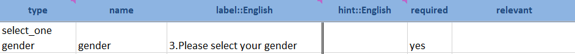
Writing questions - Single and Multiple Select
A select question is perhaps one of the most common question types you will need to become familiar with when creating your XLSform.
Under the “type column” you would write select_one/select_multiple and then the “list_name” from the choices sheet for the answer options you wish to show.
Then you will give this question a name and a label, the label will be the text which appears on the form. These three are mandatory but you can set additional constraints or relevancies as needed.
Notes:
For the next few slides I am going to demonstrate how to write many of the various question types I just explained. Starting with one of the most common question types, multiple choice questions in the form of both single_selects and multiple_selects.
You will definitely need to familiarise yourself with logic behind these kinds of questions to create an effective XLSform.
Firstly, under the “type” column you would write either select_one or select_multiple (be sure to remember the underscore) and then the list_name from the choices sheet for the answer options you wish to show with this question, also remember to put a space between these two parts.
You would then give this question a variable name and type in the text you would want to appear on the screen for the user, remember to give a label for each language you wish to conduct your survey in as languages are not automated. Of course these are the only 3 mandatory inputs, but you could set additional constraints, skip patterns or adjust the appearance of the question. We will come back to each of these later in the presentation.

Slide 6
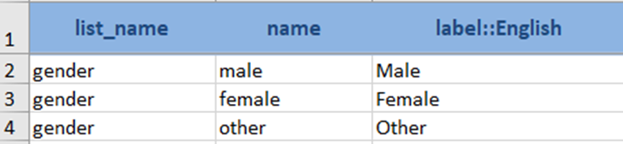
Writing questions - Single and Multiple Select
On the choices sheet, you will create a row for each of your answer choices
Use the name you wrote in the survey sheet as your “list_name”
Write in some variable names for each of these options (there should be no spaces (can have . or _)
Under “label::[language]” write in the label for the answer choice which will appear on the form
Notes:
Of course there is more to be done with multiple choice questions as you also need to list the answer choices you wish to be associated with the question. On the choices sheet you will create a row for each potential answer choice. In the list_name column you will write the name you wrote into the type column for this question, in the example we wrote select_one gender therefore our list_name here on the choices sheet would be “gender”. In the name column we give a unique name for each of the potential answer choices, remember one row per answer choice. Under the label column you will write in the text you would want to appear on screen when the user is answering the survey.
Just like with the label on the survey sheet, there must be a column for each language you use in your survey.

Slide 7
Writing questions - Text
Text questions are another common question type, though it is recommended not to use too many of them in one survey as select questions are much more optimized for data management and analysis.
You do not need to do anything with the choices sheet; simply write in “text”, your variable name and your question label in the respective columns
For instance, in the example below, we have created a question asking the respondent for their name:
Notes:
Another common question type was text inputs, though it is not recommended to use these too often in one survey as select questions are much ore optimised for data management an analysis. Simply text fields can easily have too many variations of the same answer, this could even be due to slight spelling mistakes or some users using capital letters where others have not despite typing the same word. Therefore, cleaning data from text questions can be extremely tedious, there it is best to avoid them when possible.
If you are to include one however, say to ask someone’s name or for any comments about how the interview went, then you do not need to do anything with the choices sheet. Rather you just write text into the type column nd give your question a name and label. This is definitely one of the more simple question types to code.

Slide 8
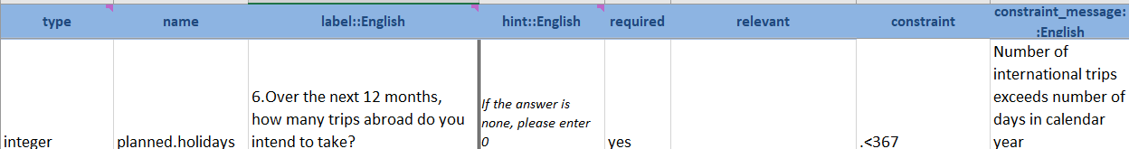
Writing questions - Integer vs. Decimal
Integer and decimal questions are very similar, the main difference being integer questions only accept a whole number as its input while decimal will allow for decimal numbers such as 1.2. Be sure to use the one which is most appropriate for the data you are trying to collect.
The example above shows an integer question. You write name and label much like you would any other question.
We have also provided a hint to the enumerator that they should write 0 rather than leaving the question blank if the answer is none.
We have also added a constraint and a constraint message; we have restricted the input to only be less than 367 so that one cannot say they are taking more trips than there are days in the year. We will come back to these in more detail.
Notes:
As previously mentioned, integer and decimal questions, the only difference being that integer questions will only accept a whole number while decimal will accept any real number including those with decimals. It is best to be sure to choose the one which is most appropriate for the data you are trying to collect and wish to analyse/report.
In the example shown, I have created an integer question. In the type column I would write integer, and write a label much like you would for any other question.
We have also provided a hint to the enumerator which will appear on screen below the label instructing them to type in a 0 is the answer is none. I have also added a constraint and associated constraint message, restricting any answer to this question to be less than 367 so that nobody can state they are taking more trips abroad than there are days in the year as this seems quite unrealistic. As such we can use constraints to ensure good data quality and validity.

Slide 9
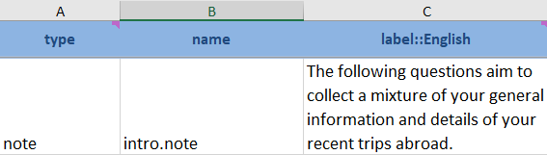

Other question types
You can use notes to display text to the data collector, such as notes and instructions to the respondent, but which do not require any form of input.
You can also ask for dates using the “date” question type. In the example below, we ask the respondent for their date of birth. Note the use of “no-calendar” in the appearance column; this controls how the user inputs the answer. In this case, the device will not show a calendar format but in a month/day/year list to select from.
Notes:
I have shown you some of the key question types but there are plenty more not discussed or demonstrated in this presentation so please feel free to explore ODK further. Here I am just going over another 2 useful question types you may wish to include in your survey. As previously mentioned, notes are a useful way to display a chunk of test to a user or data collector such as instructions or statements that should be read aloud to the survey respondent. These do not require any input, though you can set skip patterns or relevancies to them as well if you want them to only display under certain conditions. For these you only need to give them a name and label or hint and write “note” into the type column.
You can also ask for date inputs by using the “date” type. For instance, you could ask people for their birth date or a recent example form my own work has been asking for the date they sowed a plot. This can be quite a useful type of question to play around with the appearance column as you can use this to alter how it is inputted, including restricting it to only needing a month and year data and not need a specific day. For instance, the no-calendar option included this example means that on mobile devices a list of month/day/year options will appear rather than a standard calendar widget.

Slide 10
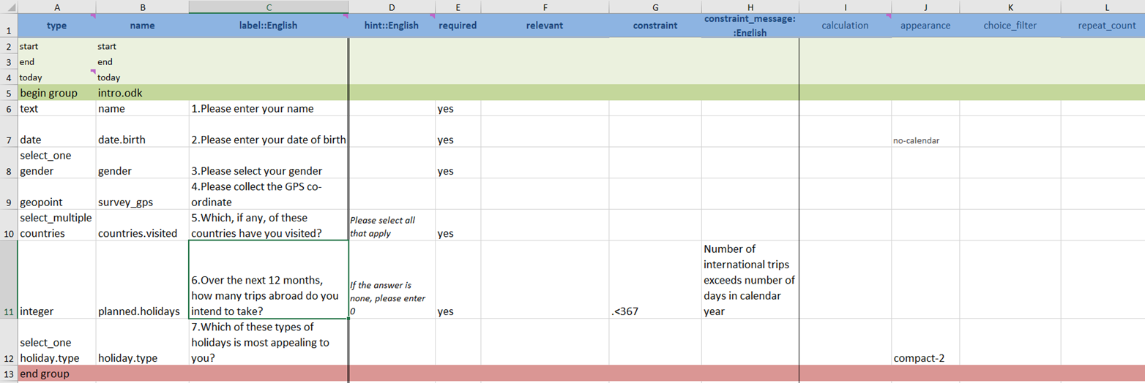
Metadata
There are many more metadata questions which can be collected:
Metadata type | Meaning
deviceid | IMEI (International Mobile Equipment Identity)
subscriberid | IMSI (International Mobile Subscriber Identity)
simserial | SIM serial number.
phonenumber | Phone number
username | Username configured
email | Email address configured
audit | Log enumerator behavior during data entry
A number of additional internal question types exist for the purposes of gathering metadata about the data collection process such as the start time, end time and the date. (as shown in the example above)
It is generally good practice that these be put at the start or end of your form and grouped together. These are not displayed but collected automatically and do not need a label.
Notes:
There are a number of internal question types that exist for the purposes of gathering metadata about the data collection process such as the start time, end time, and the date as shown in the example below. These can be useful for data monitoring and may be useful to include when presenting the results of data analysis, depending on the metadata which is collected. There are a few metadata options which are automatically collected by ODK including the submission time but these options you can explicitly ask for in your XLSform.
It is generally good practice to group these together at the start or end of your form, these are not displayed and are automatically collected internally. As such they do not require a label, only a type and name. There are many more additional metadata types including deviceid, phone numbers, usernames, emails and you can even audit enumerator behaviour though this creates many complicated variables so auditing will be useful only in very certain circumstances, mainly when the analysis of metadata is primary to one’s objectives.

Slide 11
Calculate
Calculate are an extremely useful and versatile question type you can use within your forms.
Could be used for multiple purposes
  Calculate variables for the analysis stage
    Save incredible amounts of time and effort in the post data collection stage, can recode variables/create new ones where possible
    Of course some variables are best coded afterwards in response to the data itself so do not overuse calculate
  Calculate variables for internal use
    Names & numbers to be referred to in text
    Statistics/Numbers to be double checked e.g. totals
    To simplify a constraint/skip pattern
Notes:
Lastly, a very useful question type is the “calculate” field. They are very versatile and can be used for many purposes within your forms. The idea behind a calculate is that you can calculate new variables internally within your form without directly asking the user for the information.
There are many reasons why you may wish to do this. Firstly you could use this tool in order to create variables that are required in the latter stages of your project including analysis. In other words, if you know there is a variable you would want for the purpose of analysis, for example a unit conversion, a total or some average, then you could directly calculate this internally within your form. This could save incredible amounts of time and effort in the post data collections stage by recoding or creating new variables at the time of data collection.
Although you do not want to use this for every possible variable as some simply cannot be done at this point such as variables which are dependent on more than one person's observation or a simplified recoding of open text variables.
You could also use calculations for internal use. You could dynamically generate names or numbers which are referred to in text, for example you can capture a users answer choices to a single or multiple select using a calculate and then ask secondary questions about these choices all while ensuring the answer choice is included in the text of the question as a helpful reminder to ensure the question is more understandable. Similarly you could ask users to double check your aforementioned unit conversions or totals to make sure they believe this to be accurate. Finally, you could use them to simplify how you write your constraints or skip patterns. For example if there is a group of questions which should only be asked to employed women of reproductive age with at least 2 children under the age of 5, well rather than using lots of “ands”, “or” ,“ifs” to try and capture this information within your constraint, you could create a calculate question which uses previous questions to determine if the user is indeed in this category. If they are, then this variable is equal to 1 and if not, it equals 0. You can then use this calculated variable as part of your constraint instead.

Slide 12
Calculate – Operators/Functions
You would write “calculate” into the type column and then write your formula into the calculation column (e.g. ${v1} + ${v2}). There are many operators and functions you can use:
Operators
  Maths (+, -, *, div)
  Comparison ( =, != (not equal to), >, >=, <, <=)
  Boolean (and, or)
Functions
  Accessing response values (selected, selected-at, count-selected, jr:choice-name)
  Repeated groups (sum, count, max, min)
  Strings (starts-with, ends-with, contains, substr (substring), concat)
  Maths (round, pow (power), log, log10, etc.)
Notes:
A calculate works slightly different to other question types we have seen here today as it works internally. Therefore it does not require a label, similar to the metadata I showed you before. However it does need a name like any other question in the “name” column. Other than this, you would write “calculate” into they type column. Crucially, when you have a calculate in your form, then another column basically becomes mandatory as a calculate will not do anything without the “calculation” column. In this column your write the formula which defines your variable. For example if you were just wanting to add two variables together then you could just write variable1 + variable2 into the column.
There are many operators and functions you can use, far too many to detail here so I shall just list off a few key ones which are either fairly self explanatory or ones I advise you to explore depending on the needs of your project.
Firstly we have some basic Maths operators including addition, subtraction, multiplication and division.
Some comparison operators including equal, not equal to, greater than, greater than or equal to, less than and less than or equal to.
Boolean operators for “and” as well as “or”
We also have some more specific ODK functions;
For instance there are functions specific for accessing response values to single and multiple selects including selected – which can tell you if a certain choice has been selected, selected-at – which will return the nth selected answer for a multiple choice question, count-selected – will tell you how many options have been selected from a multiple choice question and jr:choice-name – which returns the label of a selected answer rather than its name.
There are some for dealing with questions in repeat groups as well, for instance sum, count, max and min will work with numerical questions which are repeated. For instance max will return the maximum from the answers to a numerical question which is with a repeated group of questions.
There are a number of functions for dealing with strings such as starts-with, ends-with, contains, substring and concat.
And finally there are some further Maths functions including rounding, powers, log functions and other scaling tools.

Slide 13
Summary
Many different question types you can use
  Single and multiple select
  Define your answers in the choices sheet
Decimal and integer
Text questions
  Best to limit their use
Many, many more – date, note etc.
Metadata can be useful for data monitoring
Calculates are highly flexible and useful
  Try not to complicate them too far beyond your own skills and limits

Slide 14
From the webinar series:
Introduction to ODK
Created and presented by Alex Thomson
CCRP – Research Methods Support project
May 2020

