Slide 1


Introduction to ODK
Part 2: XLSForms – Form Structure
Creative Commons Attribution-ShareAlike 4.0 International
Notes:
Welcome to part 2 of this series of introductory video presentations on “An Introduction to Open Data Kit (ODK)”, a learning resource compiled for Statistics for Sustainable Development for researchers, students or anyone else who may be interested in learning the fundamentals of ODK and mobile data collection.
This presentation shall introduce the concept of XLSforms and cover the basics of their content and structure. The examples shown in this video will all be part of an example survey form partnered with this presentation which you will be able to download and explore. You may also use this form as part of a practice project to help familiarise yourself with ODK and mobile data collection. It is also the form which is attached the example project associated with this resource.

Slide 2
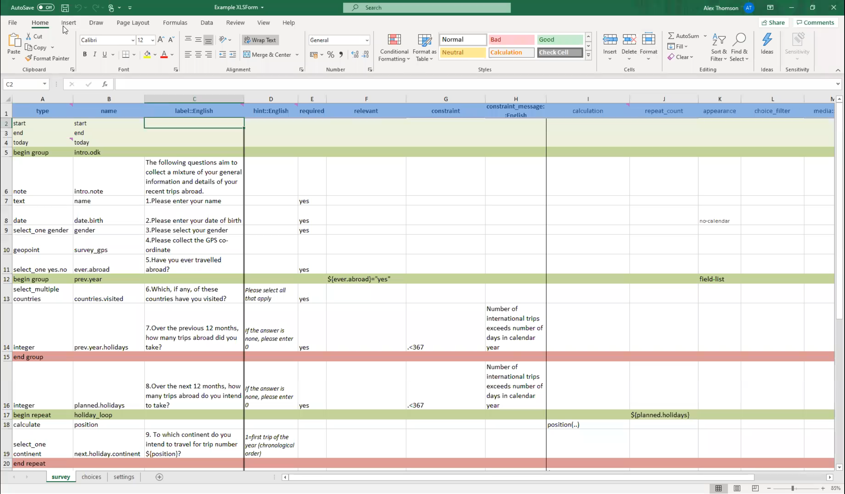
Example XLSForm
The example XLSForm used for demonstrations in this webinar series is available for download at:
https://stats4sd.org/resources/500
You can use it to explore and practice or follow along with these videos.

Slide 3
Contents
What is an XLSform?
Contents & Structure
  Survey sheet
  Choices Sheet
  Settings Sheet

Slide 4
What is an XLSForm?
XLSforms help with the transition from paper to digital surveys and are fundamental to developing your skills in ODK (Open Data Kit)
An XLSform is a standard form structure created to simplify the creation of digital forms in Excel
They provide a practical standard which is simple to get started with, especially as they are created with a simple and accessible tool – Excel
The more you learn about the standard structure and syntax, the easier it is to create complex forms for your data collection
These are the forms which will be uploaded online when you create a project on Kobo/Ona etc. for the purposes of mobile data collection. These services will convert these into another format so they can be used for data collection on electronic devices, so long as your form fits with the standard structure.
Notes:
Before diving into what can sometimes be a complex topic it is best to first explain what exactly an Xlsform is.
Xlsforms are the first big step in helping to transition form paper to digital surveys are essential to developing one’s sills in ODK.
It is essentially a standard form structure designed to simplify the creation of digital forms in Microsoft Excel. They provide a practical standard which is simple to get started with, especially given they are created using a simple and accessible tool in the form of Excel.
The more you are able to learn about the standard structure and syntax, the easier it will become to create more and more complex forms for your project. The big steppingstone will be familiarising yourself to the fundamentals of xslforms in order to build a foundation from which you can develop your skills.
Xlsforms can be uploaded online when you create a project in Kobo/Ona etc for the purposes of data collection, these servers will automatically convert these into another format which is compatible with other sites and data collection apps on mobile devices. This will only work so long as your form fits with the standard structure and does not contain mistakes. There is a site linked at the end of this video to which you can upload your from to check that it is at least syntactically correct.

Slide 5
XLSform Contents
Your XLSform must meet certain structural requirements to function.
There are two sheets that your Excel workbook must include:
  The Survey Sheet – This will contain the bulk of the content including all your questions and information about how they appear
  The Choices Sheet – This lists all answer choices for any multiple-choice questions
These are mandatory and must be included otherwise your form will not work
There is a third optional sheet
  The Settings Sheet – while not mandatory, it would be good practice to use this option. This sheet adds additional specifications such as default languages, form names, versions, form id and encryption options.
Notes:
So what is the contents and structure of and xlsform.
As alluded to, there are certain structural requirements any XLSform must meet in order to function. Firstly there are two sheets that your Excel workbook must contain.
The survey sheet which will contain the majority of your forms content, this essentially where you build up the flow and contents of your questionnaire. It will show all your questions, how they appear, all your groupings and any constraints or skip patterns.
The choices sheet meanwhile will list all your answer choices for any multiple-choice questions in your form.
These two sheets are absolutely mandatory and must be included otherwise your form will simply not work.
There is also a third optional sheet, which while not required, it would be good practice to familiarise yourself with how this sheet works and to include it onto any form you construct. This sheet will add additional specifications such as default languages, form names, version id, form ids and even encryption options.

Slide 6
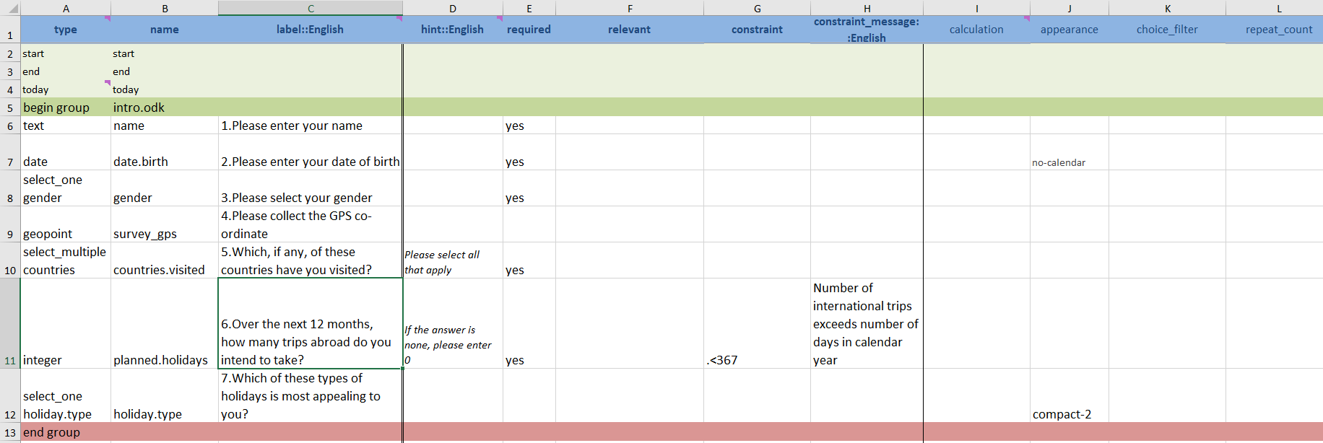
Survey Sheet
The survey sheet is where the bulk of the form is constructed and will contain most of the form’s content. It will also dictate the overall structure of the form. It will have the full list of questions, as well as any additional notes to the data collector, and will have information about how they appear.
Notes:
Firstly, let’s begin with the Survey Sheet. As mentioned, this is where the bulk of the form is constructed and will contain most of the forms content. The picture shown here is how a basic 7 question form could look in Excel.
This sheet will contain the full list of questions including any additional notes to the data collector and will have information about how they appear.

Slide 7
Survey Sheet
Column | Meaning
Type (Mandatory) | The type of question/input e.g. select_one, integer, date, select_multiple, note, trigger
Name (Mandatory) | This is the name you wish to give to this input (No Spaces)
Label::[language] (Mandatory) | The main text which will appear on the screen for this question/note, you name the language (English, Spanish etc.) you want the survey to appear in and write your text in this language. Translations are not automated. You can have multiple of these columns, one for each language.
Hint::[language] | Some sub-text for the question, usually some notes to the data collector
Required | Simple column defining whether or not this question has to be answered
Relevant | This is where you set criteria that must be met in order for the question/group/note that must be satisfied in order for it to appear
Constraint | This is where you can set what answers are acceptable for a given question, e.g. if you are asking for a distance, ensuring you can’t input a negative number
Constraint_message::[language] | The message that appears when the set constraints are not met
Calculation | This is for when you are making a calculate field, it will contain a formula. Such as adding two previously inputted variables to get a total.
Appearance | A column for setting how questions/groups of questions appear. E.g. minimal on a select_one will show the choices as a drop-down list
Notes:
There are a number of columns your survey sheet can contain, the first 3 of which in this table are mandatory and therefore must be included. The relevancy of the rest depend on what additional requirements your questionnaire has, how you wish to structure it and any customisation options you wish to employ.
Type- this column classifies what type of question/input this row is, it could be a select one, integer, date entry, a calculation etc. We will come back to the different types of questions shortly.
Name – This contains the name which you are giving to your input, this cannot contain spaces or special characters. It is best advised to stick with numbers, letters, periods and underscores.
Label::[Language]: this is the main text will appear on the screen for the question/note. It is worth noting that you should be naming the language in this column e.g. Label::Englsh, Label::Spanish. You will need to write the text you are wanting to appear in the correct language as translations are not done automatically at any point in the ODK system. They have to be done manually. You can have multiple languages in your form, in which case you will need a column for each individual language you want to use.
Hint::[Language}: this will contain any subtext you wish to go along with questions. They can be used for any purpose technically, though they are most commonly used for providing instructions to data collectors such as “Do not read the options aloud, allow the respondent to think of an answer and attempt to match it to one of the options shown if possible)
Required- A simple column of yes or no telling the form whether or not this question must be answered, a blank cell is assumed to be a no as default.
Relevant: You can use this column to code in ay skip patterns by telling the form under what circumstances should this question appear, such as not allowing a question about how many children under 18 someone in their 90s has.
Constraint: You can use this column to set what constitutes an acceptable answer for any given question such as not allowing a negative number when asking for a distance.
Constraint_message::[language]: working similarity to hints and labels in terms of languages, this column contains a message that would appear whenever an inputted answer violates the terms of the constraint you have set.
Calculation: One of the types of inputs you can create is a calculate, which is an internal calculation which does not appear on a users screen. This column is where you write the formula for this calculation, such as adding two other variable together in order to get a total.
Finally, the appearance column, this where you can set how questions/groups of questions will appear on a mobile device. Such as minimal on a select_one which will show the answer choices as a drop-down list.

Slide 8
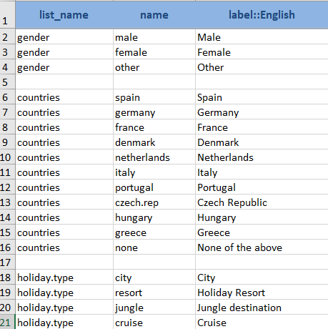
Choices Sheet
The choices sheet is where you define your answer choices for any multiple-choice questions.
It contains 3 mandatory columns:
  list_name: this is a name you use for this list of choices and will be used in the survey sheet with your question (i.e. select_one gender)
  name: the unique variable name for that answer choice
  label::[language]: the label used for the answer choice which will be shown in the form.
  Each row represents an answer choice and those with the same list name are considered part of a set of choices. They can be reused for more than one question
Notes:
The Choices sheet is where you define your answer choices for any multiple choice questions.
As with the Survey sheet, it will contain 3 mandatory columns, list_name – this is the name you use for this particular list of answer choices and will correspond with the one used on the survey sheet with the question. For example if you have a question asking for gender, you may have a list of options called gender, in which case on the survey sheet your “type” column would read select_one gender.
The name column, is the basic unique variable name that you give for each specific answer choice. Like with the “name” column on the survey sheet, this cannot contain any spaces.
The label::[language] columns will work the same way they do on the survey sheet in that this is the text which will appear on screen when you are collecting data and you will need a separate column for each language you are collecting data in.
Each row represents and answer choice and those with the same list name are considered to be part of a set of choices, they can be reused for more than one question, so you do not have to create separate lists for each question. If they require the same answer choices, then it only needs to be made once.

Slide 9
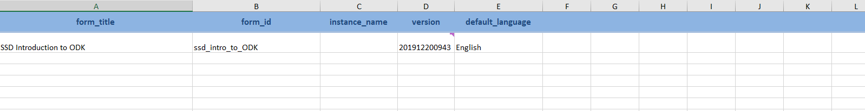
Settings Sheet
The settings sheet is technically optional, though making use of it would be good practice. This contains some general settings about your form such as its title, id, version, a submission URL. If some of these are left blank or the sheet is missing, then some of the information is pulled from the .xls file itself.
If you are carrying out your survey in multiple languages, you can use “default_language” to set which language would appear as the default. (Can ONLY pick from the languages which are used in the survey and choices sheets; it is not auto-translated)
Notes:
Finally the settings sheet, which though optional would be good practice to utilise. This will contain some of the general settings about your form such as its title, id, version, a submission url etc. if some of these are left blank or the sheet is missing entirely then some of the information is puled directly from the excel file itself.
If you are carrying out your survey in multiple languages then you can also use this tab to set which one would appear as the default, but of course you can only pick from the languages which are used in the survey and choices sheets as it is not auto-translated.

Slide 10
Summary
An XLSform is a standard form structure created to simplify the creation of digital forms in Excel
The Survey sheet is used to create the majority of the structure and content of your digital form (mandatory)
The choices sheet is used to fill in all your multiple-choice question options (mandatory)
The settings sheet is used to define many of the settings about your form including the default language

Slide 11
From the webinar series:
Introduction to ODK
Created and presented by Alex Thomson
CCRP – Research Methods Support project
May 2020

