Slide 1
Organising online meetings
Review of lessons learnt, best practices and suggestions
Sam Dumble
May 2020

Slide 2
Organising online meetings
Objectives
Planning framework
Specific tips, tricks and suggestions
Resources

Slide 3
Objectives
The aim of this document is to provide a consolidation of lessons we have learnt about conducting online meetings from our own experiences and from reviewing other resources.
(For the purpose of this document – “online meetings” refers to any meeting of three or more people in an audio/video format. Including webinars, meetings, discussions).
Key messages:
Prepare for the meeting well in advance
Ad-hoc meetings are likely to fail to meet objectives, waste a lot of time, and make people less likely to attend in the future.
2. Adapt the style of the meeting to the relevant audience & purpose.
There is not a ‘magic bullet’ for an amazing meeting. We need options by context!

Slide 4
Acknowledgments
Content compiled from various online sources, see final section, and input from various members of the CCRP Research Methods team:
Ric Coe
Carlos Barahona
Nuru Kipato
Shiphar Mulumbu
Nicolas Greliche
Alex Riba-Civil
Dave Mills
Jane Poole

Slide 5
Organising online meetings
Objectives
Planning framework
Specific tips, tricks and suggestions
Resources

Slide 6
Planning framework
Planning is vital to any successful meeting, online or in person.
However, there are many additional components of this to consider when producing an online meeting than a face-to-face meeting.
I have structured a planning ‘framework’ into 6 components
1. WHY?
Aims and objectives
2. WHO?
Target audience; roles and responsibilities
3. WHEN?
Sensible scheduling
4. HOW?
Facilitation and technology
5. WHAT?
Content
6. WHAT NEXT?
Follow-up

Slide 7
WHY… are you planning an online meeting?
What are your specific goals and objectives for the activity you are working on?
Make sure that the meeting is designed around achieving these objectives. Make sure these objectives are well communicated in invitations, and the meeting introduction.
Are you sure that you need an online meeting to meet these objectives?
  Would this be better served over email?
  Or one-on-one conversation(s)?
  Or a resource document/video?
If no: stop planning the meeting. Ask someone for advice!

Slide 8
WHO… is the meeting for?(1)
Link back to your objective when considering invitations. Communicate the purpose very clearly when inviting people to attend.
Consider why they would want/need to join your meeting, not just why you want them to attend your meeting.
You want the right people to attend, not necessarily as many people as possible. Larger groups are more difficult to manage, and can also prevent the ‘right’ people from speaking freely.
Identify the people who you think would be vital for a successful meeting. This could be due to their situation, knowledge or experience; either what they have that they can contribute to the meeting or what they lack which they can gain from the meeting.

Slide 9
WHO… is the meeting for?(2)
As the level of interaction planned for the meeting increases the number of participants should decrease (and vice versa). Up to a certain threshold anyway.
Unless there is a very good reason, do not publicly advertise the meeting as open-to-all; this opens up a whole new range of potential problems and considerations. Specifically target the potential attendees. Even within organisation – targeted invitations are more likely to yield attendance than a blanket email.

Slide 10
WHO… is doing what?
Who you would like to present something at the meeting? (see: What?)
Who is responsible for contact lists & emailing the invitations?
Who is hosting/facilitating the meeting? (see: How?)
Who is taking notes?
Who is responsible for recording/sharing/editing the video?
If the answer to all of these questions is ‘me’ you are probably doing it wrong.
Spreading roles around the team, will:
increase engagement in the meeting
make things run smoother
reduce your own burden
If someone has a specific task or purpose in the meeting, they are
more likely to attend the meeting
more likely to contribute (1)
(1) https://books.google.co.uk/books?id=KwXFDwAAQBAJ&pg=PT48&lpg=PT48

Slide 11

WHEN… is the meeting?
Respect time zones and working hours as far as possible.
Check for conflicting events or holidays in all working countries
Identify the ‘essential’ attendees, and set a time convenient to them. Trying to find a time for all possible attendees may be impossible.
If a recurring meeting or series, keep to a consistent schedule.
Unless there is a major oversight, do not reschedule after sending an invitation. This will confuse and annoy people.
2.30pm on a Tuesday…??? (2)
(2) https://qz.com/work/653033/heres-the-best-day-and-time-to-hold-a-meeting/

Slide 12
WHEN… should I be planning the meeting?
Task | When? (AT THE VERY LATEST)
Identifying roles, discussing content & plans, and scheduling a convenient time | -3 weeks
Send invitations over email | -2 weeks
Check progress of content with presenters | -1 week
Check in again with presenters; be aware of any non-standard tech requirements they might have | -48 hours
Send invitation reminder over email | -24 hours
Deadline for presenters to send copy of content | -24 hours
Ensure computer doesn’t need updates, check audio/video quality. Try to create a quiet environment | -1 hour
Facilitators & presenters join pre-meeting to confirm format | -5 minutes
Start meeting! | 0
Begin meeting follow-up | +1 hour

Slide 13
WHEN… should I be planning the meeting?
This is not meant as a prescriptive list
But the principle of working out the timetable, and the tasks needed, and the responsibilities, should be done as the first step in the planning process to ensure good preparation
See the appendices of: https://stats4sd.org/resources/476

Slide 14
How… is the meeting operated?
Pick a platform and stick with it.
  As a team we gain familiarity
  The people we regularly interact with also gain familiarity.
As of today – as a team we use Zoom. We should stick to this, until:
  We have clear evidence of a different platform having significantly better features that we would need or want
  The platform becomes too expensive/unreliable/non-usable in some way
Other teams will make other choices (Teams; Google; Skype; etc). This is also fine.

Slide 15
How… should the facilitation work? (1)
Make sure everyone knows their role
Consider a pre-meeting between the presenter and the facilitator. This can be done over email, but ideally by joining the meeting 5 minutes early and checking audio/video/presentations.
Time management
Ensure all presenters know the amount of time available for their presentation. Send a private message when they have 2 minutes remaining. Cut them off verbally if they exceed the time by more than 2 minutes.
Monitor timing during discussion times in relation to the agenda

Slide 16
How… should the facilitation work? (2)
React quickly to problems
If there are audio/video problems from the presenter, the facilitator should be the first to react and notify the presenter of the problem
Deal with tech problems in private conversations
This is unlikely to be relevant in the public chat/conversation. Redirect to a private conversation

Slide 17
How… should the facilitation work? (3)
Question management
Encourage participation from as many different people as possible – not just the loudest/most senior.
Consider ‘pre-allocating’ who will ask questions – ensures that ‘quieter’ people are engaged in the content, and gives them time to think without putting them on the spot
Set clearly the mechanism for how to ask questions. There are lots of ways of doing this – in smaller groups ‘jumping in’ will be fine; in medium groups using ‘hand raise’ will work well. In large groups it may be better to ask participants to write questions somewhere and then the facilitator can chose which to address.

Slide 18
How… should the facilitation work? (4)
Crowd control
Mute microphones of participants during presentations. Inform presenters if there is excessive background noise, or interference.
Mutually agree whether video is on or off
  If video on – everyone should put video on. This can help in discussions; a large part of effective communication is in body language.
  If video off – everyone should turn video off. In larger groups, or during presentations, or under limited bandwidth, video will be too much of a distraction.
Say NO
If questions are very niche or off-topic then re-direct these questions to email follow-ups or side meetings
Similarly if conversation strays too far from the topic at hand, the facilitator should re-direct
Welcome attendees
Do not launch in to the content of the meeting immediately; people will need time to join and connect and may be running late. Rather than silence, or discussion about waiting, try to encourage informal discussion and introduce people who may not know each other, or be aware of who else is connected under what screen name.

Slide 19
How… should the facilitation work? (5)
Dynamics
Choice of facilitator is very important to create good dynamics within the meeting. It should ideally be someone:
Fully aware of the meeting contents and structure
With good knowledge of the topic discussed
With good knowledge of all the participants, and their backgrounds
Able to have enough confidence & authority to be respected
Not intimidating to the audience
Able to find the balance between letting conversations flow; and winding down for time
Able to spark conversations, if they are lacking
This is a difficult job!
Some people will be much better suited than others
But – involving the facilitator early in the process will help
Gaining experience as a facilitator in ‘smaller’ meetings before graduating to ‘bigger’ meetings will also help.
In larger groups – split this role into two. One person as “host” (for the person management) and one person as “facilitator” (for the tech management). See “Who?” for further reasons why this is a good idea.

Slide 20
How… should I act as a participant?
Etiquette as a participant is also important. As far as possible:
Mute your microphone if you are not speaking
Set up in the place where you can best maintain a quiet environment with minimal noise or interference
Check audio and video quality. If it is not good enough invest in better equipment
  Always use headsets rather than relying on the internal microphones
Follow the rules set by the facilitator particularly regarding: being called on to speak, use of video & timing
Get to the point. Try to make contributions and questions as clear and concise as possible, so that they can be well understood.

Slide 21
What… should I present? (1)
Keep content as simply presented as possible
Minimise unnecessary clutter on screen or distracting animations
Don’t constantly switch between slides/windows/videos
Break content into chunks.
‘Listening’ should ideally be no more than 10-15 minutes. Break this with discussions, exercises, changes of presenter.
Could be as simple as just asking for input in the chat; but participants will need time to absorb and process the information for themselves. That cant be achieved from a 2 hour monologue.
Well designed interactive elements (e.g. using Shiny, or Mentimeter, or any other online tool) will help. Badly designed ones will cause unwanted distractions. Test any interactive elements, with at least one other person, before using them for real

Slide 22
What… should I present? (2)
If there are assumptions/pre-requisites then ensure that these are explicitly mentioned in the invitation to the meeting
Include links to videos, resources, articles etc. in the invitation
Adapt the content to the knowledge of the participants – if you think the pre-requisites for participating in the meeting are too high either:
Trim the participant list
Modify the content
Begin the session with an explicit overview of the agenda; and the amount of time that you plan to allocate to each task. Even if this is included in the invitation, a recap at this point is useful.

Slide 23
What… should I present? (3)
(Returning to the “WHY”)
Online lectures are not an especially good teaching mechanism
If conducting a training – use meeting times for discussions and questions.
Provide materials and exercises for participants, and consider creating videos.
If part of a series – we want to keep things so that participants don’t get lost from missing a session; and we want resources which are re-usable. So the more content produced permanently rather than in a meeting, the better.

Slide 24
What next… after the meeting?
Make sure the meeting ends with clear action points
Email these action points immediately after the meeting has finished along with any slides, and links to resources or sites mentioned in the meeting. Send this to all attendees
Also include a feedback form (if desired) in this immediate email – tell people at the end of the meeting that you will be sending a feedback form
If there is a series of meetings, confirm the timing and draft agenda of the next meeting
Send meeting notes, video (if applicable) within 2 days of the meeting concluding. Send this to all invitees, not just those who attended.

Slide 25
Organising online meetings
Objectives
Planning framework
Specific tips, tricks and suggestions
Resources

Slide 26
Note for all of these tricks
Keep it simple.
Test these tips out yourself before using them for real.
Some of them you may find incredibly helpful.
Some may be confusing and make things actively worse.
Different people may come to different conclusions about the same thing!

Slide 27
Useful Zoom features
Remote control
Allows you to give control of your screen to someone else.
Particularly useful in meetings with multiple presenters – slides can be run from one computer but controlled by the individual presenters.
https://support.zoom.us/hc/en-us/articles/201362673-Request-or-Give-Remote-Control

Slide 28
Useful Zoom features
Breakout rooms
Allows you to split the group into sub-meetings. Equivalent to working in “small groups” in a face-to-face meeting.
https://support.zoom.us/hc/en-us/articles/206476093-Getting-Started-with-Breakout-Rooms

Slide 29
Interactive tools
Mentimeter – has a bunch of online tools for voting, polling, gathering feedback. Limited uses are free.
https://www.mentimeter.com/
Tricider – a very simple interface for gaining comments or questions and allowing people to comment and vote
https://www.tricider.com/
In meetings with lots of participants, consider something like this for Q&A. First come first served may not always be easy to manage; and questions in chat will zoom past very fast and could be hard to isolate.

Slide 30
Timing
When mapping out timing – make sure to allow time for Q&A and for transition between different presenters.
It is much better for the meeting to be shorter than expected rather than longer – so be generous with time allocation, and consider cutting content/agenda items if your hypothetical timings are too excessive (> 2 hours).
Refer back to WHY? – which of these points being dropped could be addressed in a different format?

Slide 31
Sneaky tricks
Never start the meeting on time!
People will be connecting from multiple locations, and may be delayed from the previous meeting over-running.
Plan to start at 3-5 minutes past the scheduled start time.
Use the 3-5 minutes as an “icebreaker” for casual conversations and introductions. This way everyone can see who is online. Especially useful if there are people who do not know each other.
Past 5 minutes – do not wait any longer. Start the meeting regardless of who is not there. Otherwise you are wasting everyone's time.

Slide 32
Sneaky tricks
If in a small group – consider working with interactive documents if ‘work’ needs to be done in the meeting.
Google documents are very well suited to this, can have multiple editors at the same time and discuss the edits being made.
But realistically in a group of more than 3-4 this will stop being useful.

Slide 33
Organising online meetings
Objectives
Planning framework
Specific tips, tricks and suggestions
Resources

Slide 34

Webinar Best Practices
Webinar Best Practices A SUMMARY OF EXISTING RECOMMENDATIONS”.
https://stats4sd.org/resources/476
Really comprehensive document from a Canadian NGO. The Appendices are especially useful – a checklists what to prepare and when for (i) the organiser/facilitator and (ii) the presenter.

Slide 35
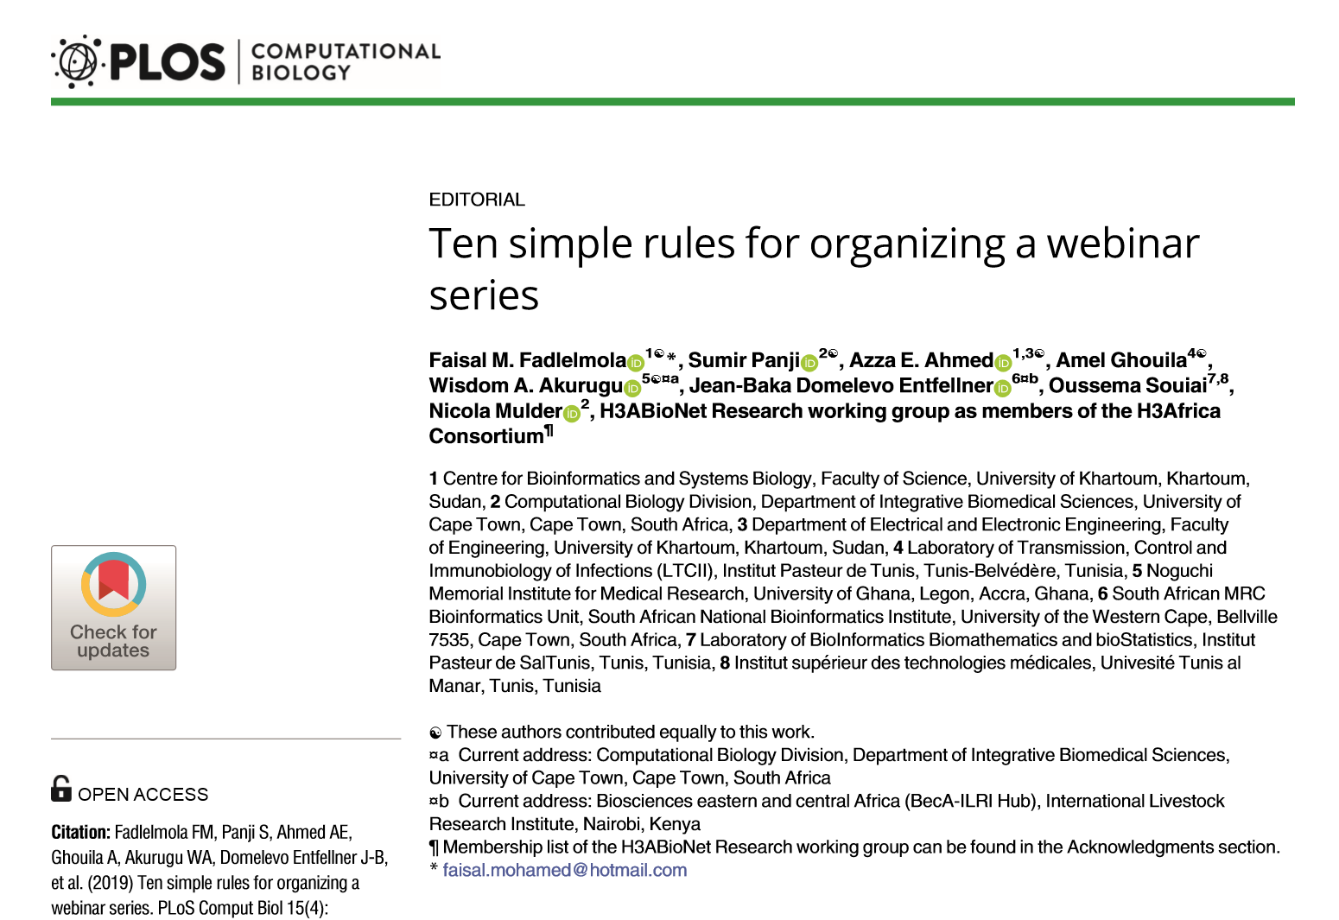
Ten Simple Rules…
Ten simple rules for organizing a webinar series
https://stats4sd.org/resources/475
Journal article, focused on running webinars within Africa. Lots of useful suggestions, and general guidance.

Slide 36
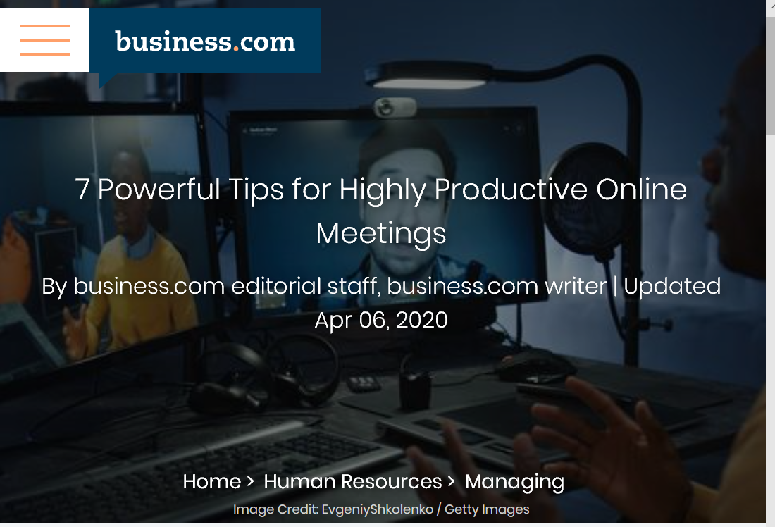
7 Powerful Tips…
7 Powerful Tips for Highly Productive Online Meetings
https://www.business.com/articles/7-powerful-tips-for-highly-productive-online-meetings/
Well-structured, common sense advice for meetings. Both as a participant in a meeting, and as an organiser.

Slide 37

Delivering effective Virtual Presentations
Delivering Effective Virtual Presentations
https://books.google.co.uk/books?id=KwXFDwAAQBAJ
E-book covering various aspects – particularly on presentation styles.
The chapter on facilitation is available as a free preview. The cost of the book is not excessive for a full copy.

Slide 38

Evaluation of Evidence-Based Practices in Online Learning
Evaluation of Evidence-Based Practices in Online Learning
https://www2.ed.gov/rschstat/eval/tech/evidence-based-practices/finalreport.pdf
US government meta-analysis and best practice guidelines for providing online training.
It is long and 10 years old. But the executive summary has some interesting findings which perhaps challenge some of our assumptions.

Slide 39

Virtual Meeting Facilitation
Virtual meeting facilitation
https://stats4sd.org/resources/473
Presentation provided for CCRP – with emphasis on facilitation and structure of the meeting.

Slide 40
Some journal articles
A selection of journal articles, which may or may not be of interest. Mostly these are from an American context; and somewhat older. So may not all be completely relevant.
https://www.ncolr.org/jiol/issues/pdf/7.3.2.pdf
https://jime.open.ac.uk/articles/10.5334/jime.453/
https://www.joe.org/joe/2011december/a4.php
https://files.eric.ed.gov/fulltext/EJ1111518.pdf

