Slide 1

Hypotheses, science and statistics
Thoughts for students in agriculture and agroecology
Ric Coe, December 2024
Notes:
Hello. My name is Ric Coe and I work for both Statistics for Sustainable Development and CIFOR-ICRAF. I am going to share a few thoughts that might help you in your student research project.

Slide 2
Aims
Prompt some thinking...
… but keep it practical.
Help develop good research habits…
…those you learn as a student will stick..
Notes:
My aims in this short talk are to prompt some thinking about research hypotheses. The subject can get very deep and philosophical, and I want to keep it practical, pointing to things you can do to improve your research.
You, as students, need to learn good research habits now rather than learning things that you have to unlearn later, and I hope this talk will be part if that process.
My suggestions are based on years of working in research in agriculture, agroforestry and agroecology, and also working with students.

Slide 3
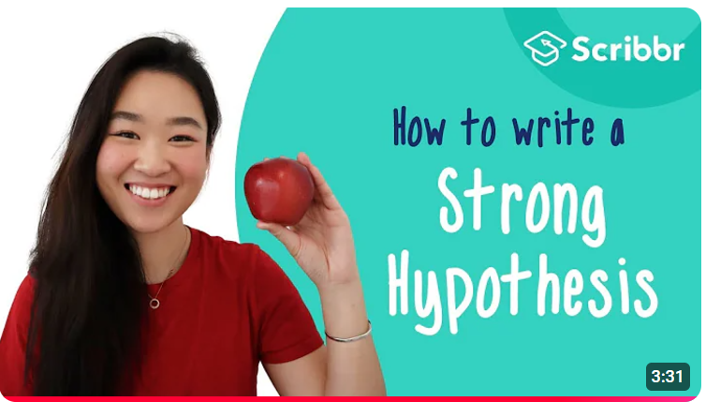
Plenty of advice on hypotheses in student research
Many resources available.
Good basic rules (silly example)
Too simplistic to lead to effective research
Notes:
When planning your research you are encouraged, or required to write hypotheses. That is correct, and you can find plenty of advice on how write them. This YouTube video (https://www.youtube.com/watch?v=PCgLjDDD4ek) is just one of many examples. It contains straightforward, sound advice even though it uses a silly the example. But the advice given here is too simplistic to lead to good research in our area of agriculture and agroecology. I want to point out a few additional things to think about.

Slide 4
The research cycle and hypotheses
Hypotheses
Two (or more) alternative statements of “how things work” that can be distinguished with further observations.
Observe
Reflect
Generalise
Plan
Progress in science
Scientific understanding advances by proposing hypotheses, testing them, thinking about the implications of the result, and trying again.
Notes:
I will start with a reminder of where hypotheses fit into research. A simple description of the scientific process is as a cycle. We make observations, reflect on what they tell us and what might explain them, try to state some general lesson or interpretation, then plan to take more observations (for example by doing an experiment) that will allow us to test out what we have learnt, and the continue the cycle. (1) Hypotheses come into this as the rules or explanations that we propose to explain what is happening (2) So scientific understanding progresses by proposing hypotheses, testing them, reflecting on the result and repeating. Over the centuries there has been much deep thought on what how this works and you might want to read about it, but my aim now is to keep this simple and practical.

Slide 5
Research and practice in agroecology and agriculture
Aims of research are to find improved practices for farmers
Hypotheses often of the form H1:“Practice P has effect E”.
Example:
  Spraying with tephrosia extract controls aphids
Alternative (often implicit) H0:”Practice P has no effect”
Do a study (eg an experiment).
Decide whether data is aligned with H1 or H0
H1: effect | H0: no effect
Data
Does data support H1 or H0?
Conclude there is an effect | Conclude effect is not proven
Notes:
Much BSc and MSc student research in agroecology and agriculture has an aim of finding things farmers can do differently to solve a problem. Typically a new practice is proposed as having the desired effect, and research done to test whether it does have this effect. For example, a hypothesis in pest management might be “Spraying with extract of Tephrosia will control aphids”. Hypotheses have to be compared with an alternative, and the usual one selected is a null hypothesis that the practice as no effect(1). Its easy to imagine an experiment to test this hypothesis – we have a number of plots sprayed with Tephrosia and a number that are not, count the aphids on both. The research involves collecting data (2) that will allow us to decide (3) which hypothesis is more reasonable. Does the data support the hypothesis that there is an effect (4) or not (5)?

Slide 6
Limitations: one or more of the following usually apply
We know H0 is false.
The real situation is complex – result depends on many factors and simply trying to choose between H1 and H0 is unrealistic.
The research might lead to a recommendation but does not advance scientific knowledge because it does not address any open scientific question or debate.
The result does not help generate recommendations for farmers because their decisions depend on many things, not only presence/absence of an effect.
Notes:
This style of hypothesis and research design often have one or more of these weaknesses. 1…2…3…4… Let’s look at each of these in turn, though they are related to each other.

Slide 7
1. H0 is known to be false
You choose to look at an effect because it is already known to exist.
The real question is not “does it exist?” but “can we use it?”.
For example, it is large enough to make a difference to farmers.
Improvement:
Compare:
  H2- the effect can not be used in practice.
  H3- the effect could be exploited.
Implications:
  You need to know what it takes to exploit an effect. For example, how large does it need to be?
Notes:
The first problem is that the hypothesis of ‘no effect’ is often known to be false. For example, you choose to do an experiment on Tephrosia and aphids because it is already known that Tephrosia can kill or repel aphids. (2) The real question is not ‘does the effect exist’ but ‘can we use it’. For example, is the effect large enough to make a difference to farmers.
(3) An improved pair of hypotheses to compare might be H2 and H3, in which we ask whether effects are usable, not whether they exist. That has implications, such as needing to know what makes an effect usable by farmers.

Slide 8
2. There is no simple yes/no answer about the effect
The question “Is there an effect?” does not have a yes/no answer, so the hypothesis is disconnected from reality.
The real question is “How does this effect interact with other things?”
Improvement:
Formulate a more complex and realistic hypothesis:
  H4- the effect occurs in XXX conditions and is modified by YYY.
Implications:
  you need to have ideas about what these other factors and interactions are and can do a more complex study to investigate them.
Notes:
The second common problem is that we are asking the simple question of “Is there an effect” but this has no answer because the real situation is more complex. The answer to the question “Does Tephrosia control aphids?” probably depends on many factors such as the weather, the crop, the time of year, how serious the aphid problem is, what other crops and insects are around, and so on. So, the real questions that need answering are about this complexity.
(1) We can improve the research by formulating more complex hypotheses about these interactions. They will probably require a more complex experiment inorder to investigate them.

Slide 9
3. The research does not advance scientific understanding
If informed scientists all agree on something, you do not advance science by again showing it is true.
Improvement:
Choose a topic or process where there is some unknown or controversy to resolve.
Formulate hypotheses that are not already understood, and your results will provide information about something new.
Notes:
My third point is that we should be trying to advance scientific understanding at the same time as advancing practice for farmers. If we only care about finding a way for farmers to manage aphids, we can simply suggest Tephrosia to them so they can try it out.
One way to advance science is to investigate topics and hypotheses that are in some way novel or controversial. To do that you must be familiar with the current science of the topic you are looking at, and where the unknowns lie. That is why you do a literature review. Use it to find out what is not known, not only what is known.

Slide 10
4. Result does not lead to recommendations
If the task is to turn some known science into useful practices for farmers, then simply showing an effect exists is not enough.
Implications:
Understand what it means for a practice or recommendation to ‘work’ from a farmer’s perspective.
Include farmers in the design and assessment of the study
Notes:
The fourth point is that there are many characteristics of a practice that influence whether farmers find them useful, other than simply whether an effect exists. If you want to contribute to development of farmer practices then these other factors need to be built into your research approach. Involving farmers in the design and assessment of the study is an important contribution to that.

Slide 11
Statistics supports the science
Statistical analysis of your data should support the research process.
Each of the 4 points above have implications for the way you analyse data.
Well known and standard methods may be part of what you need but will rarely provide all the answers.
Keep your real research questions in mind as you analyse data and ask yourself whether the statistics is helping you answer them.
Notes:
These four common problems with research hypotheses also have implications for the statistical analysis of your data. The statistical analyses you do should be connected to your research hypotheses and questions. The real research questions you have can rarely be answered by a simple yes/no result. So, the statistics that supports or quantifies your results is not going to be a simple yes/no answer, or a result that says an effect is significant or not.
The statistics you need will depend on the questions and hypotheses, and also on the design and the way the data have turned out. Some well-known methods may be part of what you need but will rarely be the whole answer. As you analyse the data, keep your real research questions in mind and ask yourself whether the statistics is helping you answer them.

Slide 12
It’s not easy
All these are complex topics.
Research habits you pick up while a student will stay with you, so make sure they are good habits.
One good habit: question deeply all you do:
  your research questions, hypotheses and research designs
  your data analyses and the meaning of your results
Notes:
All of the above are complex topics.
Experienced researchers will not always agree on them and there are no simple recommendations for you. Each of the points I have discussed leads to further questions, controversies and methods. Of course, if it was easy, you would not need to spend years studying and learning how to do research.
Here is the important point:
Research habits you pick up while a student will stay with you, so make sure they are good habits. Here is one good habit: question everything you do deeply. Don’t accept standard rules or approaches, but challenge them. The best new research is not going to look just like previous research, and you should be questioning and thinking carefully about every aspect of what you are doing.
I hope this gives you something to think about.

Slide 13
Created and presented by Ric Coe
CRFS – Research Methods Support project
December 2024
Notes:
If you’re interested, the slides for this presentation as well as lots more resources can be downloaded from our website at stats4sd.org/resources. Thank you very much!

