Slide 1

Models, science and statistics
Thoughts for students in agriculture and agroecology
Ric Coe, December 2024
Notes:
Hello. My name is Ric Coe and I work for both Statistics for Sustainable Development and CIFOR-ICRAF. I am going to share a few thoughts that might help you in your student research project.

Slide 2
Aims
Prompt some thinking...
… but keep it practical.
Help develop good research habits…
…those you learn as a student will stick.
Notes:
My aims in this short talk are to prompt some thinking about models in research, particularly the statistical models you use when analysing data. The subject can get very deep and technical, and I want to keep it practical, pointing to things you can do to improve your research.
You, as students, need to learn good research habits now rather than learning things that you have to unlearn later, and I hope this talk will be part if that process.
My suggestions are based on years of working in research in agriculture, agroforestry and agroecology, and also working with students.

Slide 3
Models in science
“Models are analogies representing important parts of a system”
Ford (2000)
“A model is a representation of an idea, an object, a process or a system that is used to describe and explain phenomena”.
Science Learning Lab
Models can be useful for:
  Exploring
  Understanding and explaining
  Predicting
  Testing hypotheses
Notes:
You will often hear of models in research and when analysing your data. One well known book explained that “models are analogies that represent important parts of the system”. I agree, but don’t find it a help explanation of why they are important. This science learning lab website has a good simple introduction, that starts by saying “A model is a representation of an idea, object or process”, which is more understandable

Slide 4
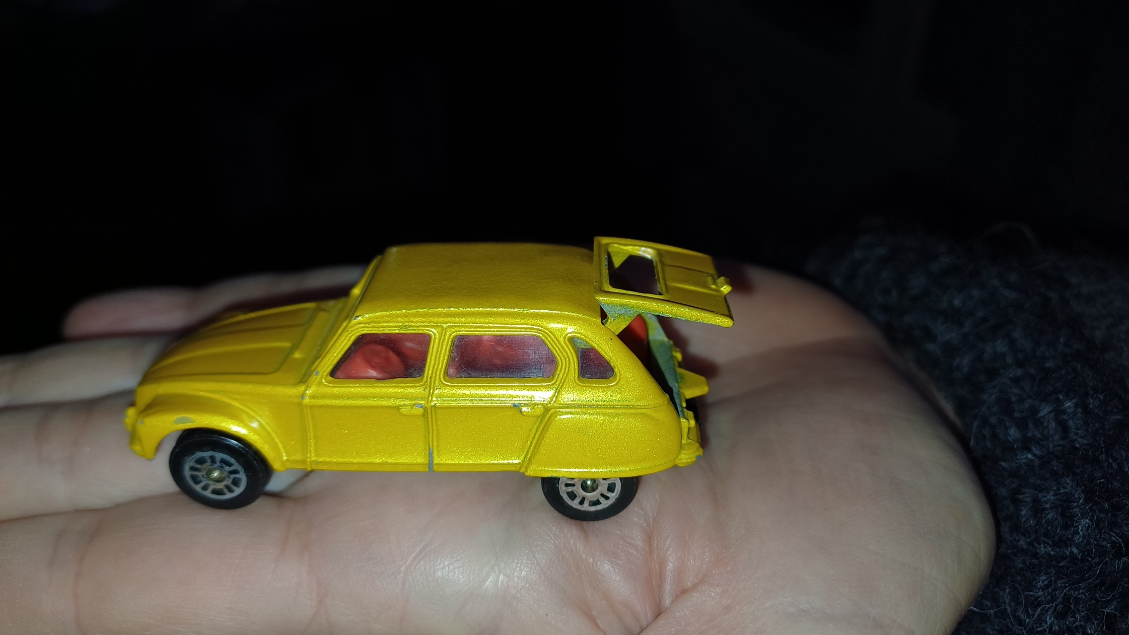
Notes:
Here is a model, a small analogue of a larger object. It’s a model of a car, based on a real one. Is it useful? It would be useless for trying to predict the maximum speed of the real one, or how far you can drive it before it needs an oil change. But it’s quite good for explaining what it means to have a wheel at each corner, or how the back door lifts up.

Slide 5
Models in science
“Models are analogies representing important parts of a system”
Ford (2000)
“A model is a representation of an idea, an object, a process or a system that is used to describe and explain phenomena”.
Science Learning Lab
Models can be useful for:
  Exploring
  Understanding and explaining
  Predicting
  Testing hypotheses
Notes:
Without getting into philosophical discussions about what a model is, we can say that practically, models can be useful. They have roles to play in exploring a subject, understanding and explaining what is happening, making predictions about what may happen in a new situation, and testing hypotheses.

Slide 6
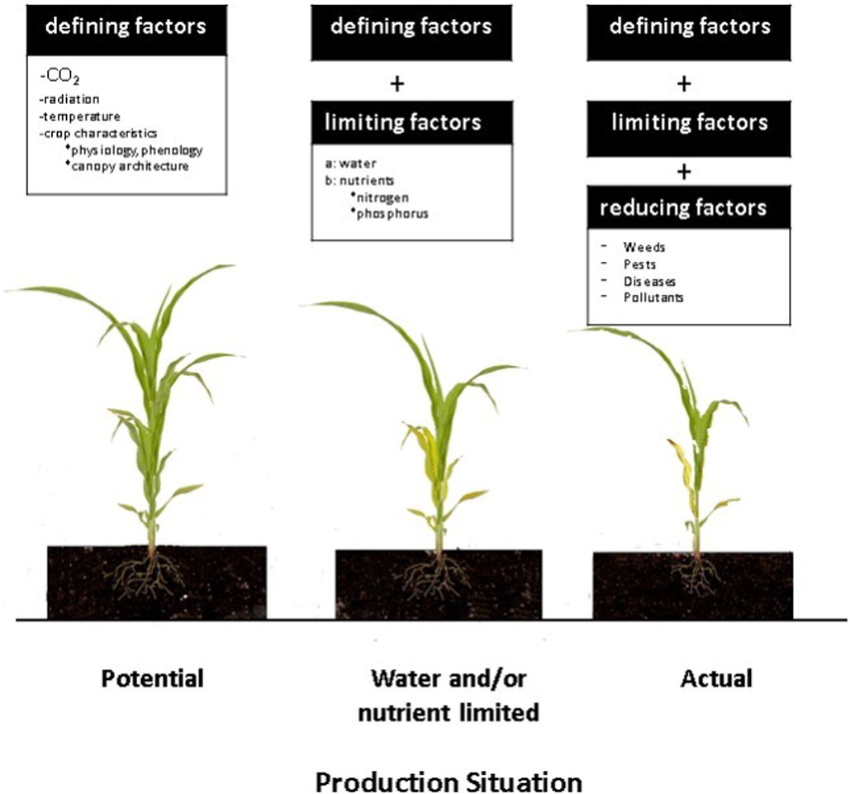
Jones et al (2017)
Notes:
Crop production is a central part of agriculture so many scientists have produced models of crop production. One approach is to described the processes of photosynthesis, using carbon dioxide and radiation to produce biomass (1). This can be based on the detailed physiological understanding of photosynthesis and plant growth that science now has, and aim to have a model is aligned with what we know.
In real plants, that production may be limited by water or nutrient supply, so a different model is needed if we want to understanding the effect on crops of water limitation (2), and crops in a field are also affected by weeds, pests and diseases. Yet another model is needed to describe those(3).
None of these crop models involve people, animals or other parts of the farm system that influence crops in practice. So scientists that are interested in those aspects of agriculture sometimes develop models that include those components of the farm system…

Slide 7
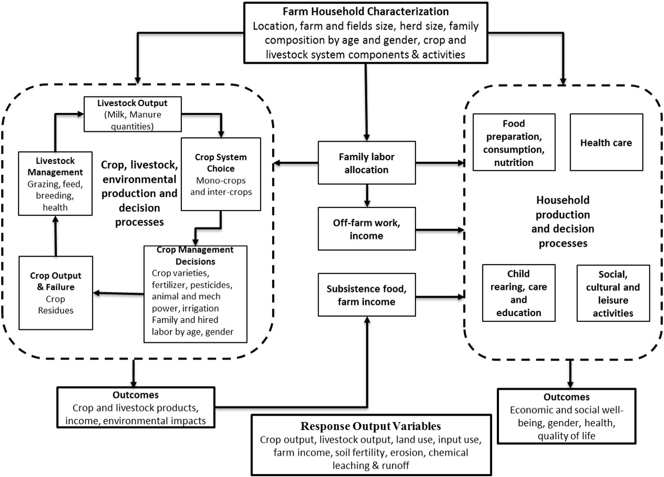
Good models will be aligned with scientific knowledge… but are always simplifications of reality.
A model may be useful for some purposes but will not be useful for all purposes
Notes:
At first glance this looks comprehensive, but you don’t have to stare at it for long to see things that are not represented but will sometimes be important. For example, labour is an input to production but the money that would buy things like seed and fertilizer is not represented in this model (5).
(6) This is Not a criticism of the model. I am simply pointing out that a model of anything only represents or describes some aspects of it, so we will need different models for different things.

Slide 8
1
2
3
Conceptual models
Describe the components and processes you are thinking of.
Jones et al (2017)
Notes:
These are examples of conceptual models. They describe the components and processes you are thinking about, but they do not describe the details of how these things work.
Your research has to be based on an explicit conceptual model. For example, if you are studying crop growth are using the concepts in 1, 2, or 3 here? Or perhaps a number 4? Without deciding that, you can not decide what processes, factors or variables you are going to investigate and measure.

Slide 9
Data and models
“Combine models and data to answer questions”
(Bolker 2008)
Data can make general models specific so we can:
Evaluate the model by comparing with observations.
Answer quantitative questions – how much, how often.
Notes:
As a student planning and carrying out research you will certainly come across models when analysing your data. You have probably been taught about ‘statistical models’, and a lot of the statistical analysis you do will involves using models of some sort (even if that is a bit hidden). This author said we combine models and data to answer questions. That’s a good way to think about much of the statistical analysis you do with your research data.
Combining models and data can make a general model specific so we can evaluate it by comparing the model with observations. If the model is found to be adequate, we can then use it to make specific predictions and answer quantitative questions – how much or how often does something happen,
Let’s look at a simple example.

Slide 10
Phosphorus response experiment
Experiment:
Rate of phosphorus (P) fertilizer
Maize yield
Two sites
Made up data.
Notes:
Here is a bit of data from a simple agronomic experiment. The experiment compares the effect on maize yield of adding different levels of phosphorus fertilizer, and it was done at two sites. I actually made up this data in order to keep it simple and illustrate a point. Just looking at the graphs shows that the crop seems to respond to increasing phosphorus. That happens at both sites, but the situation is different in the two cases. For example (1) the yield without fertilizer is much lower in Site 1 than Site 2.

Slide 11
Phosphorus response experiment
Straight line model (simple linear regression)
Scientific justification:
  P is limiting yield
  P concentration in crop is constant
Poor description of the data!
Observations are not aligned with the model
Misleading answers
Notes:
Probably one of the first statistical models you leant about is one that proposes a straight line relationship between an input , here the phosphorus fertilizer, and the output of crop yield, the simple linear regression model. I can think of a scientific basis for that model, that involves the assumption that phosphorus is the only limiting nutrient and the concentration of phosphorus in the crop is constant. The result of fitting the model to the data is drawn here and it is clear that the model is not a very good description of the data. The observations do not support the model and if we try to use that model we may get misleading answers.

Slide 12
Phosphorus response experiment
Straight line model (simple linear regression) for P< 50
Acceptable
Important results to understand
Site | 1 | 2
Yield at 0 P (t/ha) | 1.4 | 3.9
Initial response to P (t/kg P) | 0.08 | 0.01
Notes:
However, the simple straight line model might still be useful! If we have questions about the initial response to low phosphorus inputs then we can use the model only at the left hand end, and it seems acceptable. Results of using the model quantify the striking differences between sites. The yield with no added phosphorus at site 2 is nearly three times that at site 1, and the response to added P is far higher at site 1. If you are the researcher here, that should raise questions about why. What is the difference between the sites that gives rise to such a large contrast in maize yields and response to phosphorus fertilizer?

Slide 13
Phosphorus response experiment
A non-linear model with a maximum yield
Acceptable description of the data
More results to understand…
…some of them different from previous model
Site | 1 | 2
Max yield | 4.5 | 6.6
Yield at 0 P | 0.8 | 3.7
Initial response to P | 0.30 | 0.03
Notes:
Now I am using a different model, one that covers the whole range of phosphorus values studied. It is more complex than the straight line, and is a non-linear model that approaches a maximum yield. The details are at the end of the presentation if you interested. It seems like a better fit to the data, and can help answer questions that can not be answered with the previous model, such as what is the maximum yield that can be obtained by adding phosphorus. But notice something else as well: results we obtained from the previous model are now different. The answer to a question such as ‘What is the initial response to phosphorus fertilizer’ depends on which model we use.

Slide 14
Two messages on models
“Statisticians, like artists, have the bad habit of falling in love with their models”
(G.P.E Box 1919-2013)
Don’t assume that the model you know and understand is right for your problem.
There may be other more appropriate models
“All models are wrong but some are useful”
(G.P.E Box 1919-2013)
None of these models are a comprehensive description of what science knows about phosphorus and crops.
Some of them, however simple, may help answer some research questions.
Notes:
Here are two quotations, both attributed to the great statistician George Box.
The first, “Statisticians – and other scientists -, like artists, have the bad habit of falling in love with their models”. He meant that it is easy to get used to using a particular model and assume, perhaps without thinking to carefully, that it is appropriate for all problems you work on. If you make that mistake you will use inappropriate models and fail in your objectives. It often applies when you are analysing your data, as you use the models you know about rather than finding models that are appropriate.
The second, “all models are wrong but some are useful”, is a reminder that models are not ‘the truth’ but, if chosen well can be useful. The simple statistical models of crop response to fertilizer that I showed are not comprehensive descriptions of what we know about the subject, but they can still help in answering particular research questions.

Slide 15
It’s not easy
You can not “learn modelling” and then know everything you need to do research.
Knowledge, skills and confidence will grow with experience.
Three habits to adopt now:
Read widely on your area of research and think about the models being used.
Write down an explicit conceptual model that you are using in your research.
Make sure that any statistical models you use also make scientific sense.
Notes:
Using developing and using models well in research is not something you can learn once and then know everything. Instead, it is something that you will learn slowly by experience.
There are habits you can adopt that will help this learning. As with other aspects of research, its best to start these habits now as you begin leaning about and doing research, rather than trying to pick them up later.
The first to read widely about your research area and think carefully about the models being used in the research you read about. Sometimes authors will be explicit about the models and at other times you have to figure out what the implicit or hidden models are.
Secondly, write down an explicit conceptual model for your research. When it is written down it is easier to reflect on it, you can show it to others and get feedback, and you can update it.
Thirdly, think carefully about the statistical models you are using as you analyse data, and make sure that they make scientific sense. For example, they should be consistent with your conceptual model.

Slide 16
Created and presented by Ric Coe
CRFS – Research Methods Support project
December 2024
Notes:
If you’re interested, the slides for this presentation as well as lots more resources can be downloaded from our website at stats4sd.org/resources. Thank you very much!

Slide 17
Literature mentioned
Bolker, B. (2008) Ecological Models and Data in R. Princeton UP.
Ford, E.D. (2000). Scientific Method for Ecological Research. Cambridge UP.
Fox et al (2015) Ecological Statistics: Contemporary Theory and Application. Oxford UP
Jones, J. et al (2017) Toward a new generation of agricultural system data, models, and knowledge products. Agricultural Systems, 155, 269-288
Just for interest… two recent reviews on P in crops
Lambers, H. (2022). Phosphorus Acquisition and Utilization in Plants. Annual Review of Plant Biology, 73, 17–42. https://doi.org/10.1146/annurev-arplant-102720-125738
Lizcano-Toledo, R., Reyes-Martín, M. P., Celi, L., & Fernández-Ondoño, E. (2021). Phosphorus dynamics in the soil–plant–environment relationship in cropping systems: A review. Applied Sciences (Switzerland), 11(23). https://doi.org/10.3390/app112311133

Slide 18
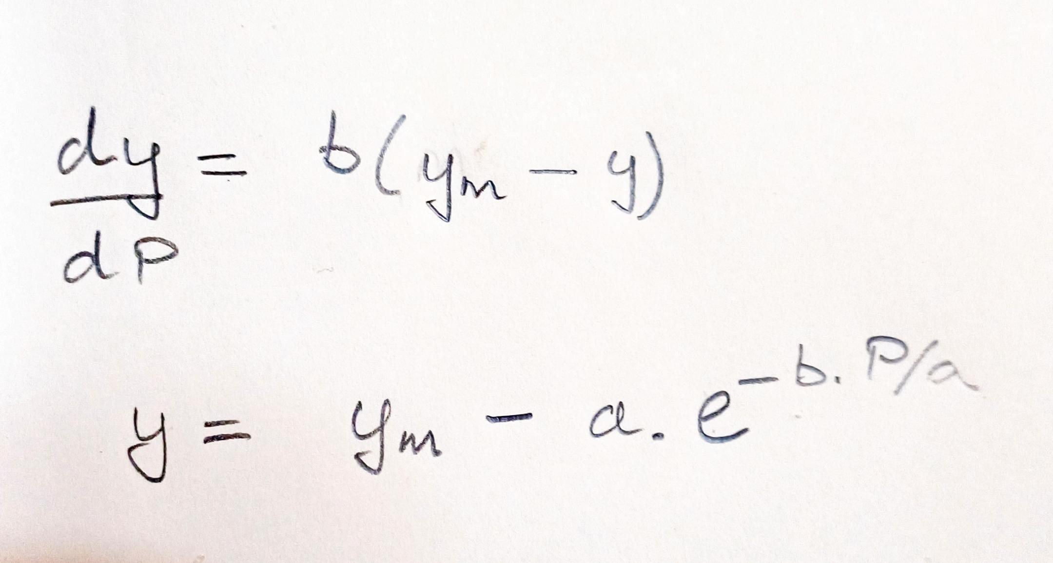
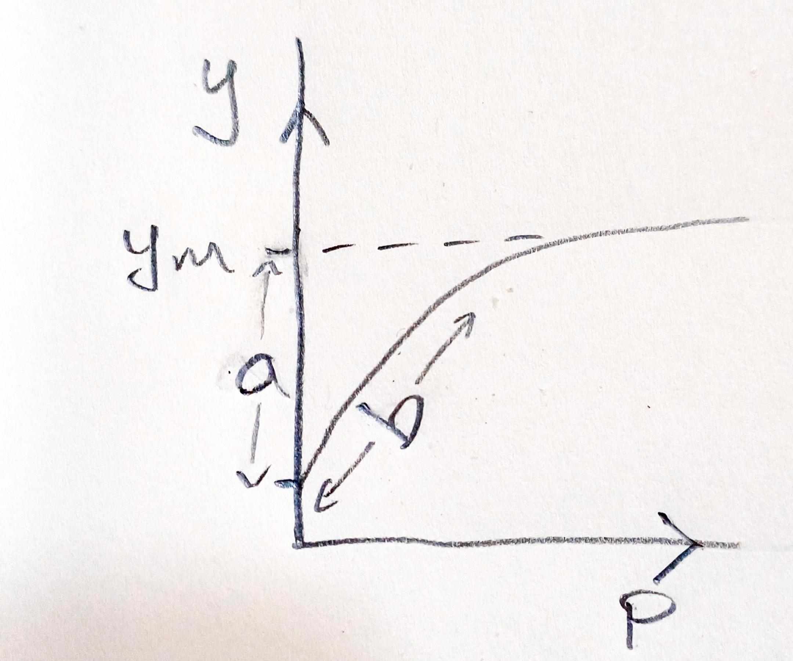
Model used in slide 12
Assume
There is a maximum yield with increasing P, determined by other growth factors
The response to P is proportional to how far yield is below the maximum
Parameters can be interpreted:
y_{m} = maximum yield
a = yield deficit at 0 P
b = slope of initial response to P
Note: you need to be comfortable with basic mathematical ideas to use any quantitative model!

