Slide 1
Research Ethics and Agroecology
RMS Seminar
Ric Coe (r.coe@stats4sd.org)
August 2023

Slide 2
Research Ethics and Agroecology
What do we mean by research ethics?
Is there anything special about agroecology?
What might it mean for CRFS (CCRP)?
This seminar
Video introduction
Standard responses
Agroecology and our work
Your experiences and thoughts

Slide 3
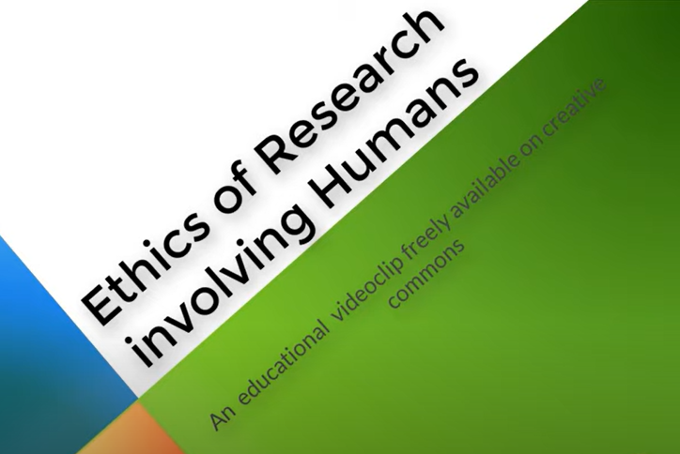
The ‘standard’ approach to research ethics
Many descriptions available
Most have the same basis
Watch - we will discuss later
The Ethics of research using human participants - YouTube

Slide 4
Research ethics principles lead to common practices
Practices
Empowering interactions
Benefit sharing
High quality research
Informed consent
Confidentiality
…
Principles
Respect
Beneficence
Justice
Processes
Education requirements
Research Ethics Review Boards
Checks at publication
Codes
Organisations
Legal codes
Professional bodies

Slide 5
Research ethics principles lead to common practices
Practices
Empowering interactions
Benefit sharing
High quality research
Informed consent
Confidentiality
…
Principles
Respect
Beneficence
Justice
Processes
Education requirements
Research Ethics Review Boards
Checks at publication
Codes
Organisations
Legal codes
Professional bodies

Slide 6
Four questions for agroecologists and CRFS
‘Ethics’ concerns
values and norms
not facts and evidence.

Slide 7
Question 1
We do research on:
  Communities
  Organisations
  Non-human species
  Ecosystems
Is focus on human subjects enough?
Are there ethical dimensions to such research?
What are the principles that ensure such research is ethical?

Slide 8
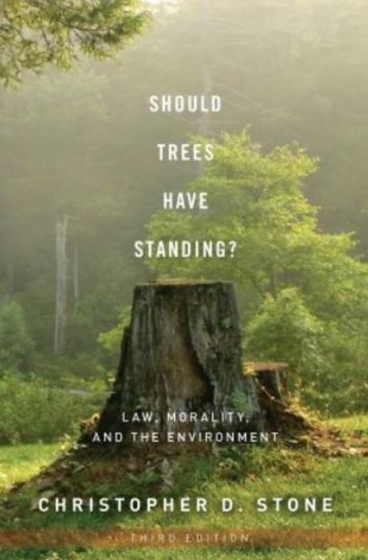


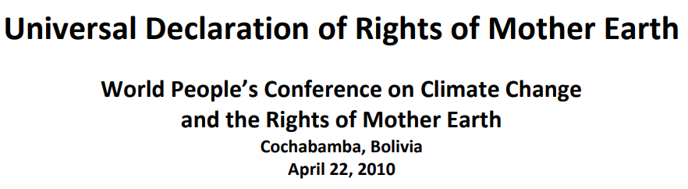
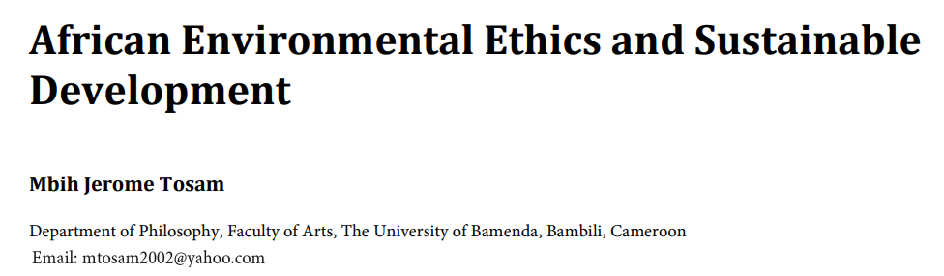
Plant and ecosystem rights
Ssekyewa (2016)
Stone (2010)

Slide 9
Plant and ecosystem ethics
“ ..a land ethic changes the role of Homo sapiens from conqueror of the land-community to plain member and citizen of it. It implies respect for his fellow-members, and also respect for the community as such”
Leopold (1949)
“A thing is right when it tends to preserve the resilience of the biotic community. It is wrong when it tends otherwise.”
Leopold (1949)
“I define Homo ecologicus through three characteristics:
(i) its relation with nature is based on sympathy and respect, (ii) it orientates its creativity upon nature and (iii) its relationship with nature is especially based on personal experience … in this way an ethical relationship with nature is defined”
Becker (2006)
What are the frames and principles beyond ‘human subjects’ we should use to affirm the ethics of our research?

Slide 10
How do we do research?
Rarely as external scholars but often:
  Associated with action
  With a change agenda
  With an expectation of the outcomes…
  … and a lot of uncertainty
  Using co-developed methods
  With long-term and open-ended engagement
Are there ethical aspects of such research that require different principles and processes?
Question 2

Slide 11
What else do we do?
CRFS and working on agroecology does not only involve research. Research is integrated with:
  Designing interventions
  Facilitating change
  Advising decision making
  Building capacity
  Communicating
  Advocacy
Are there ethical aspects of these that require different principles and processes?
Question 3

Slide 12


Who is accountable for ethical standards of work?
Question 4
Individual Researchers
Trained
Know their context and field
Hired on basis of competence
Institutions
Accountable for all
activity of staff
Manages reputational risk
May be required by law, partners, donors, publishers

Slide 13
Who is accountable for ethical standards of work?
Question 4a
What makes an ‘ethical researcher’?
Question 4
Individual Researchers
Trained
Know their context and field
Hired on basis of competence
Institutions
Accountable for all
activity of staff
Manages reputational risk
May be required by law, partners, donors, publishers
Question 4b
How do we manage the multiple institutions engaged in research?

Slide 14
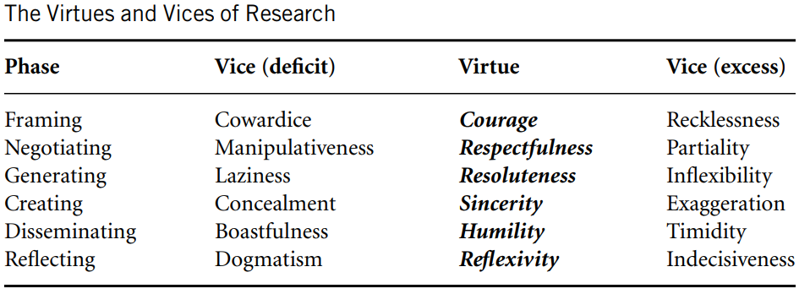
Qualities of ethical researchers
MacFarlane (2009)

Slide 15
Let’s talk
Groups for open discussion
What are ethics dimensions or questions in your work in agroecology, things you have direct experience of?
Reactions to points I made
Your institutional setting - requirements, policies, practices
    15 mins
    Post comments on Miro
    Collective look at Miro afterwards

Slide 16

Created and presented by:
Ric Coe
August 2023

