Slide 1
Qualitative Data Management
Romina De Angelis – October 2023
CRFS – Research Methods Support Project
Notes:
This is the second of 5 videos on qualitative data management.

Slide 2
Qualitative Data Tracking Systems
Romina De Angelis
Social and Qualitative Research Methods Specialist
Notes:
This video is about qualitative data tracking systems

Slide 3
Objectives
Determine features of good qualitative data management (QDM) practices.
Determine key features of qualitative data file naming processes.
Define and develop a qualitative data tracking system.
Notes:
This session includes 3 main points:
Determining the characteristics of good qualitative data management practices.
Determining the key features of qualitative data file naming processes.
Defining and developing the steps to a qualitative data tracking system.

Slide 4
Good Qualitative Data Management
Using an ethical framework to guide qualitative data management planning ensures best practices.
E.g., UK Data Service website (useful source for tips, links and guidelines for good practice in the UK).
Preferable to use country-specific ethical guidelines where data is collected to protect the rights of research participants.
Notes:
It can be helpful to use an ethical framework to guide the planning of qualitative data management to ensure best practices towards all research participants. For instance, the UK Data Service website is a good source that provides general good practice tips and links to more specific guidelines that apply in the UK (the link is provided in the final slide). However, it is advisable to refer to the ethical guidelines of the specific countries and communities where data are collected as regulations and local customs may differ from the UK ones. Particularly, ethical guidelines help protect the rights of the individuals involved in the research, who are sharing information with us and are the owners of the information. This approach is not exclusive to qualitative research and it should be applied to quantitative studies too.

Slide 5
Good Qualitative Data Management
Time-consuming & labour-intensive and it requires thinking prior to collecting data.
Choose a device to safely store digital data from recorded interviews and videos and typed field notes (also save them in the cloud).
Store files in designated folders.
Notes:
Inevitably, developing a good qualitative data management process requires investing time in planning it prior to the beginning of data collection. Good qualitative data management can also be labour intensive to be well planned and developed throughout. The time aspect also refers to the time to be invested by the people we work with and this is another element where ethical aspects play a role…
Qualitative data collection often generates digital data from recorded interviews and videos and typed field notes that need to be safely stored in a designated device. Even better if they can be simultaneously saved in the cloud to avoid data loss in case something happens to the physical device.
When storing data files from various data collection techniques, it is good practice to organise them in labelled folders (similar to what one would do when storing data on paper).

Slide 6
Good Qualitative Data Management
Protect access to data: code/password/pin for digital files & locked container for physical data.
Keep a record of the # of interviews & Focus Group Discussions (FGDs) conducted for data tracking and quality assurance.
Include the date when storing observational field notes files.
Omit personal identifiers in transcriptions and field notes.*
*It is important to ensure anonymity to participants. At the same time, it is essential to create anonymised file names to trace back individual participants if needed and inform them about these aspects.
Notes:
Access to digital data should be protected by using a secure code, a password, or pin that is known only by the data collector, or their team members. For physical data, such as in the case of written field notes or audio and video recordings, or sensitive data such as that contained in consent forms, the tools and devices containing that data should be stored in a safe place protected with a padlock or locked with a key.
Other important features that characterize a good qualitative data management approach include keeping a record of the number of interviews and FGDs conducted. This is helpful in order to keep track of all the data collected as well as to ensure easy quality assurance of the same and have the information available when presenting the research results.
Both when writing notes and when saving them digitally (usually in a Word document), it is good practice to include the date when they were taken for future reference.
Another key element is to avoid including any research participant’s personal identifier in interview transcriptions and translations and written field notes. This can be an interesting point, as on the one hand, we want to ensure anonymity to participants. However, on the other hand, we may need to link back to the information of one or more specific participants or share their identities with other team members in a research team for the purpose of data analysis. In this case, it is important to create anonymized file names that allow you to trace back the participants if needed and store them securely. It is important to inform participants about these aspects.

Slide 7
Good Qualitative Data file naming
Label data files with names that are easy to recognise, BUT without identifiers.
Assign a participant ID number in a protected document.
Include the data collection method in the file name (e.g., interview, FGD, observations, etc.).
Include the interviewer or research team member who carried out data collection.
Include the date of data collection.
Include demographic information or other meaningful codes (e.g., gender).
Notes:
As mentioned in the last point, a key step in the process of managing qualitative data is file naming. It is important to label files using names that are easily recognizable. However, it is very crucial to avoid using any detail that could make any research participant or community identifiable.
In this regard, one can assign each participant an ID number or a pseudonym to ensure anonymity and, as previously mentioned, keep a list of participants and their assigned IDs in a protected document.
When naming and storing digital data, it is useful to do so by including the data collection method used to generate them, such as interviews, FGDs and observations.
Especially when working within a research team and when multiple people need to access data, it can be helpful to include information about who collected the data for future reference.
Another important element to include when naming data files is the date when they were generated.
To facilitate future data analysis processes, one can also label data files by using codes related to demographic information such as gender.

Slide 8
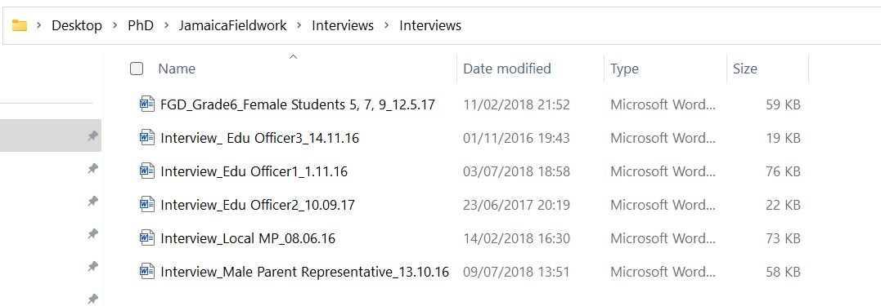
Example of good QD file naming
Label the first of 4 recorded audio interviews with a female farmer in one of 5 villages in Kenya as part of a research project that runs in 3 countries (e.g., Uganda, Kenya and Tanzania).
E.g., Interview_2023.05.12_PI0001_Female Farmer1_Kenya village1_Romina.docx
Notes:
For instance, I may need to label the first of 4 recorded audio interviews with a female farmer in one of 5 villages in Kenya as part of a research project that runs in 3 countries (e.g., Uganda, Kenya and Tanzania). In this example, I’ve started with the type of data collection (i.e., interview), the date, the personal ID code assigned to the participant, demographic information (i.e., female), the country and number assigned to the specific village and ended with the name of the researcher who collected the data.
The example in the picture refers to my personal file naming strategy during my PhD fieldwork in a Jamaican school and village. It shows files containing transcriptions of a Focus Group Discussion with 3 female students from grade 6 (who are individually identified with a number that I had previously assigned to them and stored in a separate protected document). It then contains individual interviews with different Education Officers, a local Member of Parliament, and a male parent representative. All documents contain the date when the interview or focus group took place.

Slide 9
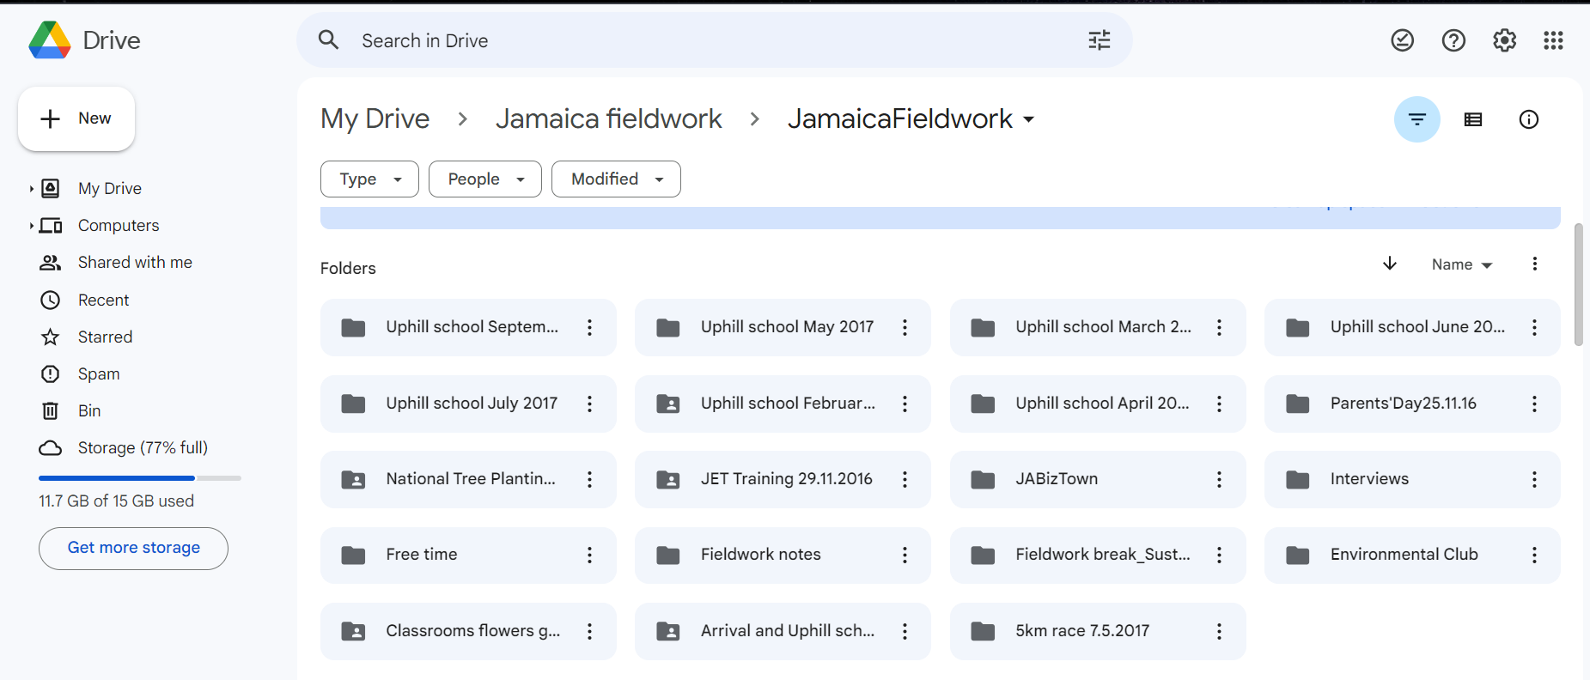
Difference between working with quantitative vs qualitative data
Qualitative ‘raw’ data may be in transcriptions and descriptive notes (sometimes pictures).
Quantitative numerical data may be stored in a database.
Notes:
In qualitative research there is a multi-layered process for organizing and storing data, compared to quantitative research. Within a qualitative approach, in fact, the ‘raw’ data from recorded interviews and field notes may be in a coded version in the transcriptions or extended descriptive notes. Qualitative data is often recorded as audio files from interviews before being transcribed into text. Or in short hand-written notes in a notebook before being expanded into typed notes in a word processing software.
Differently, data from quantitative research is usually in the form of numerical values that are used for mathematical calculations or statistical analysis. This type of data is usually stored as it is in a database or spreadsheets.
These differences imply a different way of managing quantitative and qualitative data. For instance, when taking pictures or typing notes on your laptop, it is good practice to save them both on your physical device and in the cloud (e.g., Google Drive, Dropbox, etc.). In the case of pictures and videos, it is important to name them in a way that allows you to easily identify what event from the field they are associated with. When you have a large amount of data (pics, video, notes, etc) these may require a different type of storage and organising that uses a cataloguing system/tool. The picture shows how I saved pictures, videos and documents in the cloud using Google Drive during my PhD fieldwork in Jamaica. In this way, I could also share the files with my PhD supervisors who were in the UK. The name assigned to the school is a fictitious one. You can see that folders contain more or less precise dates based on whether they contain media for a specific event or for a period of time. It is important to note that this task can present difficulties when the internet connection is not stable. In my case, since I lived in a village with no WIFI and the data on my phone was limited, I had to do it when I could access the WiFi in an internet café in the nearest town.
Following these steps will help you develop a good system for managing qualitative data, especially when working within a research team and different people need to access the data at different times.

Slide 10
Defining a good Qualitative Data tracking system
What is a data tracking system?
A clearly defined plan of who does what, how and when.
Notes:
What do we mean when we talk about developing a good qualitative data tracking system?
In short, we refer to developing a clearly defined plan of who does what and how at what point in the process, from data collection to data transcription and analysis. This is especially true when working within a research team and having different people handling data at different stages. Transcribers and/or translators, as well as coders, need to be able to easily locate the data files they need to work with.

Slide 11
Defining a good Qualitative Data tracking system
Why do you need a (good) data tracking system?
To easily locate and access data when analysing data.
To easily find and access data in the future.
Notes:
One could wonder about WHY we need a qualitative data tracking system and not just any, but a good one!
Some reasons, as just mentioned, include being able to easily locate and access data that we (or other team members) need to analyse.
Moreover, at a later point in time, one may want to retrieve previously collected data, for instance, to conduct another analysis for a different purpose. In both cases, having a good tracking system will make these tasks easier.

Slide 12
Developing a good QD tracking system
Store multiple copies of raw* data.
In a team, have a supervisor for the interviewer, transcriber, translator and coder.
Assign clear roles and responsibilities.
Conduct quality assurance and control at each stage.
Allow time to address issues as they emerge and adjust approaches in the process.
*Raw qualitative data refers to interview audio recordings, observation field notes, pictures videos and any collected data that has not been processed.
Notes:
A good practice when developing a data tracking system starts with storing multiple copies of the original data. This will help have a good backup and prevent the risk of data loss. When talking about raw qualitative data, we refer to interview audio recordings, observation field notes, pictures, videos, and any data collected by the researcher that has not yet been processed.
Non-raw data refers to data that has been processed after having been collected. It can refer to interview transcripts, expanded field notes that include the researcher’s reflections and coding.
When working within a research team, it is recommended to appoint a supervisor who will coordinate the activities carried out by interviewers, transcribers (and sometimes translators) and coders.
They can also ensure that each expert has a clear understanding of the actions and responsibilities entailed in their role.
At each stage, the supervisor will conduct quality assurance and control (that is to say, respectively, checking that data integrity, quality and reliance are maintained at each step, and by ensuring that there are no errors in the final data files and, if any, that they are corrected). They will also overlook the organization of data from recorded interviews, transcriptions, translations and coding processes. No other step in the analysis process should take place until transcriptions have been completed. Enough time needs to be allocated for it and you should remember that no personal information should be shared in this process. One way to prevent transcription errors is to conduct multiple proofreading to avoid grammar and spelling mistakes.
It is also important to keep in mind that this process can unveil issues that will require time and flexibility in order to address them at each stage. An example could be the need to reformulate interview questions differently to elicit better responses from participants.

Slide 13
Useful Resources
https://ukdataservice.ac.uk/learning-hub/research-data-management/ethical-issues/ethical-obligations/
Notes:
This is a useful link that provides an overview of ethical obligations for researchers, although it is based on the UK system and different countries may have differing regulations…

Slide 14

From the webinar series:
Qualitative Data Management
Created and presented by Romina De Angelis CRFS – Research Methods Support project
Edited and produced by Emily Nevitt and Grace Gilbert
October 2023
Notes:
In case you’re interested, the slides for this presentation as well as lots more resources can be downloaded from our website at stats4sd.org/resources. Thank you very much!

