Slide 1

Qualitative Data Management
Romina De Angelis – October 2023
CRFS – Research Methods Support Project
Notes:
This is the first of 4 videos on qualitative data management.

Slide 2
The role of Qualitative Data
Romina De Angelis
Social and Qualitative Research Methods Specialist
Notes:
This first video is about the role of qualitative data

Slide 3
Objectives
To understand:
The role of qualitative data & research VS quantitative.
The features of qualitative data VS quantitative.
The qualitative data flow VS quantitative.
Notes:
In this session, we will aim to cover 3 main objectives:
Understanding the role of qualitative data and qualitative research, also in comparison to quantitative research and data
Learning what the features of qualitative data are, and compare them with those of quantitative data
Understanding the nature of the data flow in qualitative research and how it differs from quantitative research

Slide 4
Purpose of Qualitative & Quantitative Research
Qual: To explore perceptions and experiences and to understand and interpret the nature of social phenomena & interactions, through others’ points of view, usually in a specific context.
Quant: To describe a population, to test hypotheses, determine cause and effect (experiments), and make predictions that can be generalised to a larger population.
Notes:
The aims of qualitative research include understanding and interpreting the nature of social phenomena and interactions through the participants’ and the researcher’s points of view. To achieve these aims, qualitative research uses tools that allow to explore participants’ perceptions and experiences, usually in a specific context.
Differently, quantitative research aims to describe a population, test hypotheses, use experiments to determine cause and effect, and make predictions that can be generalised to a larger population.

Slide 5
What questions does qualitative research answer?
Descriptive (What is going on?)
Explanatory (Why is it going on?)
Exploratory (What it is like for the people experiencing it?)
Notes:
Qualitative research may be employed to describe what is taking place in a particular situation – so it can be descriptive;
It may be used to uncover the reasons why something is happening –hence explanatory;
It may help explore the research participants’ views and feelings about a particular event –hence exploratory.
Comment from Carlos: I think what you say up to second 35 is absolutely fine. Given my position on this matter, I would prefer if the sound from 35 to the end of the clip (sec 54) is removed. This should be relatively easy for the editing of the final product.

Slide 6
Role of Qualitative Data
Data gathered in qualitative studies helps understand processes related to how ideas manifest or to how phenomena unfold in real life.
E.g., farmers may narrate how they learnt about and why they eventually undertook AE practices in their plots.
The above narrative may reveal factors that facilitated or hindered the adoption of AE practices.
Notes:
The data gathered in qualitative studies is useful to better understand the processes through which certain real-life events take place. For instance, farmers may share a narrative of the ways in which they learnt about agroecological practices and how and why they decided to undertake them in their plots. This narrative may also bring to light factors that facilitated or hindered the adoption of said practices.

Slide 7
Role of Qualitative Data
It helps develop a clearer picture of what factors govern people’s views and beliefs about a topic or a practice.
E.g., the exploration of farmers’ perspectives towards AE practices.
Different from quantitative approaches that use quantifiable categories and their relationships to build models to produce estimates about behaviours.
Qualitative approaches use people's cultural beliefs, norms, traditions and values to build a model.
Exploring farmers’ perspectives towards AE practices may explain why they are/are not in favour of them and what factors support/hinder their adoption.
E.g, the cultural beliefs attached to particular crops such as the taboo attached to the Bambara Groundnut in Malawi in the past. People believed that only women who had already lost a child could plant it, otherwise there was the risk to attract death to the household. Similarly, there were other life/death symbolisms and witchcraft practices attached to the nut.
Notes:
In relation to the last point mentioned in the previous slide, qualitative data can bring to light the influence of particular factors that shape people’s views and beliefs about a topic or practice.
Differently from a quantitative approach where models to produce estimates about behaviours are built on a list of quantifiable categories and their relationships, a qualitative approach investigates the cultural beliefs, norms, traditions, and values of people in a specific context and builds a model based on those…
For example: the exploration of farmers’ perspectives towards AE practices may explain why they are/are not in favour of them and what factors support/hinder their adoption, such as in the case of cultural beliefs attached to particular crops like the taboo that was attached to the Bambara Groundnut in Malawi in the past, where people believed that only women who had already lost a child could plant it, otherwise there was the risk to attract death to the household. Similarly, there were other life/death symbolisms and witchcraft practices attached to the nut. These beliefs had a number of implications for the value chain development of the crop that can be explored in detail in the research paper published from this research and is included in the list of useful resources at the end of this presentation… https://doi.org/10.1080/15528014.2015.1043112

Slide 8
Role of Qualitative Data
It reveals situated meanings and insights that are common within one or more societal groups.
It differs from quantitative approaches that attribute meaning through categorizing and codifying variables
  E.g., women’s experiences and their meanings within communities or groups may improve gender equity.
  E.g., Bambara Groundnut crop. A quantitative approach would have identified low adoption levels or a low market demand, without exploring the belief system that influences those factors.
Notes:
Qualitative data can reveal ‘situated meanings’ of community or group members in a specific context, which are rooted in their knowledge and value systems –differently from a quantitative approach where meanings are attributed through a process of categorization and codification of variables and factors….
For example: exploring women’s experiences and the meaning attributed to those experiences within a community (e.g., village) or group (e.g., Farmer Research Networks, religious groups, professional networks, etc.) may unveil lessons that can be relevant to improve gender equity.
Or also the example from the previous slide about the Bambara Groundnut crop. A quantitative approach would have identified for instance that there was a low level of adoption of the crop or a low market demand, without exploring the insights into the belief system that influences those factors…

Slide 9
Role of Qualitative Data
It can (but doesn’t have to) be combined with quantitative data to generate results that can feedback into policies and projects.
  E.g., stakeholders’ (e.g., farmers and NGOs) insights can reveal the need for better access to water to improve crop yields.
Notes:
Qualitative data can produce lessons that can constructively inform policy-making or project design and implementation. If relevant, it can –but doesn’t have to- also be combined with quantitative data.
An example of the role played by qualitative data can be found in the lessons learnt from the insights shared by various stakeholders (e.g., farmers and local NGOs) in a context that can reveal the need for better access to water to improve crop yields.

Slide 10
Qualitative Data collection tools
In-depth interviews
Open-ended questions
Focus Group Discussions (FGDs)
Notes:
Qualitative data are usually, but not only, collected by using in-depth interviews, open-ended questions in questionnaires, and focus group discussions (where individuals discuss a topic or answer questions in a group).

Slide 11
Features of Qualitative Data
Audio/video-recorded data from interviews, open-ended questions, FGDs and written text from transcriptions and observational field notes.
Larger narrative containing useful info to answer research questions.
Rich and messy!
How to organise and manage qualitative data? (another video!)
Notes:
What are the features of qual data? Qualitative data comes in the form of audio recordings from interviews, written text from transcriptions or from observational field notes.
When participants answer open questions, they often provide a narrative within which you need to search for useful pieces of info that help answer your research questions. This is why you need to organise and manage qualitative data in an accurate way to support you in the process of finding meaning in the richness and messiness of the data gathered.
A question that is addressed in another video session is how to effectively organise and manage qualitative data…

Slide 12
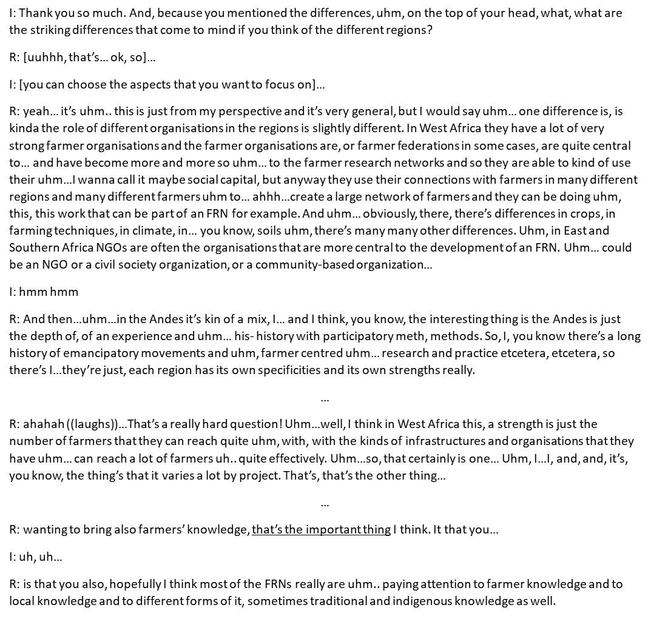

Example of Qualitative Data
When we transcribe from audio into text there is a level of data processing from our conceptual positioning.
Transcribed interviews have not yet gone through the whole process of data analysis.
Qualitative data can also be in the form of pictures or videos and handwritten text from fieldnotes.
Notes:
This example shows an extract from an interview in a text format, after the audio recording has been transcribed. This is usually the raw data that we work with when we conduct qualitative data analysis. It is important to note here that the actual raw data would be the audio recording from an interview, as when we transcribe from audio into text there is already some level of data processing that derives from our conceptual positioning within the research. However, transcribed interviews have not yet gone through the whole process of data analysis. Additionally, qualitative data can also be in the form of pictures or videos and text from fieldnotes that are first hand-written and then typed on a laptop...

Slide 13
Qualitative Data Flow
Data Collection (e.g., interviews, observations, pictures, videos)
Data Management (naming, storing, transcribing, translating, analysing)
Notes:
In qualitative research, the data flow is not linear, but often iterative because aspects of data management include aspects of data analysis, which at times can influence the data collection stages that follow initial data management steps. For instance, when transcribing an interview, you may notice that the phrasing of interview questions needs improving to allow participants to better express their views. In this case, such improvements can be made to enhance the phrasing of questions for the interviews that follow. Or, yet information shared by participants in an interview may highlight relevant aspects of exploration that had not been considered before, which may also change the direction of the research. Making these changes is often needed to ensure the quality of qualitative research and data. This data flow differs from the quantitative data one, where the data collection and data analysis (and management) stages are separated and occur in a linear and fixed way. Changing the protocol in this case can, in fact, hinder the quality of the data collected.

Slide 14
Challenges of Qualitative data management vs
Quantitative data management
QUAL: Challenges related to the diverse nature of sources of info, including audio-recordings, hand-written field notes, pictures, videos and typed text.
QUANT: Reducing errors related to accuracy through a previously arranged management process.
Notes:
Managing qualitative data can present some challenges due to the multiple types of data that you can collect, which include, audio-recordings, hand-written field notes, pictures, videos, and typed text. The challenges faced with qualitative data management differ from those of quantitative data. The latter in fact refers to reducing errors related to accuracy of data. The types of errors that can occur with quantitative data may be about measurements or human errors, and data management minimizes the opportunity for that to happen. The data management process for quantitative data is organised in advance and is based on protocols that help be systematic, consistent and accurate.
On the other hand, the challenges faced within qualitative data management are different due to the diverse nature of the sources of information (that include interviews, observations, can be written up or in media form). It can be very laborious to get good quality data and this can already be a challenge. Then, there is the ability of the researcher to engage with the data in a way that either embraces or detaches from it depending on their school of thought and being consistent with it. Your philosophical approach affects your data management approach and that can be another challenge.

Slide 15
Useful resources
JD Carpentieri on qualitative research and theory: https://www.ncrm.ac.uk/resources/podcasts/?id=jd-carpentieri
Lora Forsythe, Mala Nyamanda, Agnes Mbachi Mwangwela & Ben Bennett (2015). Beliefs, Taboos and Minor Crop Value Chains. Food, Culture & Society, 18:3, 501-517, DOI: 10.1080/15528014.2015.1043112
Ritchie J., Lewis J., Ormston R., McNaughton Nicholls C. (2013). Qualitative Research Practice: A Guide for Social Science Students and Researchers. United Kingdom: SAGE Publications.
Notes:
This podcast is part of a series on Methods by the National Centre for Research Methods, where JD Carpentieri –who is an Associate Professor of Social Science and Policy in the Department of Education, Practice and Society at University College London, and an Honorary Research Associate at the Centre for Longitudinal Studies- explains the role of qualitative research in enriching theory and helping understand the complexities of how theories play out in real life as well as how qualitative data can add insights into the findings from quantitative research when dealing with ‘wicked problems’ (i.e., problems that have many interrelated factors, at times contradictory, and often changing and which may make the problem seem unsolvable, such as the problems that agroecology aims to address). He also considers issues around ethical concerns that vary across different understandings of data protection for different research methodology paradigms…

Slide 16

From the webinar series:
Qualitative Data Management
Created and presented by Romina De Angelis
CRFS – Research Methods Support project
Edited and produced by Emily Nevitt and Grace Gilbert
October 2023
Notes:
In case you’re interested, the slides for this presentation as well as lots more resources can be downloaded from our website at stats4sd.org/resources. Thank you very much!

